Slide 1
Emoji
Lab Book
Julian, Brent and John

Slide 2
Problem
Describing your ideas and feelings clearly and concisely is sometimes really difficult
Mission
Draw emojis so you can better express your thoughts.
A picture is worth 1,837 words!

Slide 3
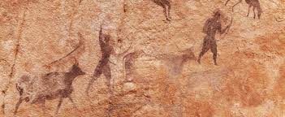
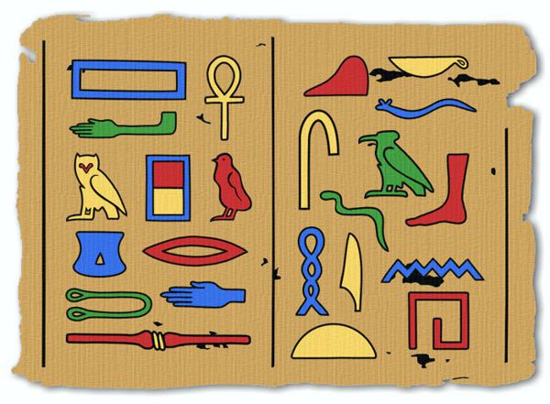
Research
Ancient cave drawings
Egyptian hieroglyphics
Modern emoji

Slide 4
Mad
Happy
Sad
Baffled
OK
???

