Slide 1
Performing Emotion
Library of shapes
Use unusual shapes to create abstract emojis that convey powerful emotions

Slide 2
Small parts I

Slide 3
Linear parts I

Slide 4
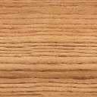
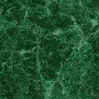
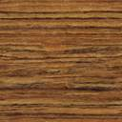
Small parts II

Slide 5
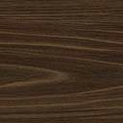
Linear parts II

Slide 6
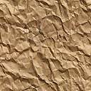
Surfaces II

Slide 7
Primary Shapes

Slide 8
Primary Shapes
Angry

Slide 9
Primary Shapes
Crazy

