Slide 1
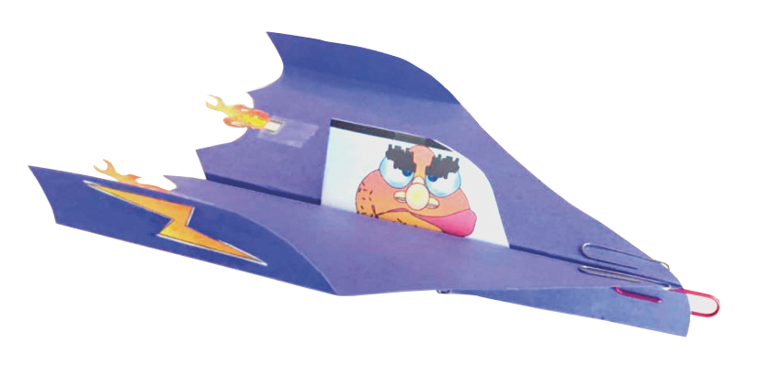
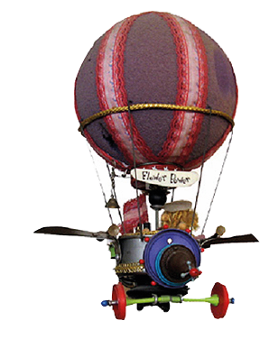
Flying Machines
Lesson Plan

Slide 2
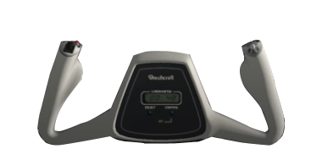
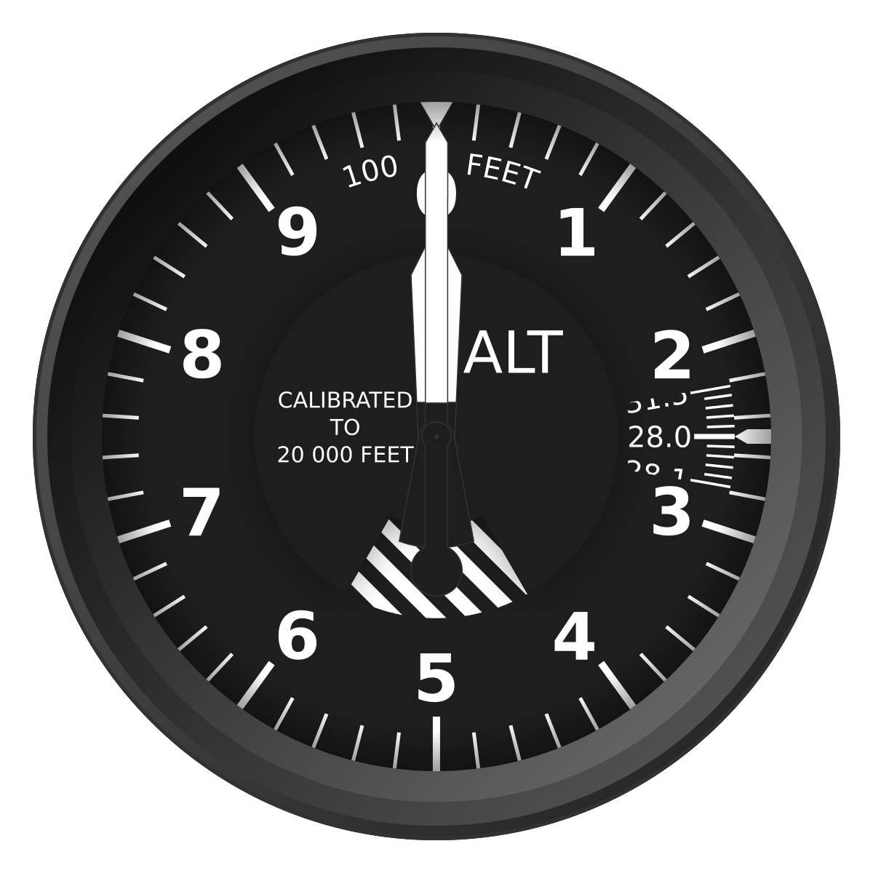

Problem: Throughout history, humans have dreamed about flying. But flying is expensive and still takes too long.
Mission: Learn how to design flying machines that could get you to school in 1 minute.
Project Goals:
Engage kids in creative building.
Exercise problem solving skills.
Learn PowerPoint basics.
Exercise presentation skills.
Learn physics of flying.
Draw a time line of man made flight.
Research flying machines by Leonardo
Why do planes fly and boats don’t?

Slide 3
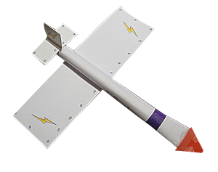
Flying Machines
Lab 1
Lab 2
Lab 3
Lab 4
Lab Book Cover
Research
Build a paper plane.
Document Problem and Mission
Adjust rectangular paper plane
Critical flight factors.
Build sling shot gliders.
The Creative Process.
Presenting Ideas.
Cartooning.
Lab 6
Lab 8
Lab 7
Lab 6
Lab 5
Document Problem and Mission
Adjust rectangular paper plane
Presentation day.
Executing your ideas.
Air powered glider.
Executing your ideas.
Air Powered Rocket
Problem Solving Skills.
Build Straw powered rockets.

Slide 4






Flying Machines: Lab 1
Objectives:
Set up Laws of the Lab
Get to know teammates.
Exercise research skills.
Exercise teamwork skills.
Exercise PowerPoint skills.
“Project Introduction”
BIY Presentation
BIY Problem and Mission
30 sec Introductions
Laws of the lab
Extreme Building
15 min
Save as: “school-date-project-name1-name2.ppt'
in a new folder under
documents called ‘BIY'
Power Point
Guru
Create a Lab Book cover.
15 min
Research/document, history, images, prior art.
Researching
Skills
Google image
search.
Copy and paste
into Lab Book.
5 min
Present Flying Machines Project.
5 min
Creative/ Modular Builder
Problem
Solver
Build a paper plane.
15 min
Clean up / Show and tell.
Presentation
Skills
5 min

Slide 5
Flying Machines: Lab 2
“Paper Airplanes and Physics of Flying”
Objectives:
Identify problem/ State mission.
Practice building tricks.
Review Lab Book Lessons
5 min
Discuss Problem and Mission
5 min
Present center of gravity and aileron demo.
5 min
Power Point
Guru
Document Problem and Mission
10 min
Adjust rectangular paper plane and adjust optimum flight.
Problem
Solver
10 min
http://www.funpaperairplanes.com/
Build new paper planes designs.
Organize competitions.
Creative/ Modular Builder
10 min
Clean up / Show and tell.
Presentation
Skills
5 min

Slide 6

Flying Machines: Lab 3
Objective:
Understand Critical Flight factors:
Center of gravity
3 dimensions of motion
Lift formula
“Physics of Flying”
Review Problem and Mission
5 min
Present “Physics of flying”
Aeronautical Physicist
5 min
http://www.funpaperairplanes.com/
Build new paper plane designs.
Creative/ Modular Builder
Problem
Solver
15 min
Build sling shot gliders.
Creative/ Modular Builder
25 min
Organize competitions.
Problem
Solver
10 min
Clean up / Show and tell.
Presentation
Skills
5 min

Slide 7
Flying Machines: Lab 4
Objectives:
Understand the importance of presenting ideas.
Know how to use PPT drawing tools.
“The Creative Process”
Review Problem and Mission
5 min
Present “3 ways to present your ideas”
5 min
Document “Presenting Ideas” in Lab Book.
(ugly, average, way cool)
Power Point
Guru
15 min
Present “Cartooning”
5 min
Draw decals and pilots.
25 min
Show and tell.
Presentation
Skills
5 min

Slide 8
Flying Machines: Lab 5
Objectives:
Know the importance of the 5 problem solving skills.
Understand the value of modular construction.
“Problem Solving Skills”
Review Problem and Mission
5 min
Present “Problem Solving Skills”
5 min
Document “Problem solving Skills” in Lab Book.
Power Point
Guru
10 min
Build straw powered rockets.
Creative/ Modular Builder
Problem
Solver
40 min
Clean up/ Show and tell.
Presentation
Skills
5 min

Slide 9
Flying Machines: Lab 6
Objectives:
Exercise teamwork.
Exercise creative building.
“Executing Your Ideas”
Review Problem and Mission
5 min
Build, test and decorate an air-powered rocket.
Creative/ Modular Builder
Problem
Solver
35 min
Organize competitions.
Problem
Solver
10 min
Clean up/ Show and tell.
Presentation
Skills
5 min
Teamwork!

Slide 10
Flying Machines: Lab 7
Objectives:
Exercise teamwork.
Exercise creative building.
“Executing Your Ideas”
Review Problem and Mission
5 min
Build, test and decorate an air-powered glider.
Creative/ Modular Builder
Problem
Solver
35 min
Organize competitions.
Problem
Solver
10 min
Clean up/ Show and tell.
Presentation
Skills
5 min
Teamwork!

Slide 11
Flying Machines: Lab 8
Objectives:
Exercise presenting ideas.
“Communication Skills”
Review Problem and Mission
5 min
Write team presentation script.
15 min
Video record project presentation.
30 min
Clean up/ Show and tell.
5 min
Post projects on invention Universe
30 min
Notes:
Minecraft 101: Class 1

Slide 12
Topics for Class discussion
Advanced student research
Time out research
What are examples of how technology has improved life?
What are examples of how technology has made life worse?
What do you think are the most amazing man made inventions?
Why is teamwork important?
What do you think are the biggest problems in the world?
How could technology help solve these problems?
Present more lesson PPT.
Organize more show and tells.
Write a story, poem or song about your project.
Organize competitions.
Make video presentations.

