Slide 1
~Lab Book~
Avery Hanson

Slide 2
The problem
It takes waaay too long to get to school!

Slide 3
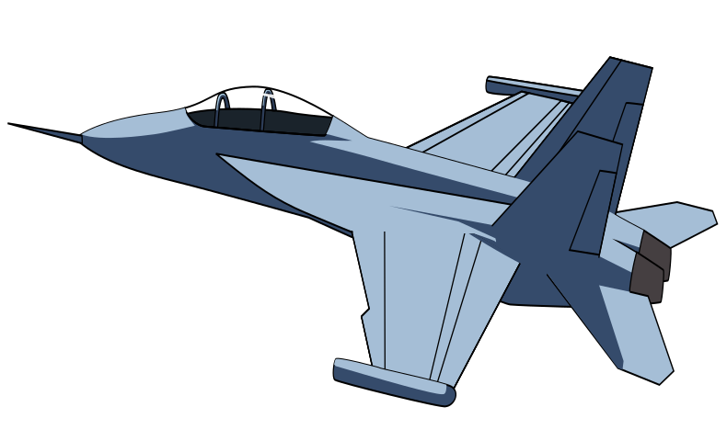
The mission!
We must find out how build a flying machine to get us to school in one minute!

Slide 4
I researched a hot air balloon because i find them very interesting. There are exactly what they sound like. It is a giant balloon that is lifted by a flame inside. It has a basket underneath for the person to stand in. they also have parts that help you steer the ballon. Once your in, up you go. It does work but it wont work to get us in school in one minutes

Slide 6
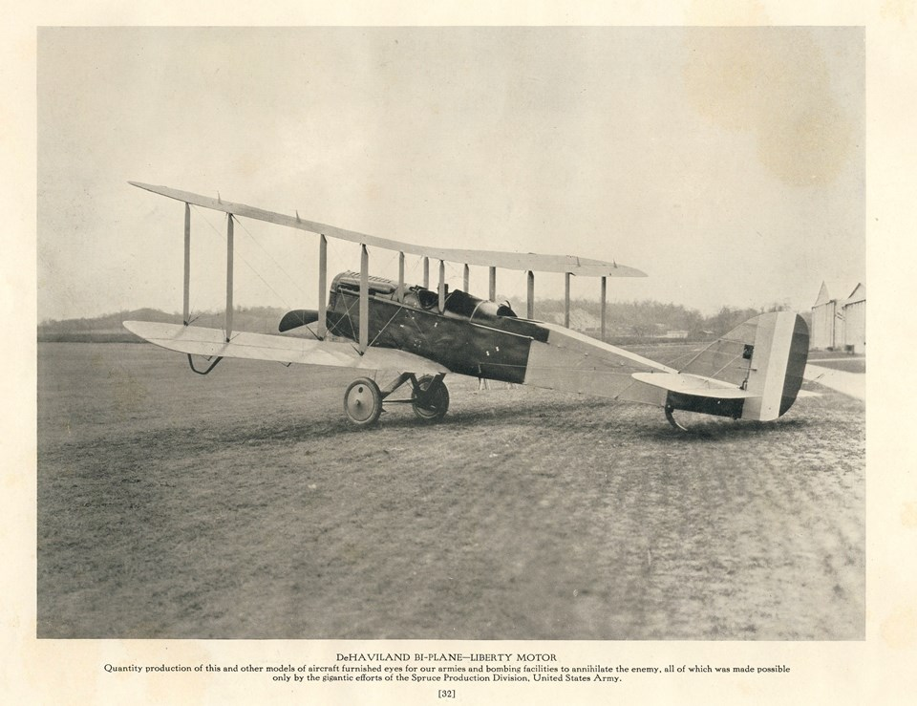
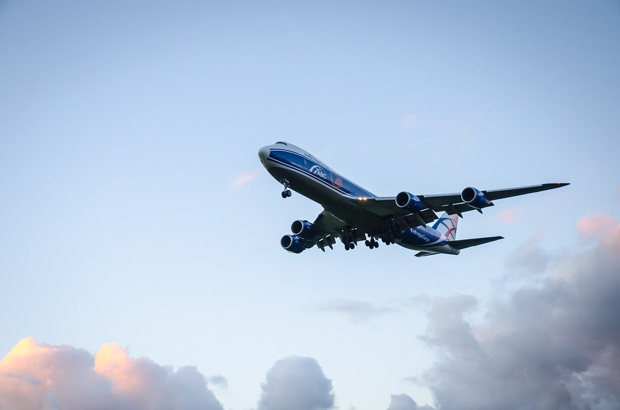
Before after

Slide 10
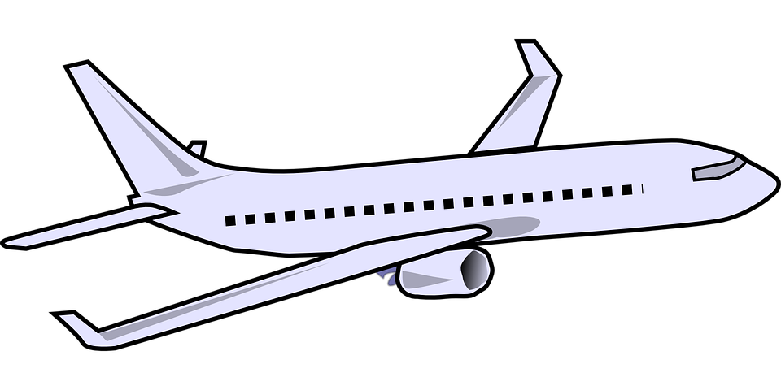
Next
i will show you
my plane!

Slide 11
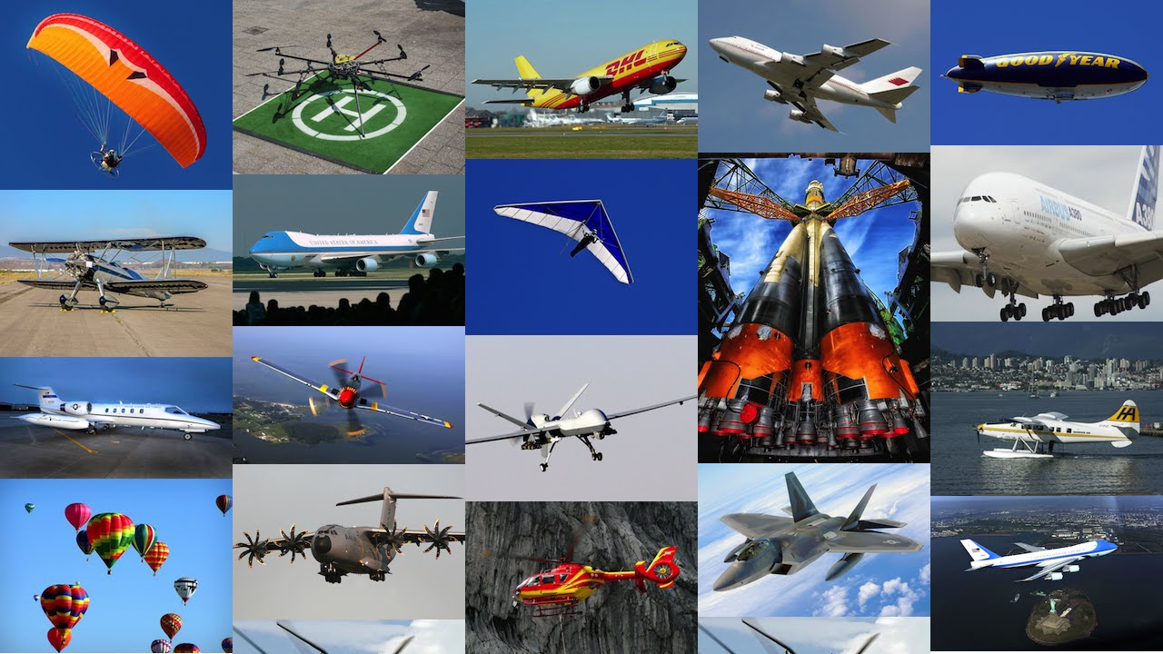
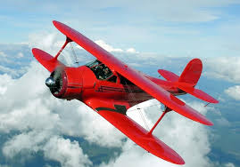
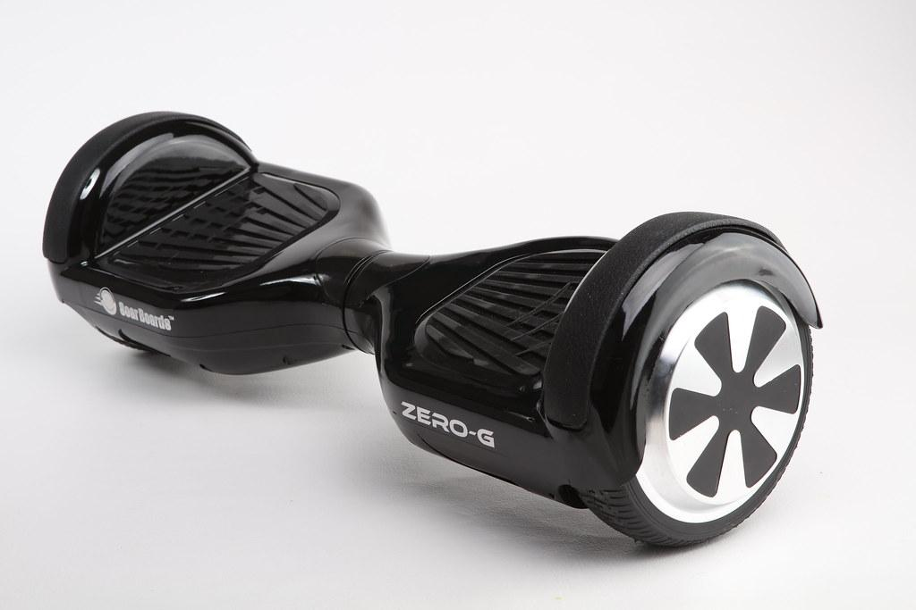

Slide 12
DRAG
WEIGHT
THRUST
LIFT

Slide 13
Find my air rocket on the website!

