Slide 1
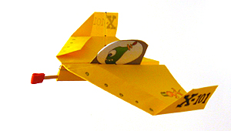
Flying Machines
Lab Book
Liam, George, Isaiah, Noah, Emmarose, and John

Slide 2
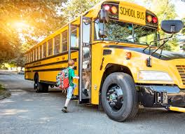
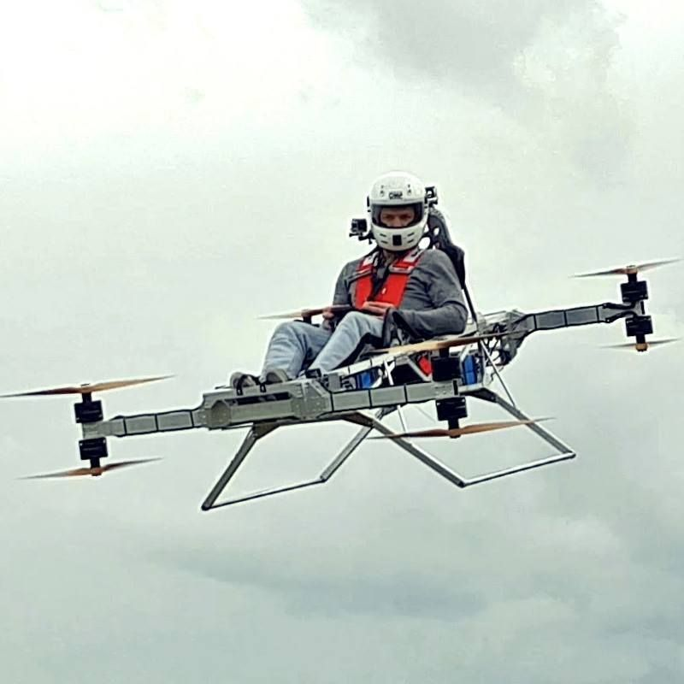
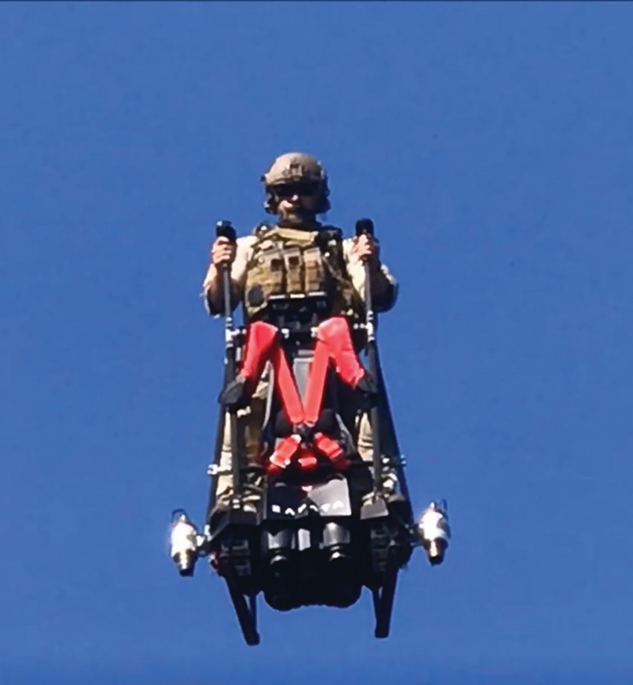
The Problem
It takes way toooooooooo long to get to school!
The Mission
Learn to build flying machines that could get us to school in 1 minute

Slide 3
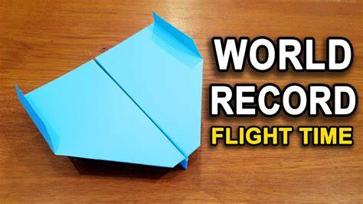
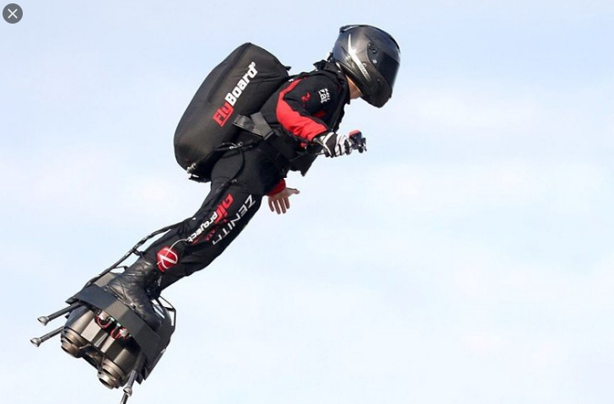
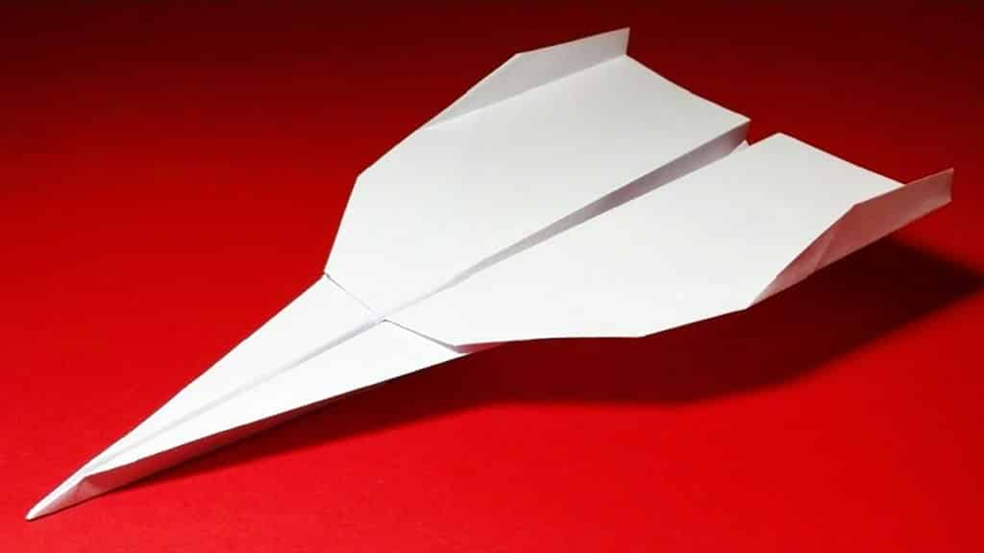
Research

Slide 4
Center of gravity
Dive: Too much weight in front.
Stall: Too much weight in back.
Glide: Center of gravity in middle.

Slide 5
Forces of Flight
Lift
From wing shape
Thrust
From
Jet Engine
Air molecules
cause Drag
Drag
Gravity

Slide 6
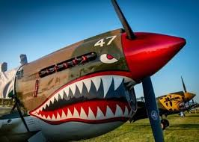
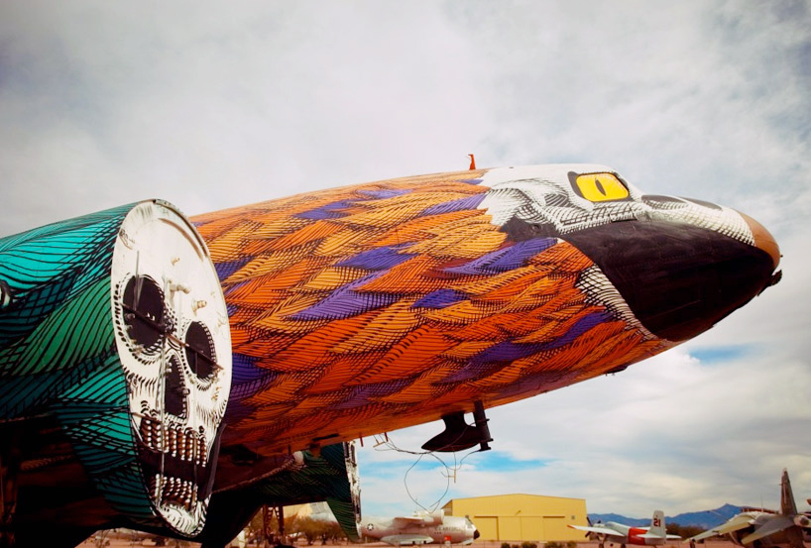
Let’s Make Our Plane Look Cool

Slide 7
Decorations

Slide 8
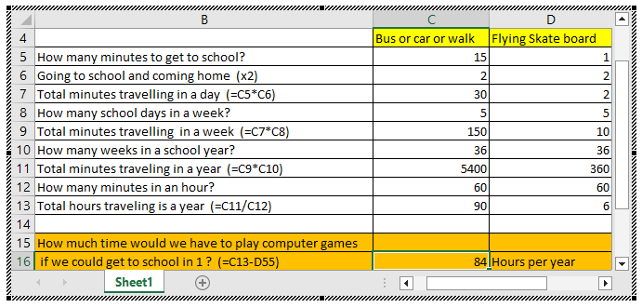
Use an EXCEL spreadsheet to calculate:
How many hours a year would you have to play computer games if you could fly to school in 1 minute?

Slide 9
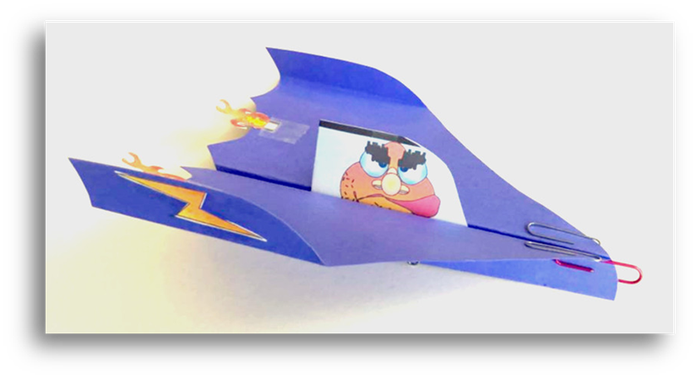
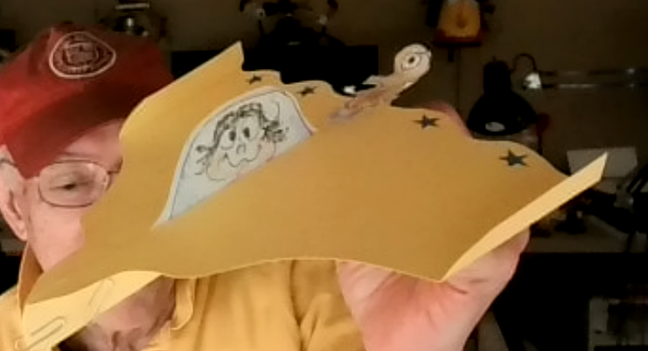
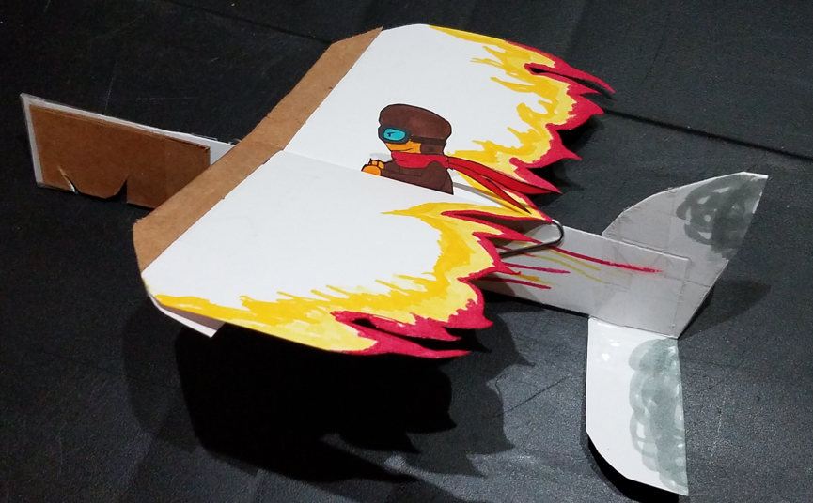
Success

