Slide 1

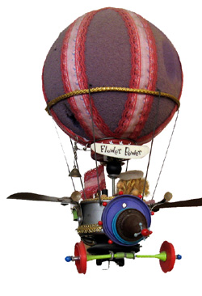
Flying Machines
“The sky is not the limit, it’s just the beginning.”
Notes:
Welcome to the build it yourself aeronautical laboratory! We will be building flying machines!

Slide 2

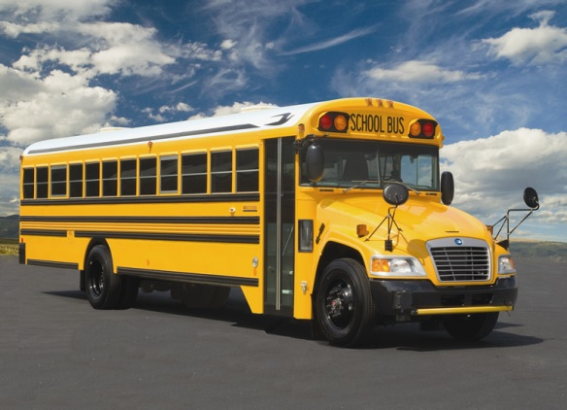
The Problem
It takes waaaaaaay to long to get to school.
Notes:
How long does it take you to school? What would you rather do? Play video games? Watch a movie? Learn a new skill? Or get on a bus?

Slide 3
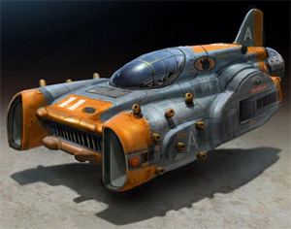
The Mission
Build a flying machine that could get us to school in 1 minute.
Notes:
How much time would you save?
What would you do with the extra time?

Slide 4
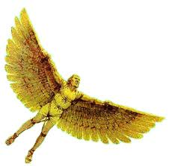
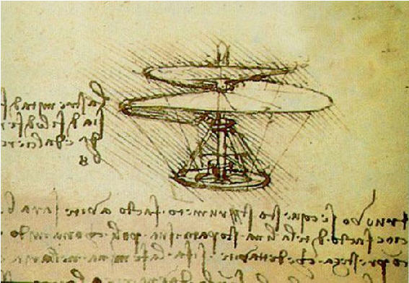
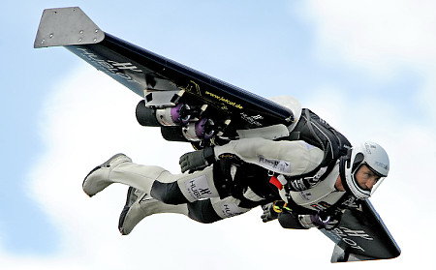
Research
Japanese Rocket Man
http://www.youtube.com/watch?v=4XObKek9Tuc
Swiss Rocket Man
http://www.youtube.com/watch?v=h4arnATc04U
Gossomer Condor
http://www.youtube.com/watch?v=sp7yv67B5Sc
Deadelus
Da Vinci
Fusion Man
Notes:
Show the kids some cool examples. Below are some talking points on myths and history. In the power point slide there are links to videos.
Skim the videos as needed, you do not need to present all of these unless the class is engaged. Be cautious of time – videos add up fast!
Daedalus wings myth: Unable to sail away, because Minos controlled the ships, Daedalus fashioned wings of wax and feathers for himself and for Icarus and escaped to Sicily using the wings.
Icarus, however, flew too near the Sun, his wings melted, and he fell into the sea and drowned.
Da Vinci: Leonardo designed a multitude of mechanical devices, including parachutes, and studied the flight of birds as well as their structure. About 1485 he drew detailed plans for a human-powered ornithopter (a wing-flapping device intended to fly).
Fusion Man: Yves Rossy is a Swiss military-trained pilot and an aviation enthusiast. He is known as the inventor of a series of experimental individual jet packs, the latest using carbon-fiber wings for flight.

Slide 5
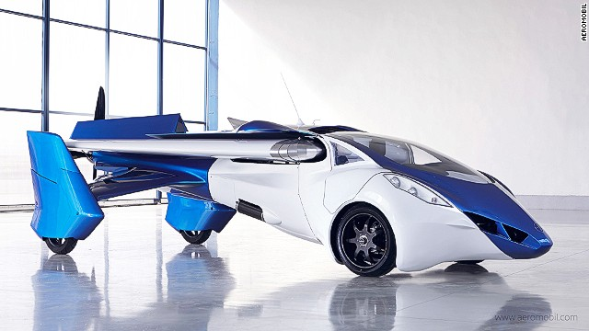
Research
Find inspiring examples of flying machines!
Notes:
Research some way cool examples of flying machines.

Slide 6
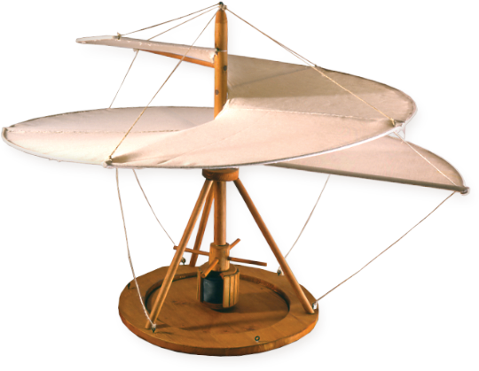
Project Plan
Project Plan:
Study project guidelines.
Set up PowerPoint lab book.
Document problem and mission.
Problem solving tricks
Presenting ideas
Physics of flight
Build (paper planes, gliders, rockets)
Decorate
Present projects.
Contests for:
  flight time
  Accuracy
  creativity and good looks
Notes:
Our project plan is ambitious. Fasten your seat belts!

Slide 7
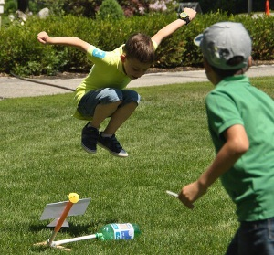
Skills Needed
Skills Needed:
PowerPoint Guru
Problem Solver
Creative, Modular Builder
Master of Presentations
Aeronautical Physicist
Notes:
You will master valuable skills.

Slide 8
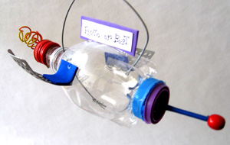

Hall of Fame
Solutions from builders like you!
Notes:
Flying machines on our drawing board.

Slide 9
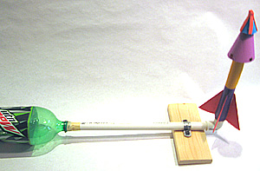
Hall of Fame
An air powered rocket made by member Avery
Higher than a mighty flag pole!
Higher that the tallest tree!
Notes:
3 – 2 – 1 Blast off
Who can fly the highest

Slide 10
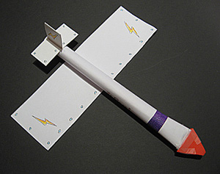
Hall of Fame
A glider made by one of our members!
See it in action!
Notes:
Who can design a glider that does a loop?

Slide 11

Break Mission Into Simple Parts
Lab Book
Example (PPT)
Notes:
Lab Books are an important part of the engineering process.
www.build-it-yourself.com/biy-projectware/biy-power-point-presentations/biy-lab-book-template.ppt

Slide 12
Break Mission Into Simple Parts
Cartoon Pilot
Build-It-Blocks Link
Notes:
Every proper plane needs a proper pilot.

Slide 13
Break Mission Into Simple Parts
Graffiti Decals
T
OES
Build-It-Blocks Link
ail
eathers
oom
Notes:
Your plane should have a name.
It must fly well and it must look way cool!

Slide 14
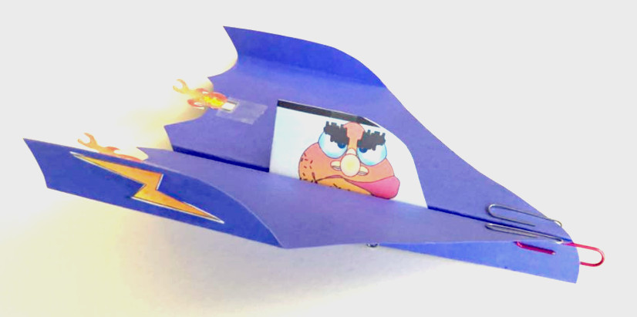
Break Mission Into Simple Parts
X-101 Airplane
Build-It-Blocks Link
Notes:
Power Point in Lessons

Slide 15
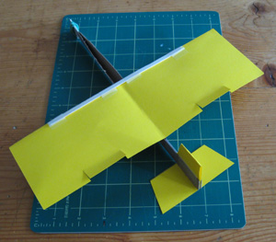
Break Mission Into Simple Parts
X-102 Glider
Build-It-Blocks Link
Notes:
Power Point in Lessons

Slide 16
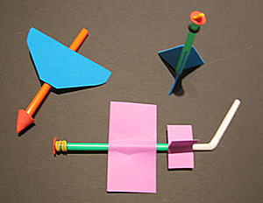
Break Mission Into Simple Parts
X-103 Straw Rockets
Build-It-Blocks Link
Notes:
Power Point in Lessons

Slide 17
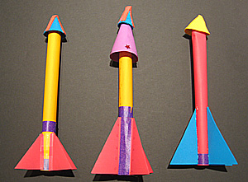
Break Mission Into Simple Parts
X-104 Air Powered Rockets
Build-It-Blocks Link
Notes:
Power Point in Lessons

Slide 18
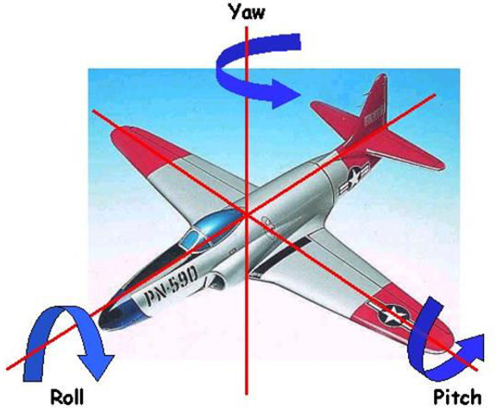
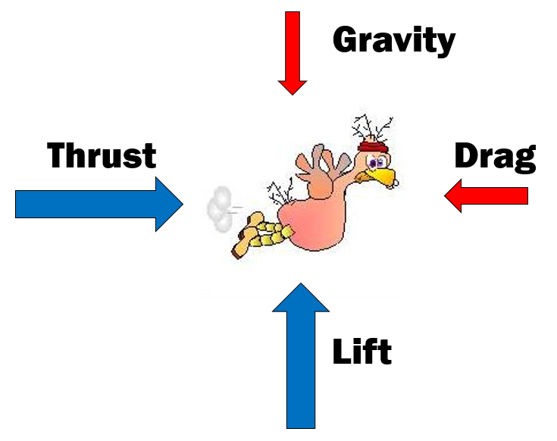
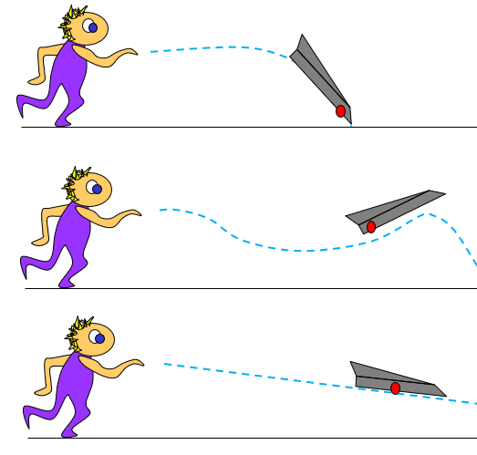
Physics of Flight
Why does a plane fly?
Forces
Center of gravity
Symmetry
Velocity
Wing shape
Axis of motion
Notes:
Good engineers build products that work.
Hot Shot engineers can explain how their products work.

Slide 19
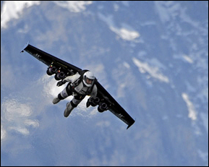
Time Saved
Notes:
Kids who get ahead may try some advanced challenges or help teach others!

Slide 20
What we should know
How to build rockets
How to communicate ideas visually
Cartoon Artist
Proper naming conventions
Physics of flight
Advanced Projects:
Create additional prototypes
Create short video of your air rocket
Notes:
Kids who get ahead may try some advanced challenges or help teach others!

Slide 21
Advanced Projects:
Draw a time line of man made flight.
Research flying machines by Leonardo
Why do planes fly and boats don’t?
What are examples of how technology has improved live?
What are examples of how technology has made life worse?
What do you think are the most amazing man made inventions?
Why is teamwork important?
What do you think are the biggest problems in the world?
How could technology help solve these problems?
Notes:
Have kids who get ahead try some advanced challenges or help teach the workshops!

