Slide 1
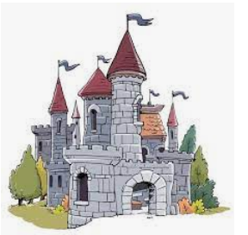
Formidable Forts Lab Book
Emma, Chubbi, John

Slide 2
Law of the Lab
1) Respect teammates: | Did you share ideas, help someone or lead your team?
2) Respect your lab: | Did you clean up, take care of tools and sort parts?
3) Don’t do dumb stuff: | Did you do anything you would not want your parents or teacher to know?

Slide 3
Document Problem and Mission in your own words
Problem
The world is in chaos!
Evil doers are stealing everyone’s candy.
Mission
Your mission is to build a mighty castle that can protect the Queen’s candy.

Slide 4
Research
Attributes of vile villians
Attributes of castles that inspire

Slide 5
Rules of Engagement
Your mission is to knock down a 6’ tower that has the queen’s candy
or you can knock everyone out by hitting them with a sponge.
The tower is protected by a 4’ tall wall.
You can’t cross the river.
You have to throw wet sponges at the opposing castle.
If you get hit by a wet sponge, you’re out. Sit on the sideline and cheer.
You can make a machine to launch the sponges. Then you can hide behind the castle walls and never get hit.
You can make shields and helmets.

Slide 6
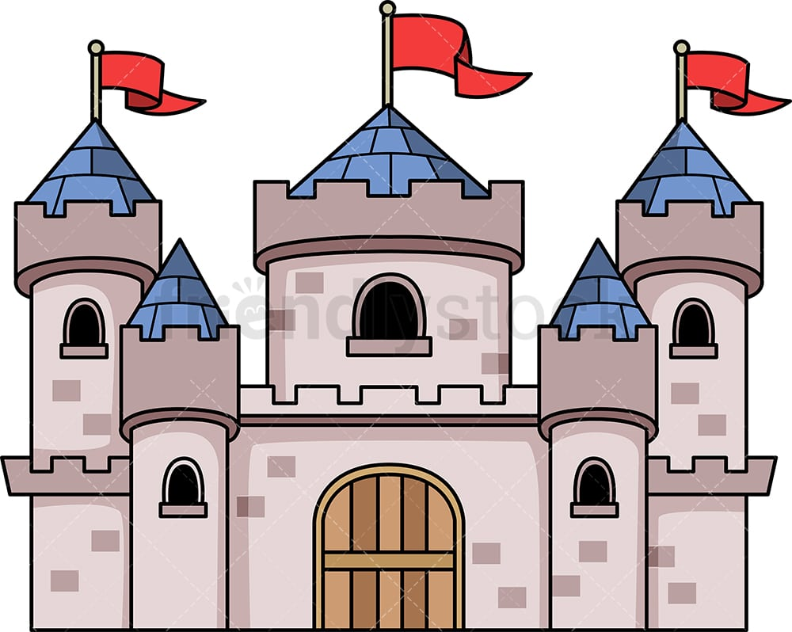
Formidable Fort Design
6’
4’
Pencil
Scissors
Ruler
Tape
Cardboard
Paper
Elevation
Start with a vision of a finished castle
Floor Plan or Map

Slide 7
Formidable Forts
Premium Quality Junk
STRONG
Cardboard boxes
Wood
CLEVER AMUNITION
Sponges
Wet towels
Water balloons
Buckets
BEAUTIFUL
Cloth
Colorful balls
Black or white plastic bags
Tin foil
Which team’s castle looks the coolest?
Which team has the most ammunition?
Which team has the strongest castle?
NOODLES
???

Slide 8
Presenting Ideas
https://build-it-yourself.com/s-lessons/lesson-present-ideas.ppt
Ugly
Inconsistent
Out of bounds
Average
Boring
In bounds
Way Cool !!!
Creative order
3rd dimension

Slide 9
Tool Rules
https://build-it-yourself.com/s-lessons/lesson-tool-rules.ppt
Don’t cut finger off.
Hold work firmly.
Cut away from all eyes.
Think what would happen if you slipped.
Clean up.

Slide 10
5 Problem Solving Tricks
https://build-it-yourself.com/s-lessons/lesson-problem-solving-tricks.ppt
#1 Focus - Identify the problem and set goals.
#2 Research - Don’t re-invent the wheel.
#3 Teamwork – Share ideas.
#4 Simplify - Break your solution into simple parts.
#5 Document - Keep a lab book.

Slide 11
Tips
File naming conventions:
Descriptive file names
Lower case letters
Use ‘-’ between words, Not ‘_’or ‘ ‘
lab-book-racer-chubbi-melany-emma-kyle.pptx
2.

Slide 12
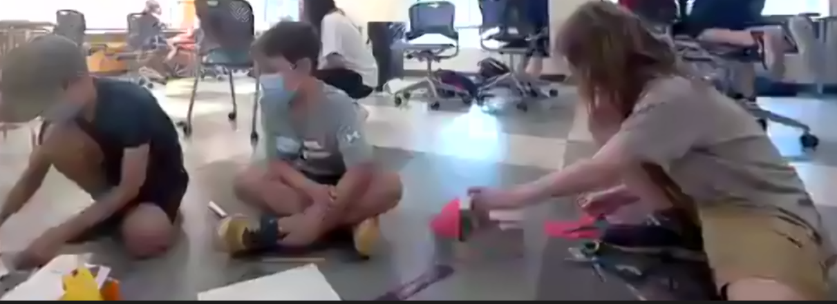
Solutions

Slide 13
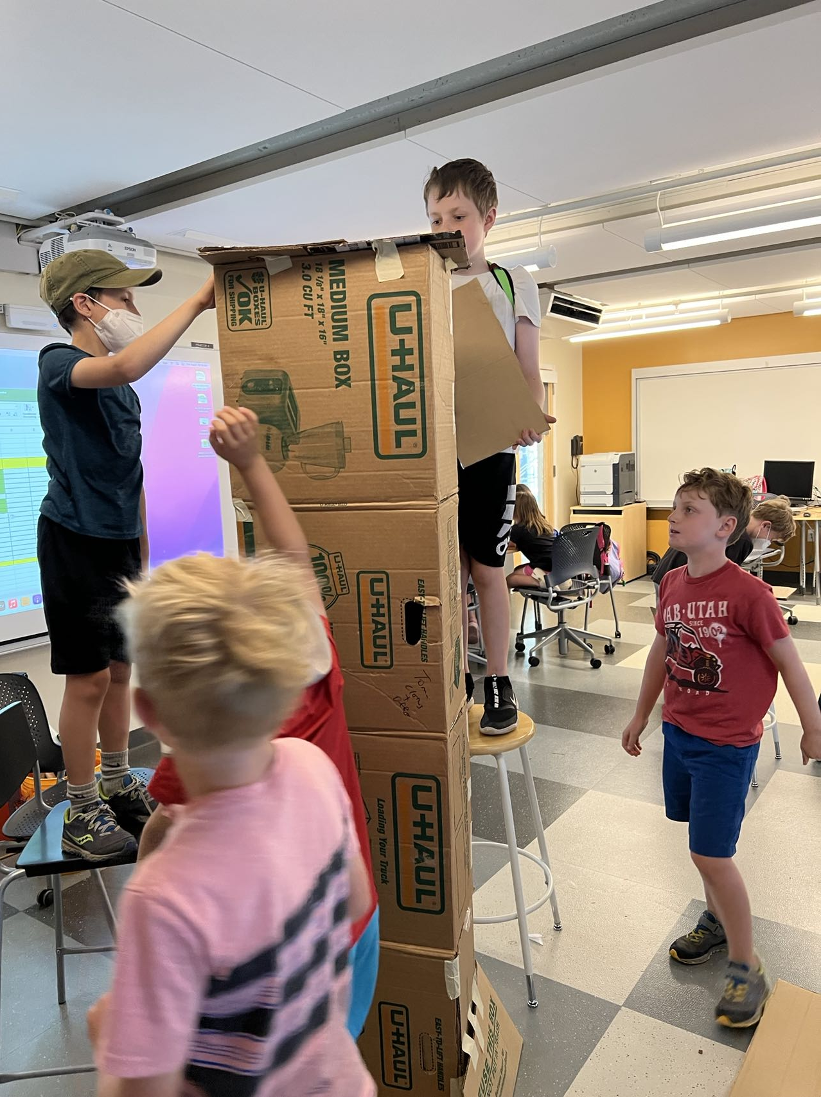
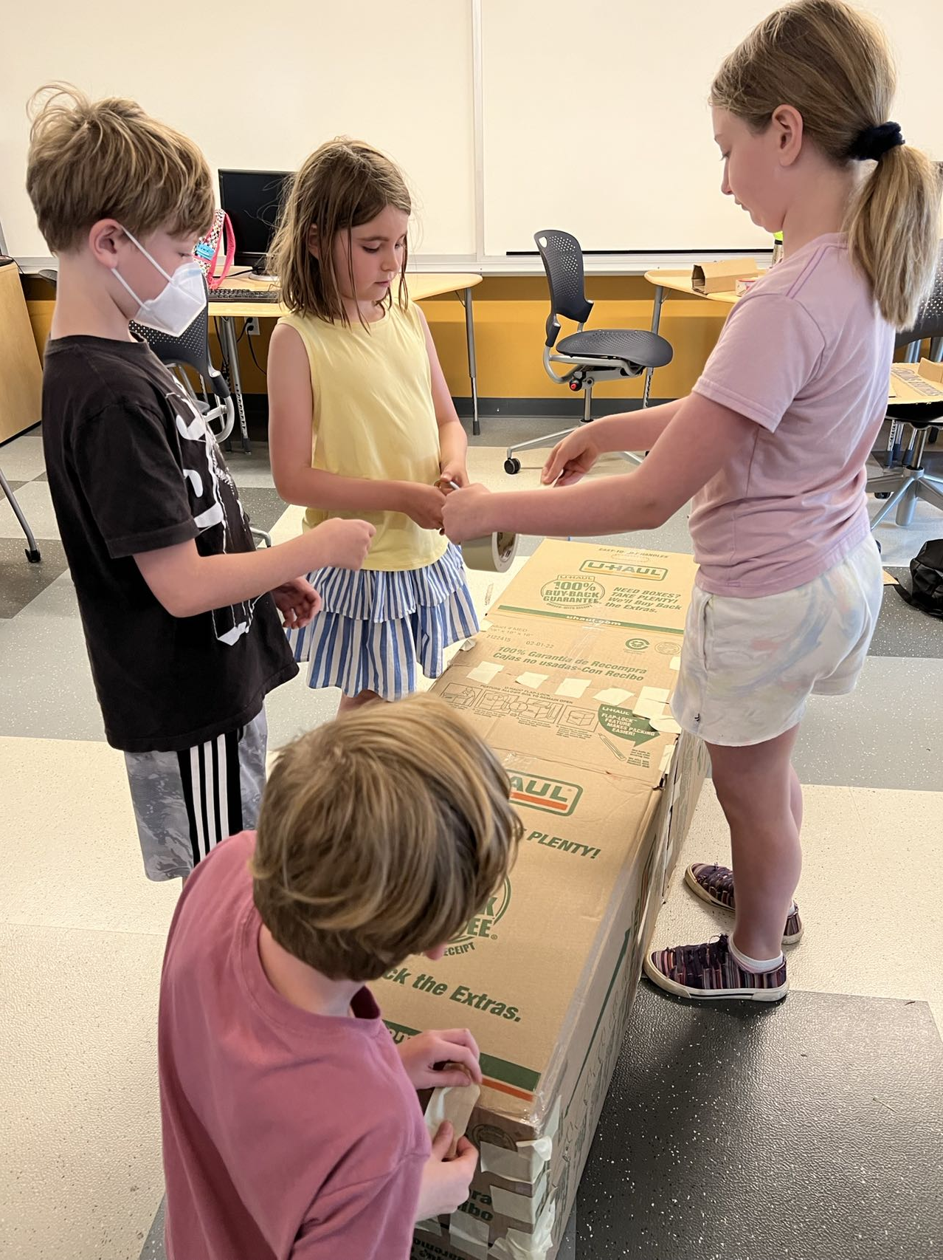
Solutions

Slide 14
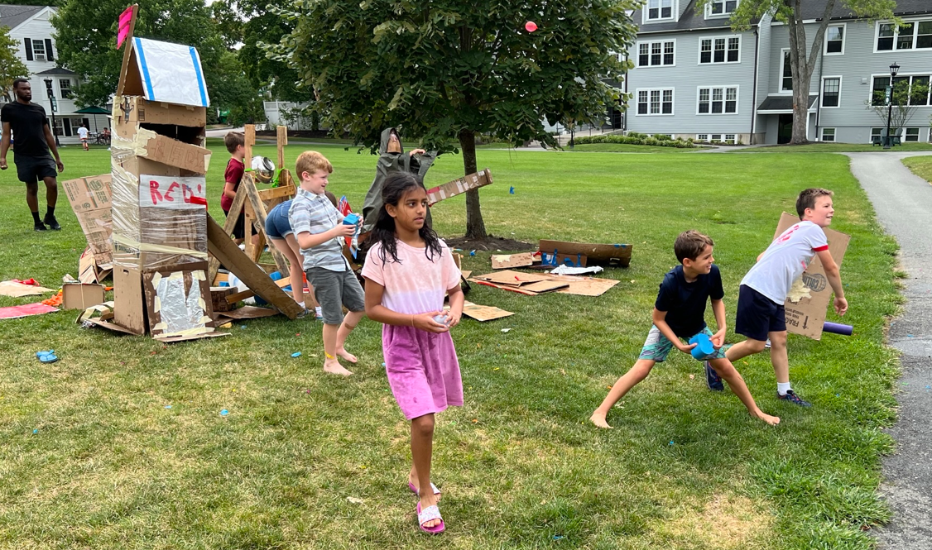
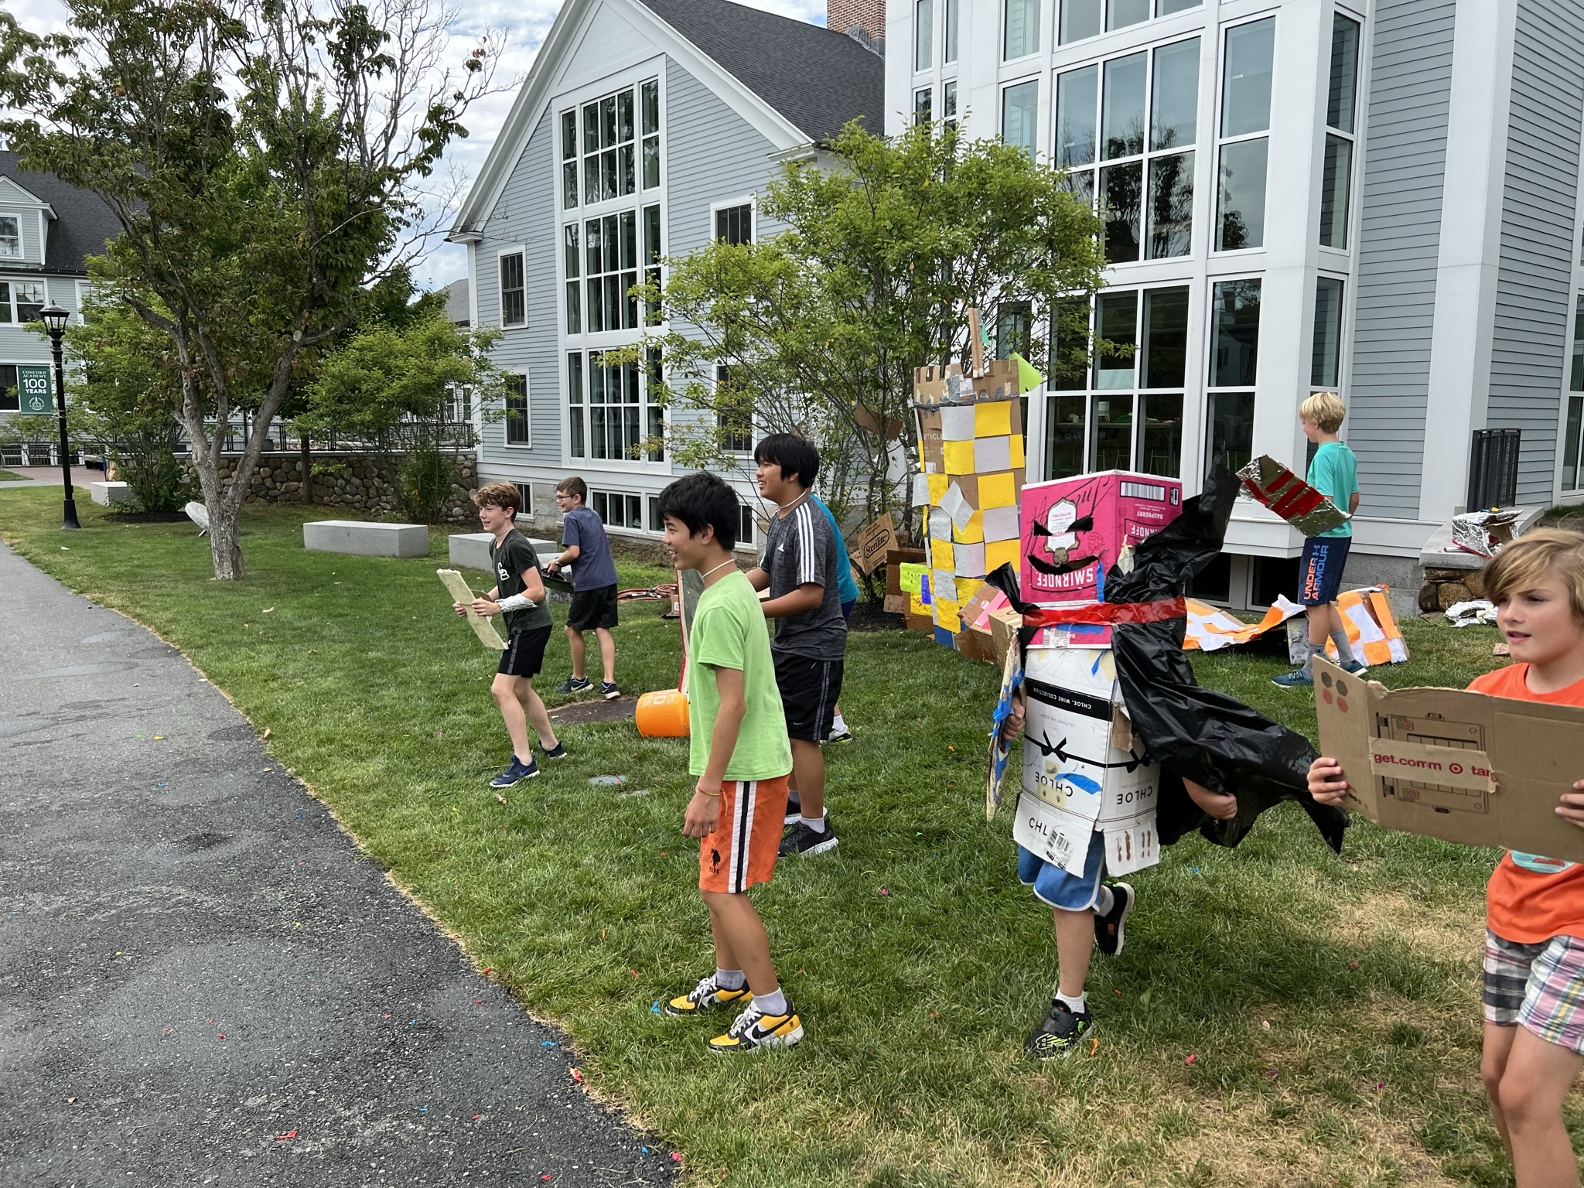
Solutions
Preparing to defend the Queen’s Candy
The Battle
https://www.youtube.com/watch?v=Jq2P3OUPh1k

Slide 15
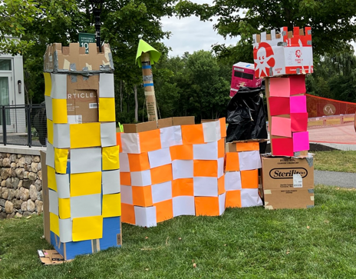
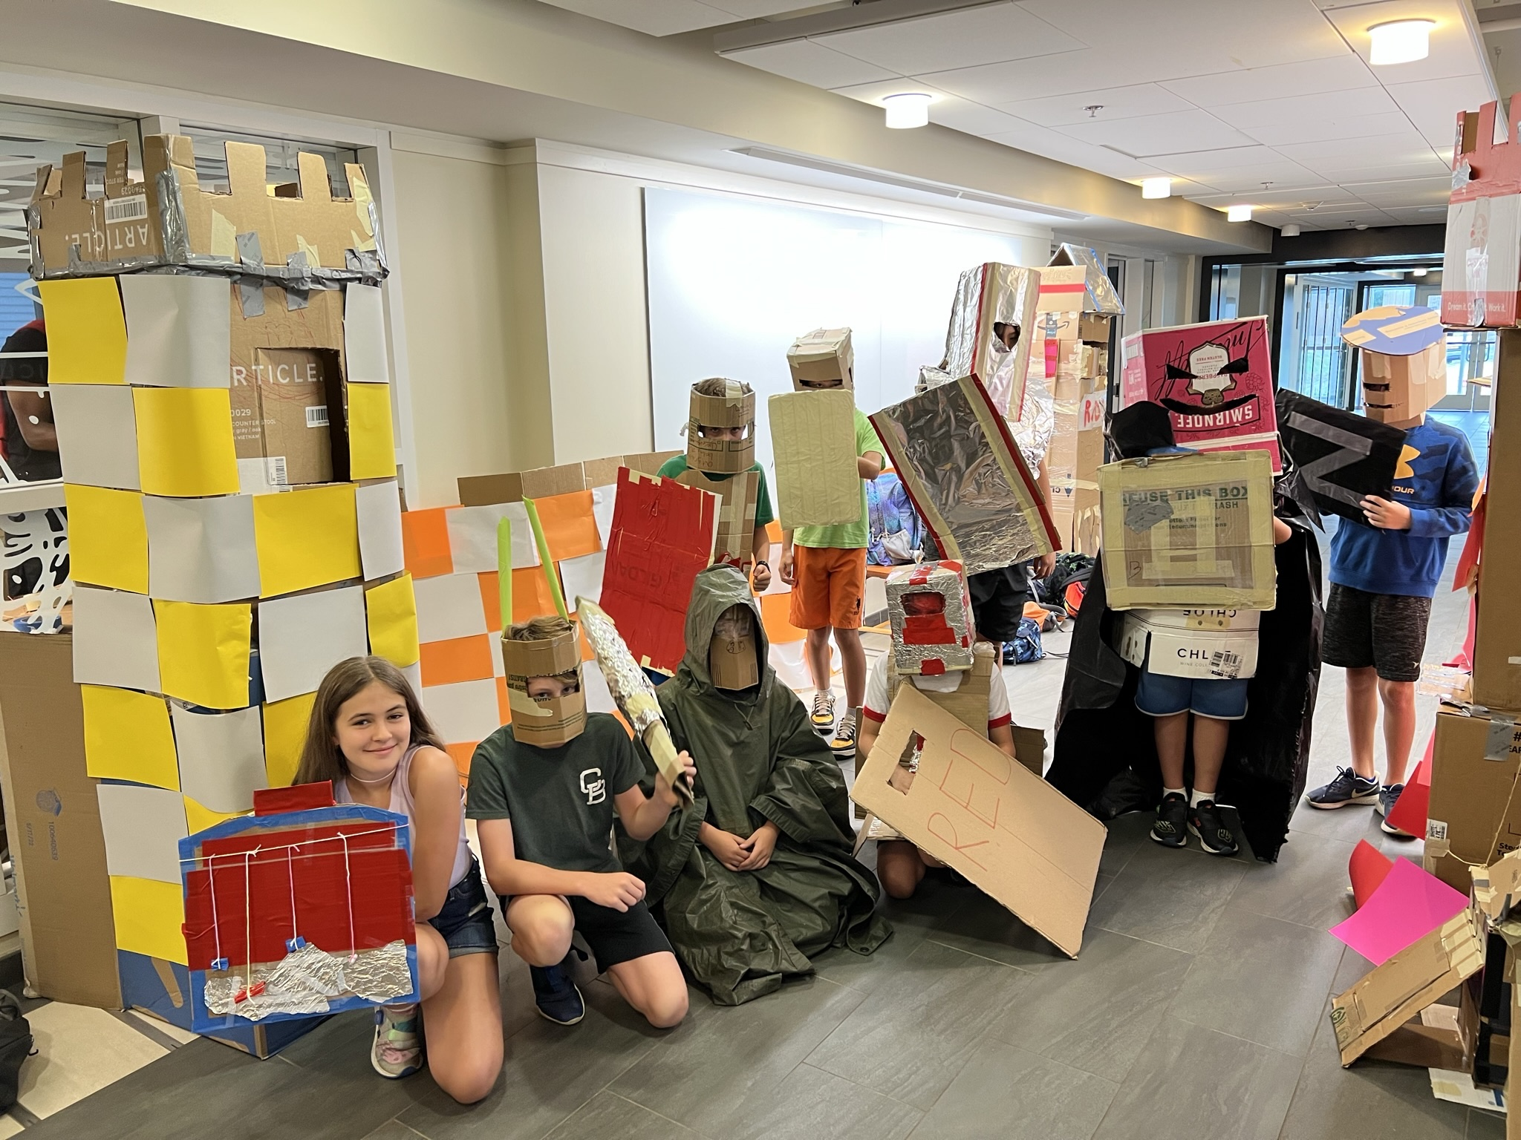
Solutions

Slide 16
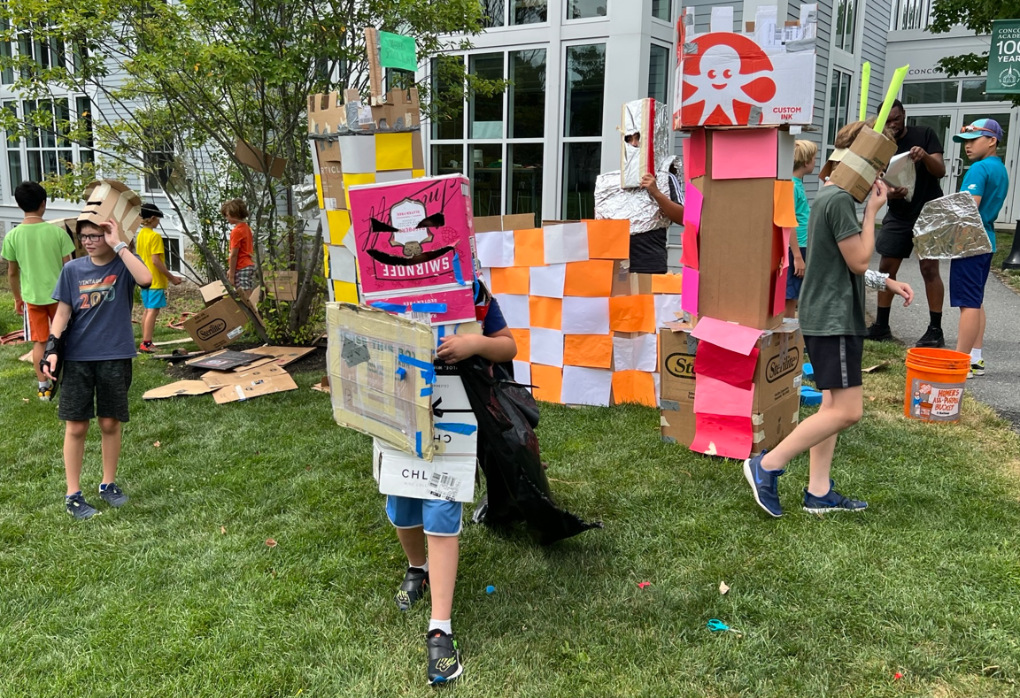
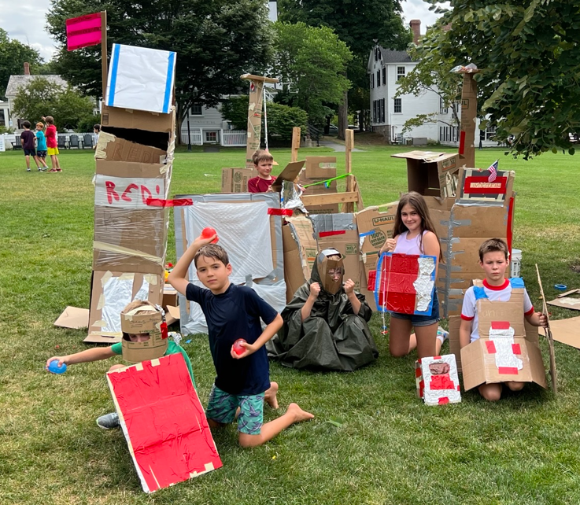
Solutions

Slide 17
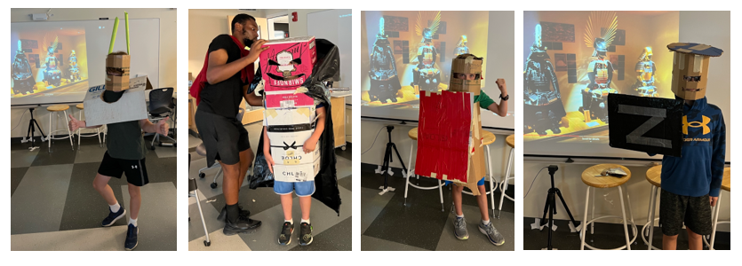
Solutions

Slide 18
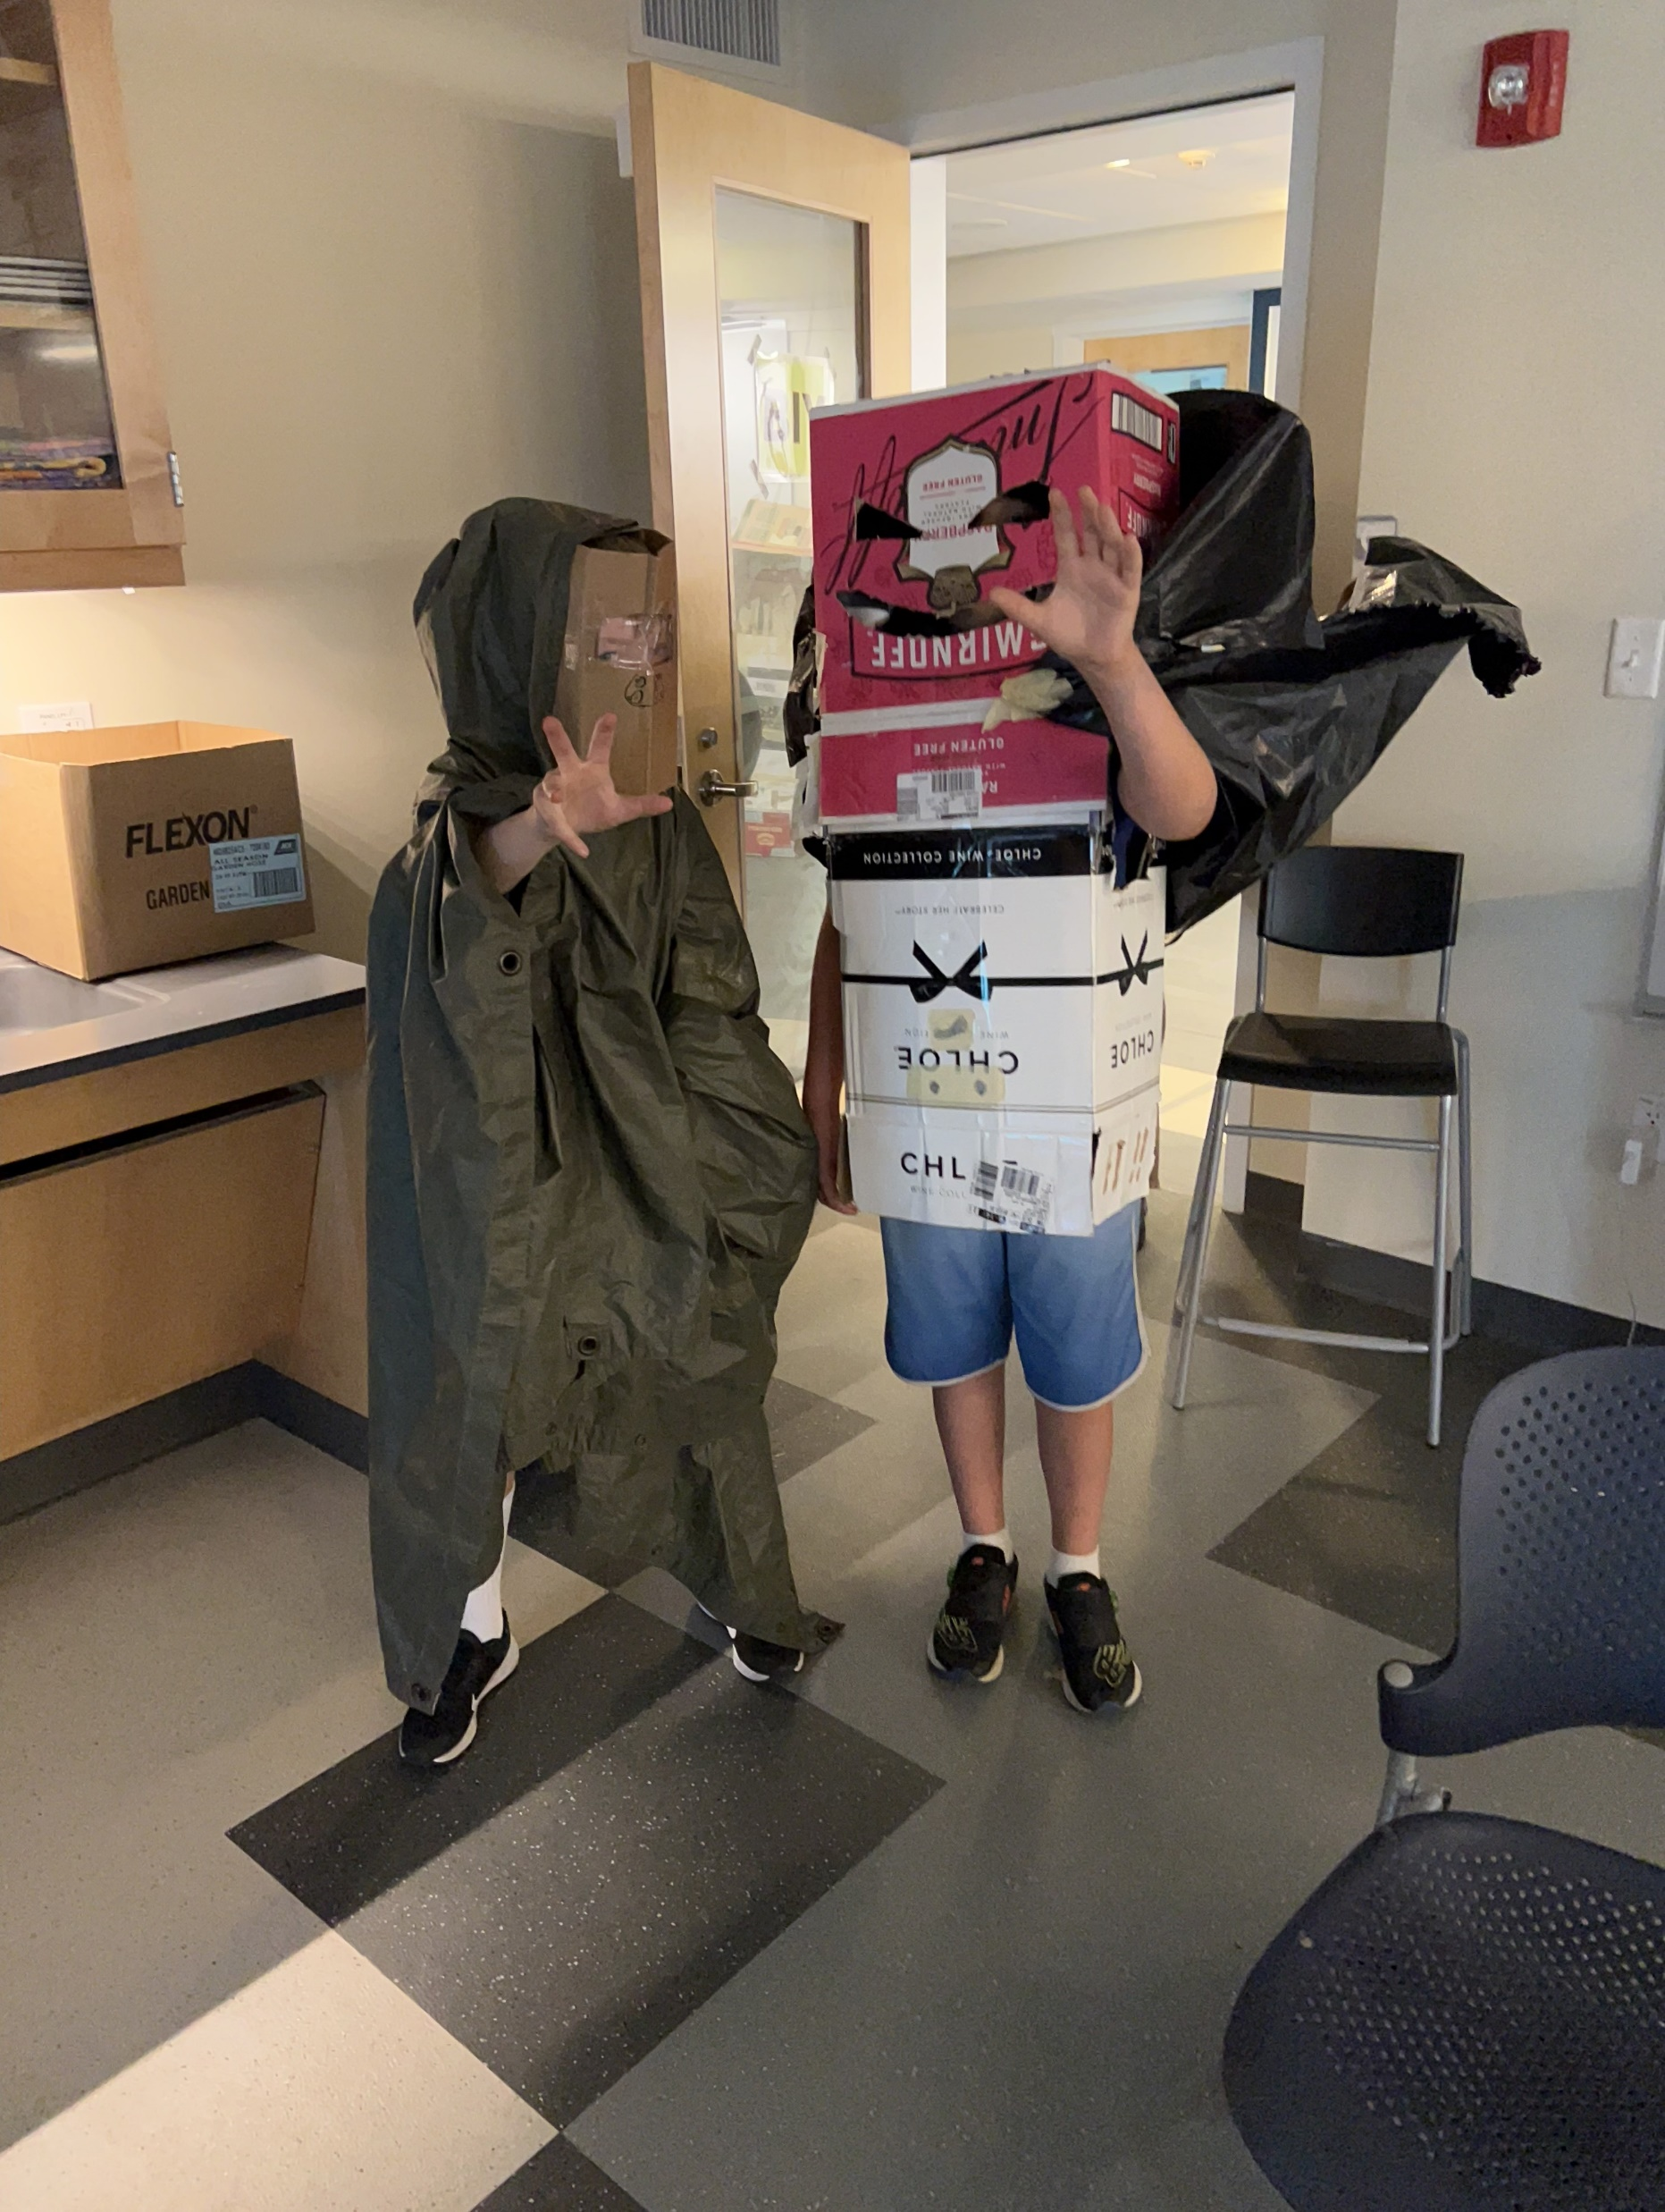
Solutions

Slide 19
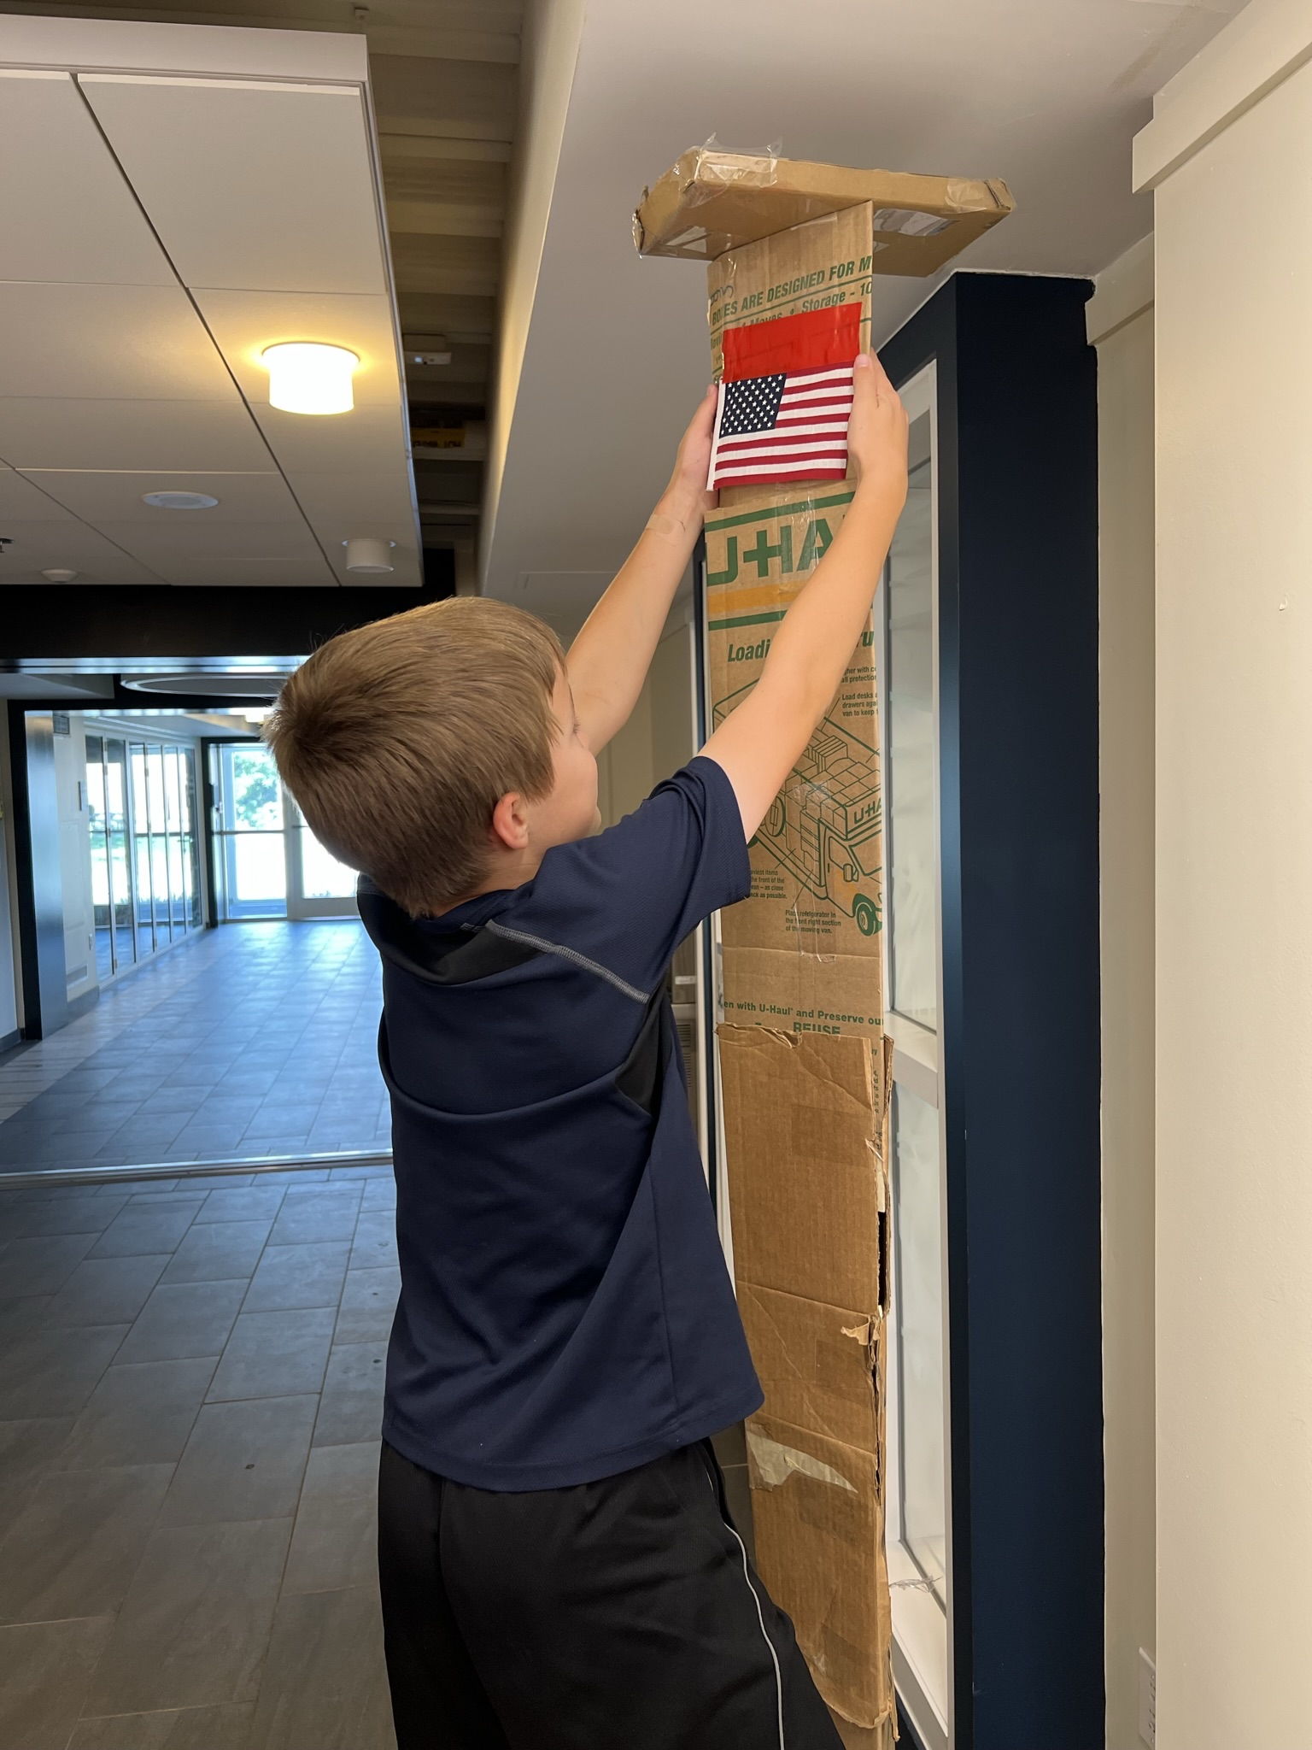
Solutions

Slide 20
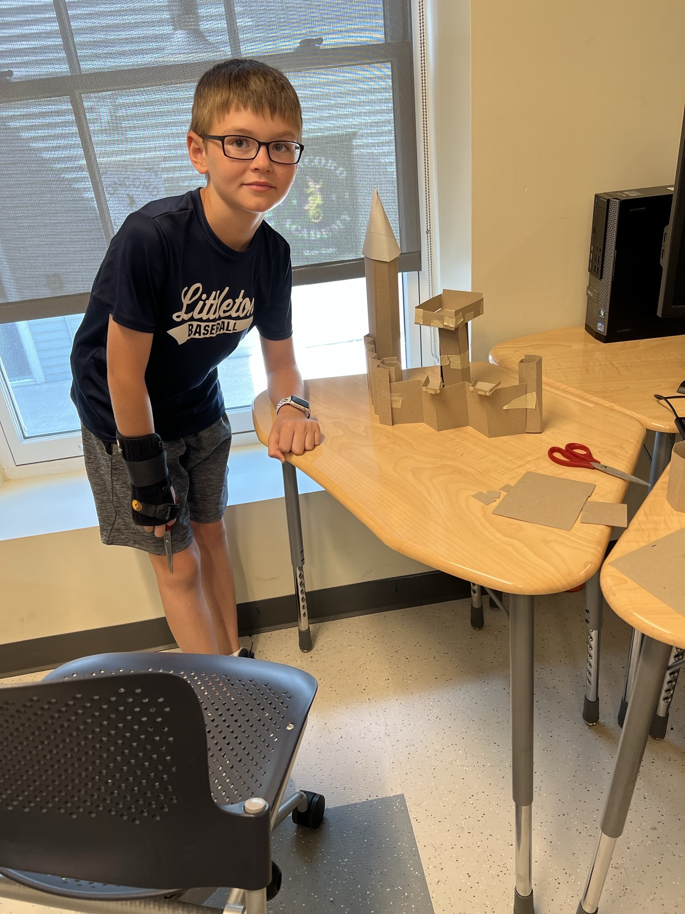
Solutions

Slide 21
Graffiti Art

Slide 22
Castle Ad
Real Estate Listing

Slide 23
Tricks Learned
Value of a Lab Book
Tool rules
???

Slide 24
Project Plan

Slide 25
Formidable Forts
Monday Agenda:
Show castle videos to get kids excited.
https://www.youtube.com/watch?v=yi4p8ZR4n28
Intro to BIY PPT with introductions
Start Lab Book cover
Deliver intro to Forts project problem / mission
Document problem and mission
Document Tool Rules
Research castles
Document rules of engagement
Layout castle floor plan
Build castle model
Critique lab books
CLEAN UP
Filler videos on Oversimplified

Slide 26
Formidable Forts
Tuesday Agenda:
Afternoon
Presenting Ideas
Davinci Castle
https://www.youtube.com/watch?v=QUaR1F03hyQ
Disney Castle
https://www.youtube.com/watch?v=_cz4_bbreNs
Premium Quality Junk (Bring in cardboard boxes, wood, junk, cloth)
Cardboard Castle
https://www.youtube.com/watch?v=2R-_rNxbhfw
Build model castles before life size castle

Slide 27
Build a model or prototype of your design
Split into groups of 2 or 3
Every group will build a square tower and a cylinder tower model
Each group gets:
Chipboard
Corrugated cardboard 8”x10”
Colored paper
Tape or access to glue gun under supervision
Scissors
Ruler
Pencil

Slide 28
Formidable Forts
Tuesday Agenda:
Morning
Update project plan. (NO PRESSURE TO DO ANYTHING YOU DON’T WANT TO DO)
Review Problem/Mission, Lab Laws
Document Laws of the Lab.
Watch kingdom wars on YouTube.
Why do we have wars?
Afternoon
View castle building and castle siege videos.
Why do humans have a long history of fighting?
Build walls.
Intro to Premium Quality Junk collection.
Document list of stuff to collect.
CLEAN UP

Slide 29
Formidable Forts
Wednesday Agenda:
Morning
Update project plan (NO PRESSURE TO DO ANYTHING YOU DON’T WANT TO DO)
Review – Practice presenting your lab books
Introduce and document Presenting Ideas.
Introduce Graffiti
Design Team Name Sign
Design flags, shields, helmets, armor, …
Premium Quality Junk Swap
Afternoon
View castle building and castle siege videos.
Build 2nd tower
Add a Solutions page
Add Tricks Learned page
Critique lab books and solutions
CLEAN UP

Slide 30
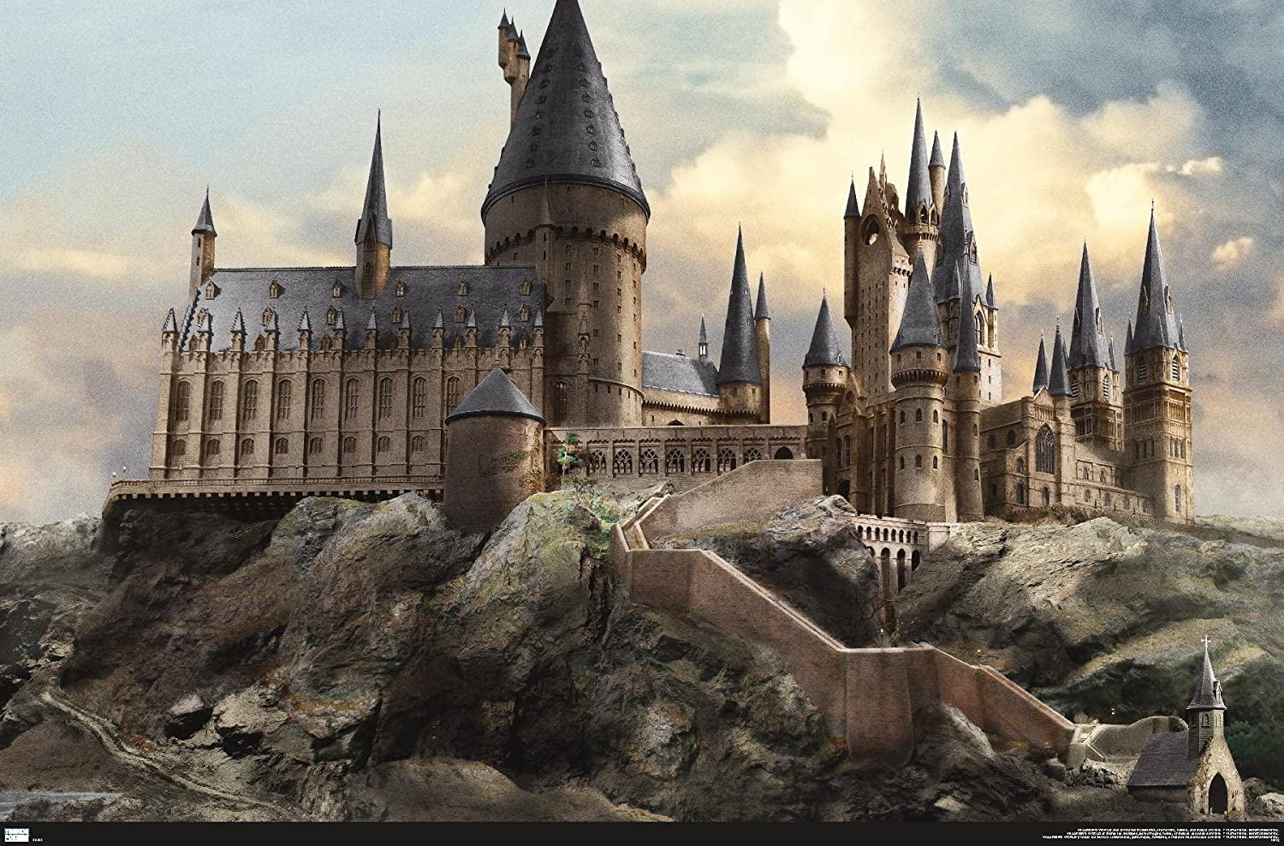
Harry Potter’s Castle

Slide 31
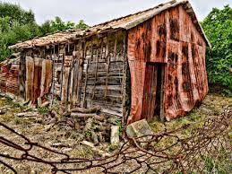
What if this was Harry Potter’s Castle???

Slide 33
Formidable Forts
Thursday Agenda:
Morning
Update project plan. (NO PRESSURE TO DO ANYTHING YOU DON’T WANT TO DO)
Review – Practice presenting your lab books.
View castle building and castle siege videos.
Integrate castle modules
Afternoon
Set up castles outside
Let the battle begin.
You have to be smart.
You have to hurl strong.
You have to look cool.
CLEAN UP

Slide 34
Formidible Forts
Friday Agenda:
Introduce and document Problem Solving Tricks.
Document Problem Solving Tricks.
Peace Summit
Record presentations.
CLEAN UP
Extra Activities:
Add project to Invention Universe.
Design a web page ad.

