Slide 1
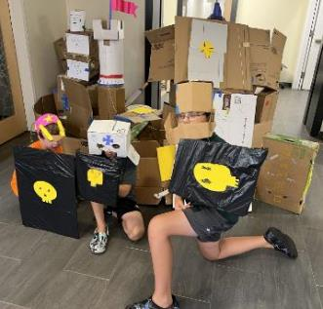
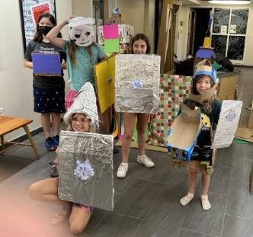
Premium Quality Junk
Supplies:
Cardboard boxes, the more the better!
Colorful masking tape, the more the better!
Tin foil
Black and White plastic trash bags
Colorful cloth for flags
Colorful wrapping paper and printer paper
Horn or Bell
Chopsticks
String or rope
Sponges, towels, water sandwich bags
Water buckets
Sling shot launcher (wood and stretch chords)
Tools:
Scissors
Magic markers
Hot glue gun
Box cutter (for adults only)
www.build-it-yourself.com

