Slide 1


Creative Art and Engineering
‘What If’ Spreadsheets
Build-It-Yourself.com
Notes:
BIB Module Title Page

Slide 2
‘What If?’ Spreadsheet
Goal:
Plan before you build.
Measure before you cut.
Follow the 4D Project Management Process.
Before Build-It-Yourself begins a development project, we need to write a project plan. A ‘What if?’ spreadsheet is part of this plan. We need to estimate:
How many people will buy or value an initiative?
How much $ do we need to invest?
When will we get a return on our investment?
Build-It-Yourself.com
Notes:
BIB Module Regular Pages

Slide 3
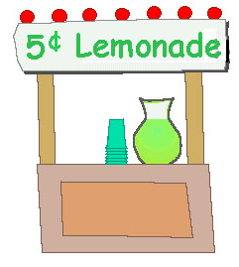
‘What If?’ Spreadsheet
Imagine we want to start a Lemonade Stand:
Why would people want to buy our lemonade?
What do you think would be a fair price?
How many people will buy at that price?
What would our expenses be?
What would be our profit or loss each month?
How much time/$ do we need to invest?
When will we get a return on our investment?
Build-It-Yourself.com
Notes:
BIB Module Regular Pages

Slide 4
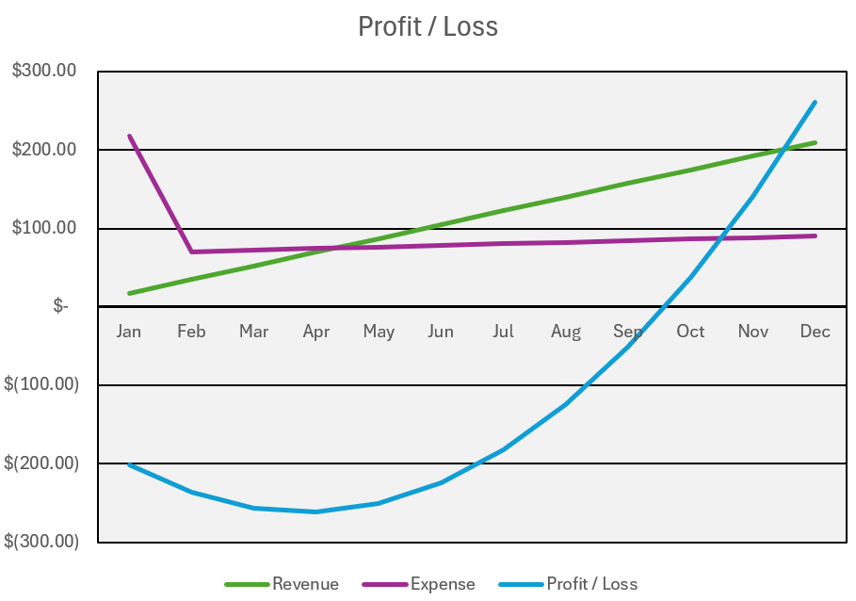
‘What If?’ Spreadsheet
Information Flow
Assumptions
Research Notes
Worksheet Calculations
Conclusions
Build-It-Yourself.com
Notes:
BIB Module Regular Pages

Slide 5
‘What If?’ Spreadsheet
Information Organization
Conclusions
Assumptions
Research Notes
Worksheet Calculations
Build-It-Yourself.com
Notes:
BIB Module Regular Pages

Slide 6
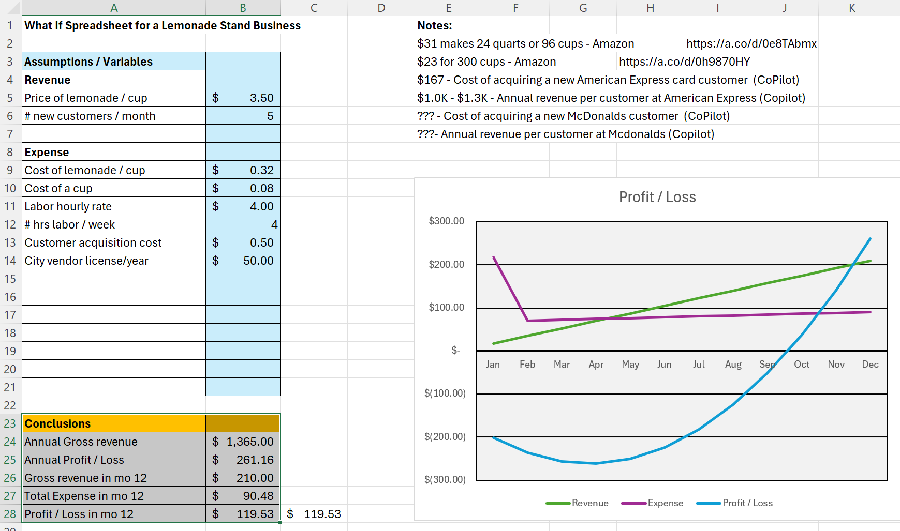
‘What If?’ Spreadsheet
Information Organization
Build-It-Yourself.com
Notes:
BIB Module Regular Pages

Slide 7
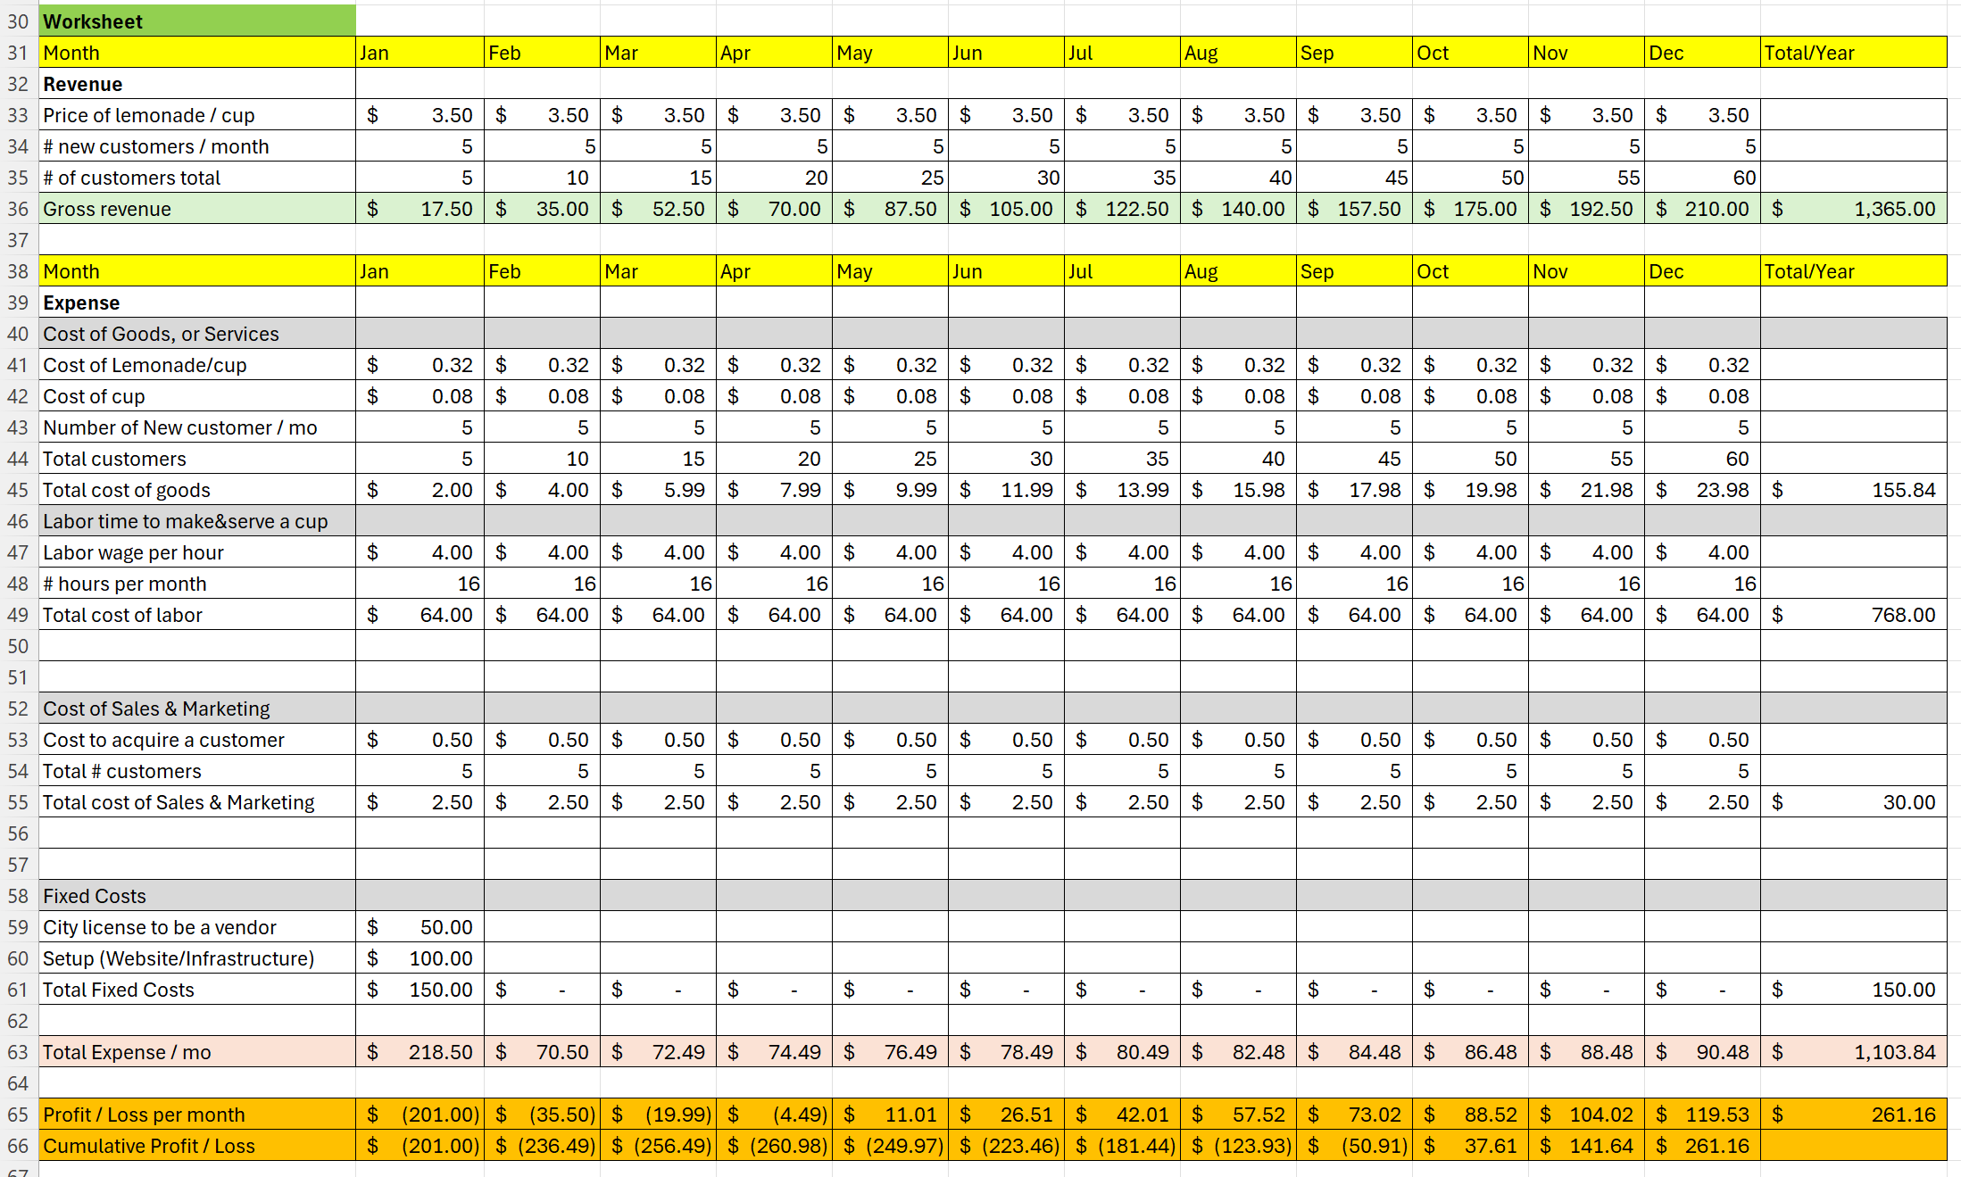
‘What If?’ Spreadsheet
Information Organization
Build-It-Yourself.com
Notes:
BIB Module Regular Pages

Slide 8
‘What If?’ Spreadsheet
#1 Predict profit.
#2 Predict investment needed.
Build-It-Yourself.com
Notes:
BIB Module Regular Pages

