Slide 1

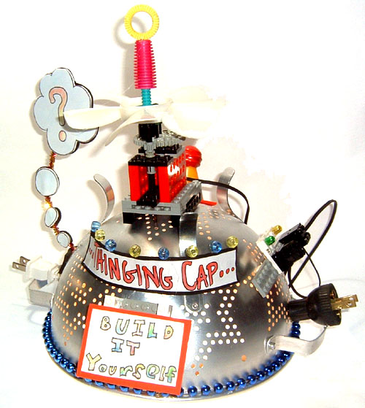
Brainstorm Hat
Creative Inventions and Robotics

Slide 2

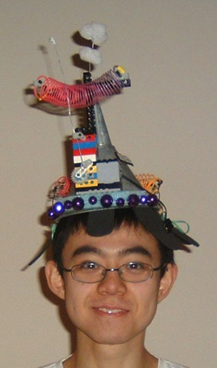
Brainstorm Hat
Brainstorming:
How important is it to look good?
If you are afraid to look silly, will this inhibit your ability to learn?
What can we do to make our lab and its builders look way cool?

Slide 3
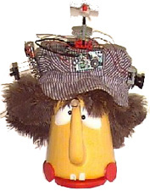
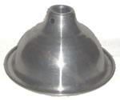
The Mission
Have you ever eaten cold noodles? Much better when they're hot!
These hats are designed to keep your brains hot and squeeze out good ideas! You can start with a regular plain hat or you can look for a colander, a bicycle helmet, a metal lamp shade or a plastic bowl.

Slide 4
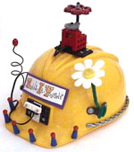
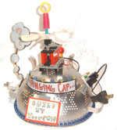
Brainstorm Hat
Then you need to go to your Premium Quality Junk collection and look for some colorful, light and funny shaped objects. Decorate your Brainstorm Hat with some of your best junk.
Add a sign or two to let people know who you are and what you're thinking.

Slide 5
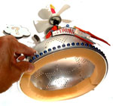
Brainstorm Hat
You may find it useful to glue some sponge or foam rubber pieces inside the Brainstorm Hat at to make it fit better and to make it more comfortable.
If your hat falls off easily, try gluing 2 pipe cleaners to the sides of your hat and then twist them under your chin.

Slide 6
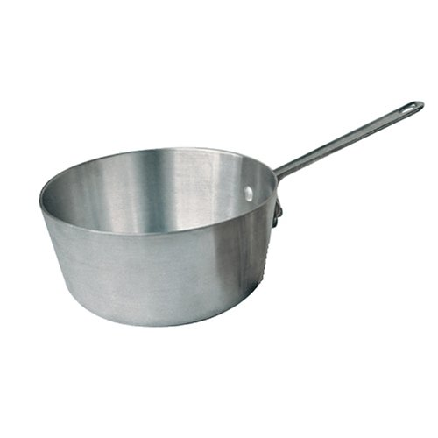

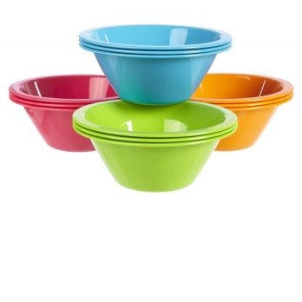
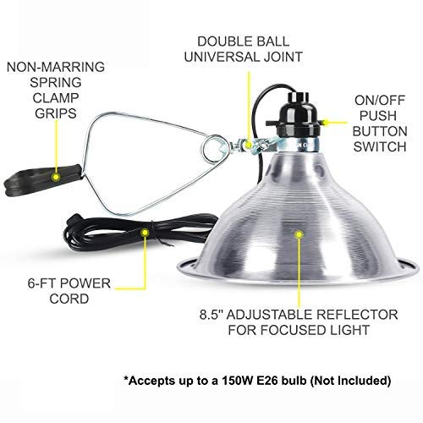
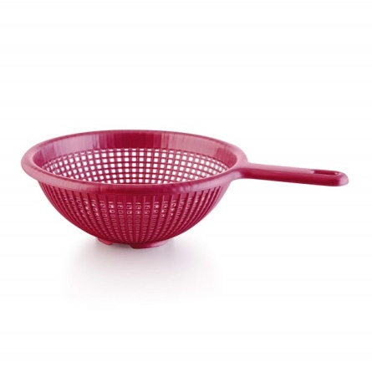
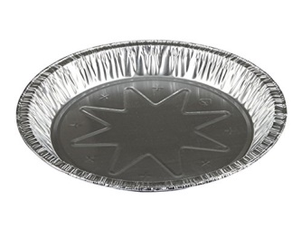
Module - Structure
The base of your Brainstorm Hat could be:
Aluminum pot.
Strainer.
Lamp shade.
Plastic bowls
Pie plate
Cone made from file folder

Slide 7
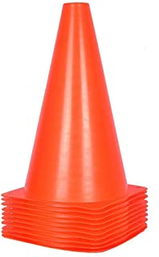
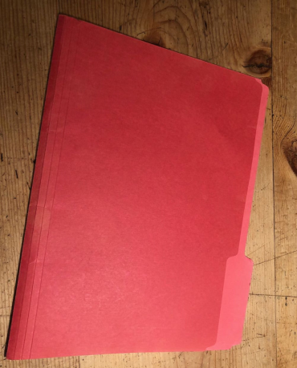

Module - Structure
The base of your Brainstorm Hat could be:
Aluminum pot.
Strainer.
Lamp shade.
Plastic bowls
Pie plate
Cone made from file folder

Slide 8
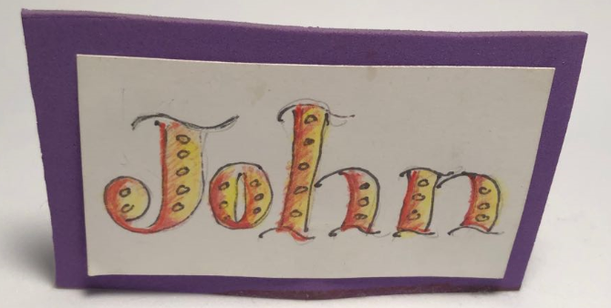
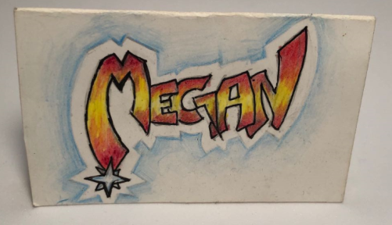
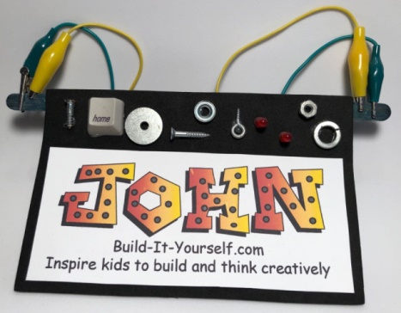
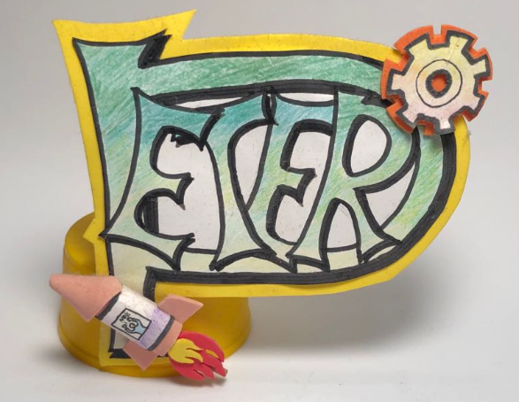
Module - Sign
What clever signs could you mount on your Brainstorm Hat?
Name
Joke
Inspiring word

Slide 9
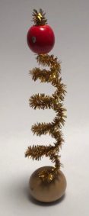
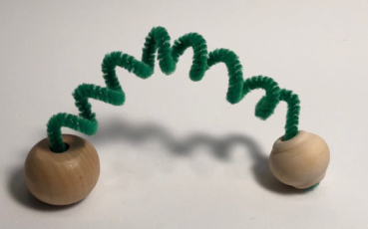
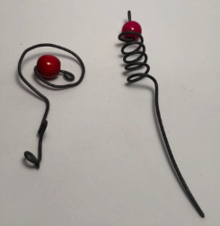
Module - Antenna
You will need an antenna to communicate with the universe.

Slide 10
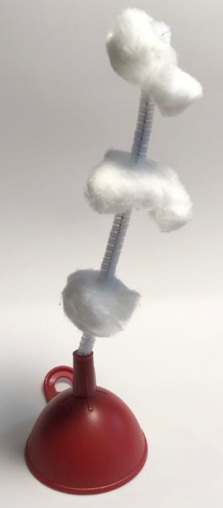
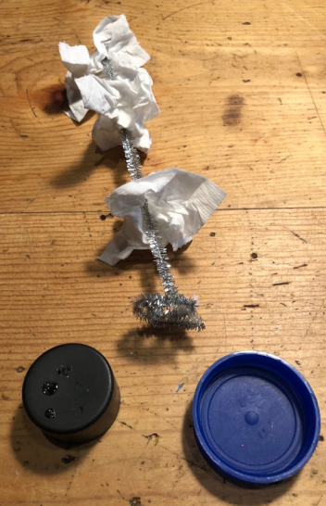
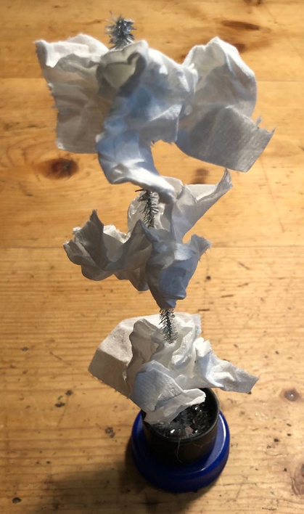
Module - Exhaust
When your brain is working hard it may need an exhaust pipe to vent the ugly ideas.
Cotton or a toilet paper sheet can make good puffs of smoke.

Slide 11
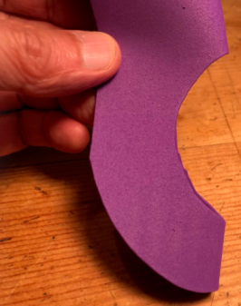
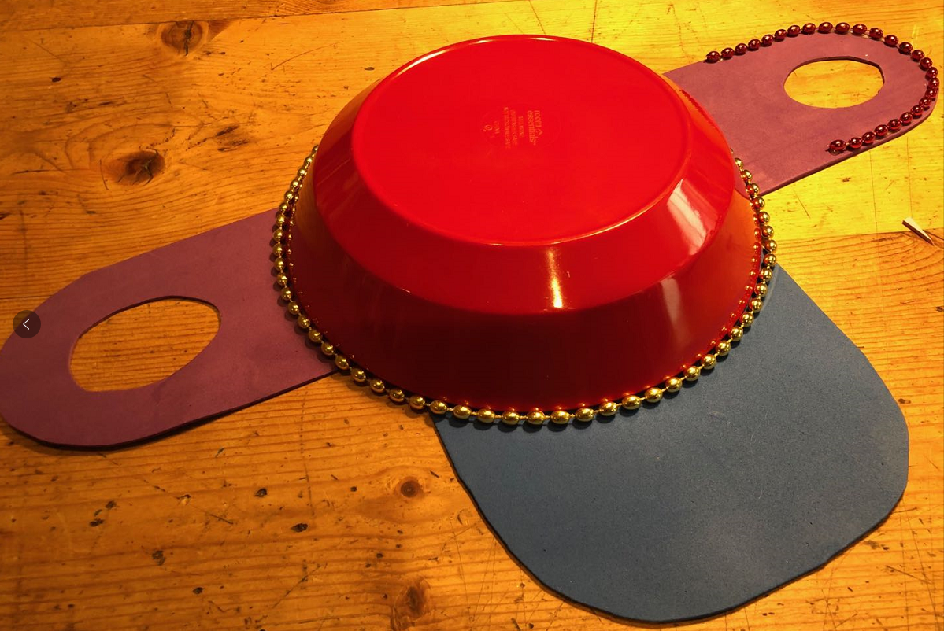
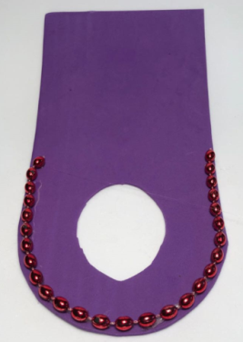
Module - Visor
How can you make your Brainstorm Hat colorful?
Add string of beads.
Add colorful brim and ear flaps.

Slide 12
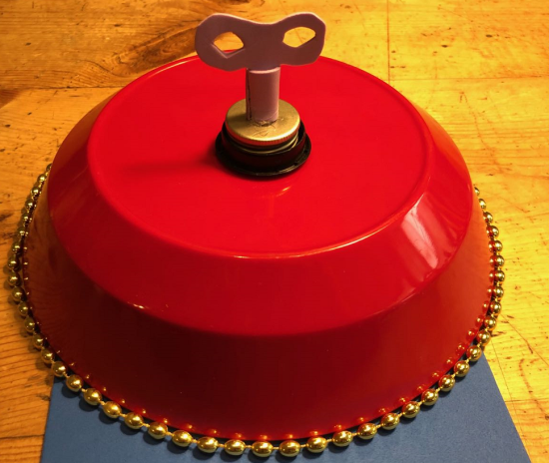
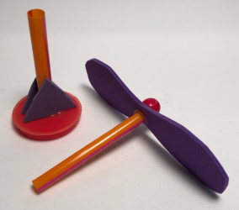
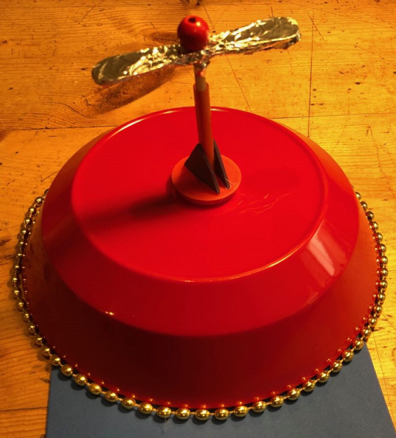
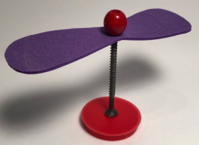
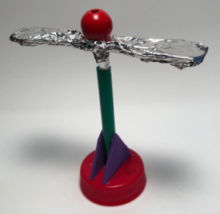
Module – Key and Propeller
How can you make something on your Brainstorm Hat move, light up or sound off when you get a good idea?

Slide 13
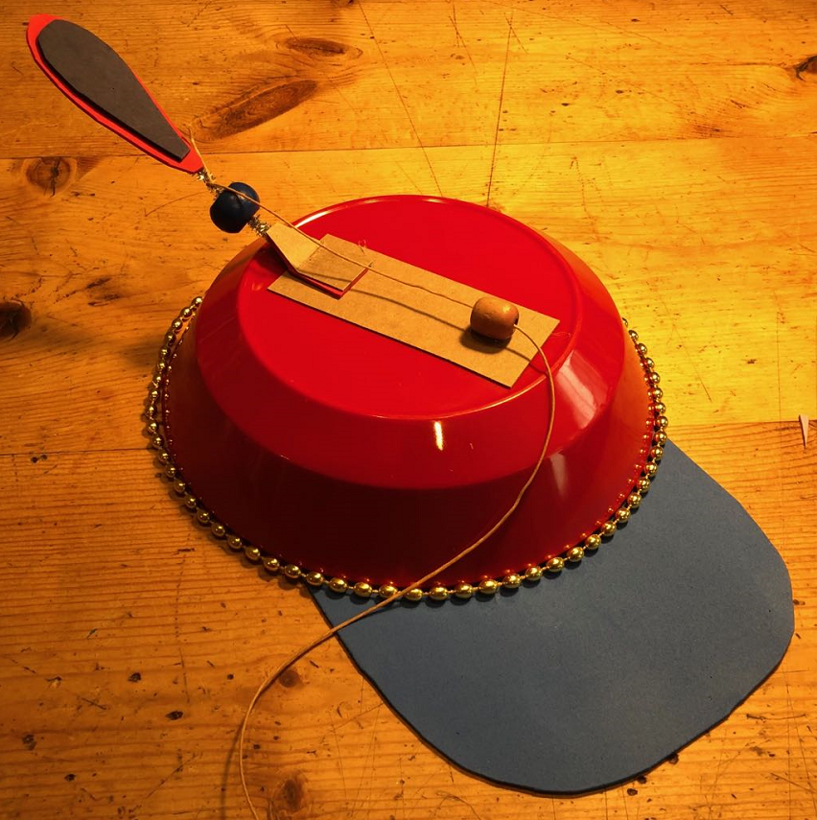
Module – Pop Up Sign
How can you make something on your Brainstorm Hat move, light up or sound off when you get a good idea?

Slide 14
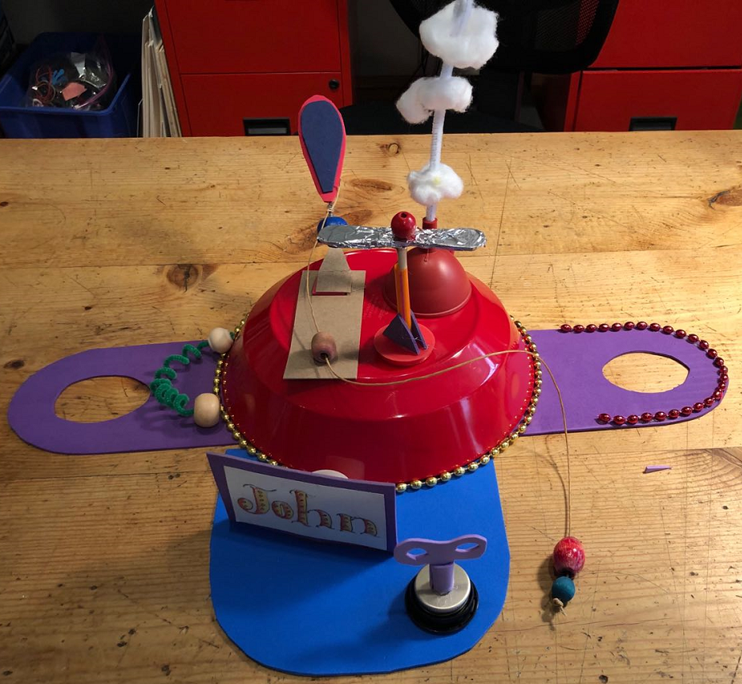
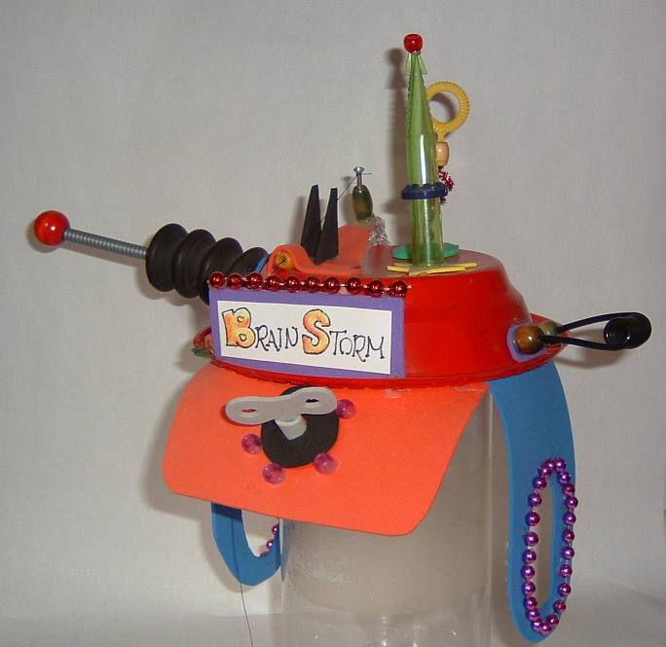
Integrate Modules

