Slide 1
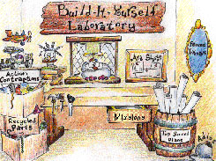

Lab Book
Set up your Laboratory.
If you wanna be an engineer, you need to look like one!
Notes:
Welcome to the Build-It-Yourself Laboratory, where dreams can turn into toys!

Slide 2



The Problem
There aren’t enough creative inventors to solve the world’s problems.
Approved
JG
Date
Oct 2023
Project
Lab Setup
Notes:
Before building, a good engineer will define the problem and set goals.
What are the biggest problems in your world? (Homework? Tests? Bullies?)
What do you think are boring or dumb inventions? (Schools that don’t allow candy? Toilets that need to be cleaned?)

Slide 3
The Mission
Build a far-out laboratory to inspire creative inventions.
If you want to be an inventor, you have to look like one!
We will build:
  A premium quality junk collection.
  An interactive smart pencil.
  A proper shingle for your door.
  An official brainstorm hat.
  A robot assistant to greet visitors.
  A lab book to document your inventions.
Approved
JG
Date
Oct 2023
Project
Lab Setup
Notes:
Before building, a good engineer will define the problem and set goals.
What are some examples of way cool inventions? (Minecraft? Transformer toys?)

Slide 4
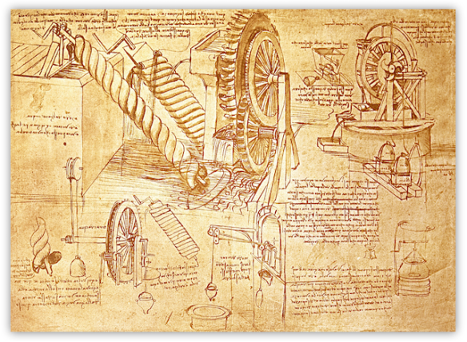
Lab Book
Document your inventions.
Tell a story about your ideas like Leonardo DaVinci
Approved
JG
Date
Oct 2023
Project
Lab Setup
Notes:
A proper engineer or artist keeps a lab book or a sketchbook.
One of DaVinci’s lab books sold for $8 million dollars!
Before a good engineer builds, she or he should know what others have done.
AND THEN
Think about first principles. Or … how can we use facts to make better solutions?

Slide 5

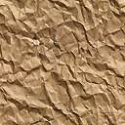
Graffiti Sign
For your door
A
Approved
JG
Date
Oct 2023
Project
Lab Setup
Notes:
A proper engineer or artist should have a proper sign on their lab or studio door.

Slide 6
Graffiti Sign
Decorate your junk box
Premium Quality
Colorful
Unusual shapes
3D
Approved
JG
Date
Oct 2023
Project
Lab Setup
Notes:
A proper engineer or artist should have a proper sign on their lab or studio door.
Before a good engineer builds, she or he should know what others have done.
AND THEN
Think about first principles. Or … how can we use facts to make better solutions?

Slide 7
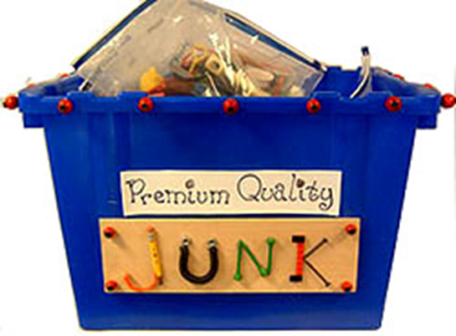
Junk Box
Pipe cleaners
Bottle caps
Tin cans
Colored paper
Coffee sticks
Straws
Feathers
Wine corks
Tin foil
Beads or jewelry
Nuts
Wine corks
“A good inventor must have a wild imagination and a big junk collection.”
Thomas Edison
Approved
JG
Date
Oct 2023
Project
Lab Setup
Notes:
Thomas Edison said, “A good inventor must have a wild imagination and a big junk collection.”
Your junk box must look way cool, so no one will throw your stuff away.

Slide 8
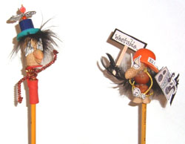
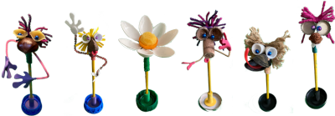
Smart ideas come from
Smart Pencils
Approved
JG
Date
Oct 2023
Project
Lab Setup
Notes:
If you want to document good ideas, you’ll need a smart pencil.

Slide 9
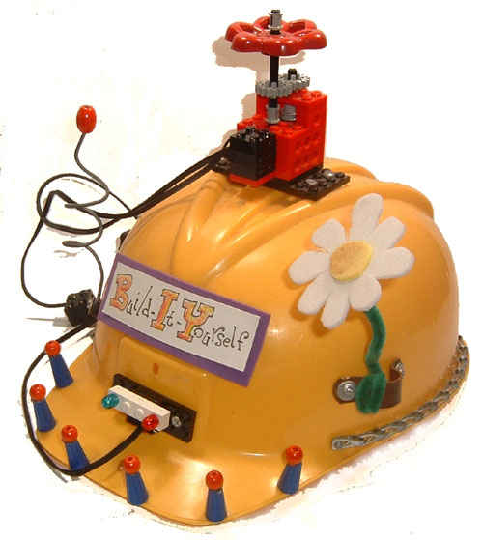
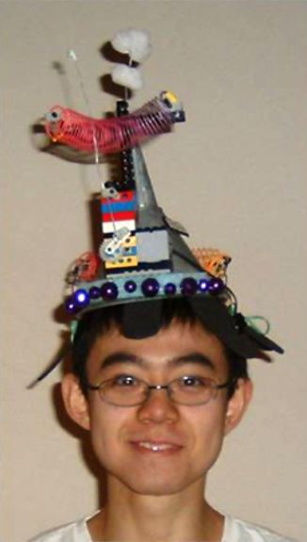
Thinking Cap
Keep your brain cells warm
“If you are afraid to look silly, it can be difficult to learn new tricks.”
Liu Huan, MIT Student
Approved
JG
Date
Oct 2023
Project
Lab Setup
Notes:
The best engineers and artists keep their brain cells nice and warm.

Slide 10
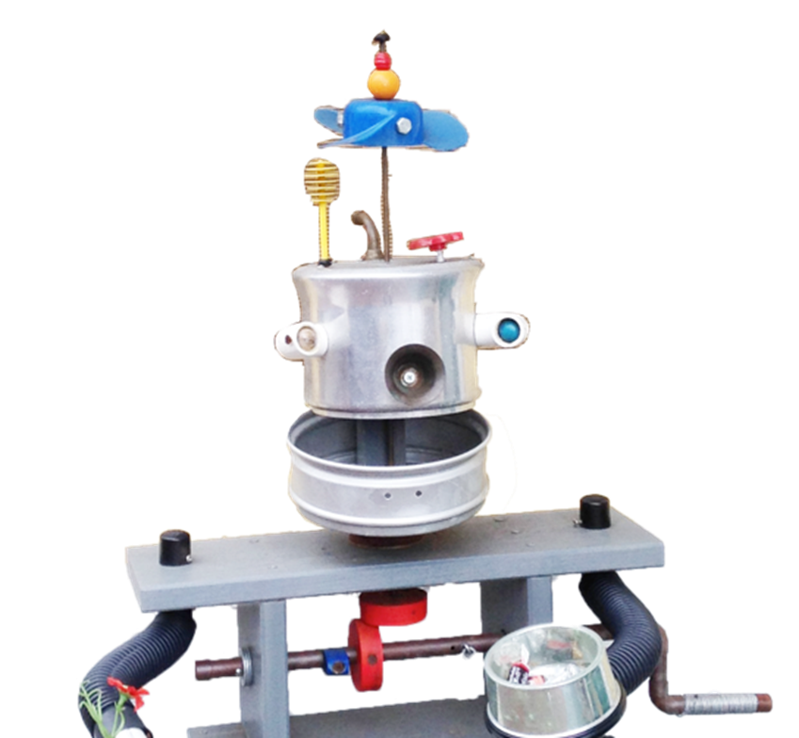
Robot Door Greeter
Approved
JG
Date
Oct 2023
Project
Lab Setup
Notes:
And finally, an important engineer or artist should have a robot assistant to greet visitors.

Slide 11

Hall of Fame
Post your solution in the
Build-It-Yourself
Hall of Fame
Approved
JG
Date
Oct 2023
Project
Lab Setup
Notes:
Inspirations lead to dreams, which lead to more and better inventions.
We want to post your inventions on Invention Universe so the galaxy can be inspired by your work.

Slide 12

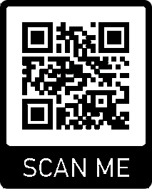
WANTED: FUNKY ARTISTS AND BUILDERS
Build online with art and engineering college students.
Grown ups need not apply.
build-it-yourself.com/apply
Copyright 2023
Notes:
Join the Build-It-Yourself team.

Slide 13
Support Materials

Slide 14
Learning Goal
Set up a creative, fun environment.
We Will Learn how to:
Think like an artist and build like an engineer
Document ideas in PowerPoint or Google Slides
Follow a process for solving problems
Present your work
Use common materials creatively
Advanced Projects
Design graffiti signs.
Build robot from premium quality junk.
Create a marketing video.
Post project on Invention Universe.
Approved
JG
Date
Oct 2023
Project
Lab Setup

Slide 15
Project Plan Agenda
Session 1 Intro to the BIY Lab
Create a Lab Book
      Cover
      Problem / Mission
Session 2 Research Examples
Session 3 Document Ugly, Average, Way Cool
Draw Graffiti Signs.
Set up Junk Box and Tools
Session 4 Build Smart Pencil
Session 5 Build a Thinking Cap
Session 6 Build a Robot Door Greeter
Session 7 Build a Robot Door Greeter
Session 8 Document and present your solutions on Invention Universe.
Approved
JG
Date
Oct 2023
Project
Lab Setup

Slide 16
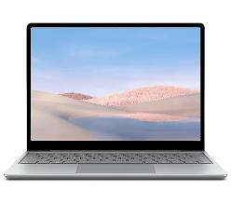
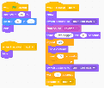
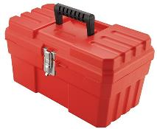

Parts, Tools, Supplies, Software
You'll need:
Power Point (or Google Slides)
Printer paper (Colored paper)
Scotch tape
Scissors
Ruler
Pencil
Junk Box
Build-It-Blocks:
  Problem-solving tricks
  Presenting ideas
  Programming primitives
Approved
JG
Date
Oct 2023
Project
AI Robots

Slide 17
Workshop discussion questions
What makes you bored?
What inspires you to be creative?
What are examples of boring and creative inventions?
What does it mean to think outside the box?
How can your environment influence how you think?
Measures of Success
Is your project presentation clear, concise, and compelling?
Did you solve the problem?
Did you solve the problem efficiently and creatively?
  Least number of lines of code?
  Cheapest materials?
Approved
JG
Date
Oct 2023
Project
Lab Setup

