Slide 1
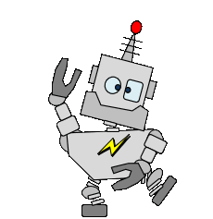
Laboratory Setup
Lab Book
George, Angela, Cindy, Lena, Ryan, and John
The cover of your lab book should make people want to open it.
Build-It-Yourself.com

Slide 2

Problem:
The world does not have enough creative minds to solve all our problems.
Mission:
If you want to be an artist or engineer to help solve the world’s problems, you must look like one.
John’s Emoji
Your lab book should tell an engaging story about your project.
Start with the problem and mission.
Build-It-Yourself.com

Slide 3
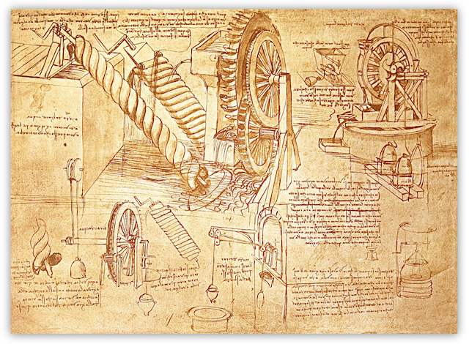
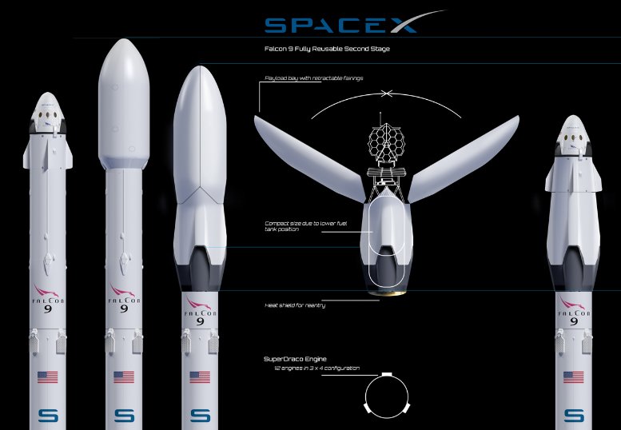
Research cool lab books:
Get inspiration and
learn from others.
Build-It-Yourself.com

Slide 4
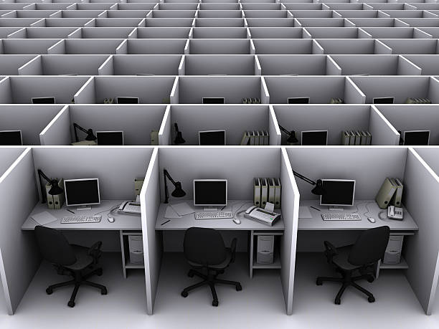

Research cool labs:
Which laboratory would you rather work in?
Build-It-Yourself.com

Slide 5
‘s
Laboratory
Graffiti Art
Colorful
Unusual shapes
3D
Readable from a distance
Build-It-Yourself.com

Slide 6
Premium Quality
Collect premium quality junk.
Sort your stuff.
Decorate your junk box.
Build-It-Yourself.com

Slide 7
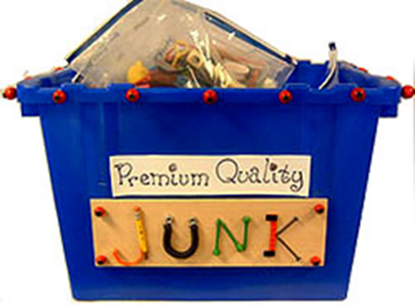
Junk Box
Pipe cleaners
Bottle caps
Tin cans
Colored paper
Coffee sticks
Straws
Feathers
Wine corks
Tin foil
Beads or jewelry
Nuts
Wine corks
“A good inventor must have a wild imagination and a big junk collection.”
Thomas Edison
Collect premium quality junk.
Sort your stuff.
Decorate your junk box.
Build-It-Yourself.com

Slide 8
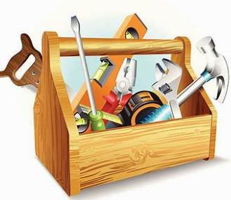
Tool Rules
Don’t cut finger off.
Use a pencil to press hot glue. Not your fingers!
Conserve materials.
Sort supplies.
Build-It-Yourself.com

Slide 9
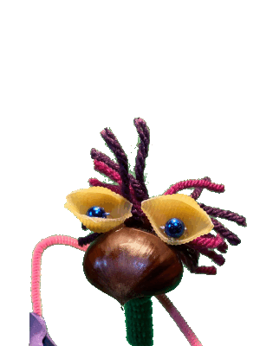
Smart Pencil
Not content to merely sketch or scrawl,
My smart pencil thinks ahead—it knows it all.
📝 Ode to a Smart Pencil
A poet’s verse, an artist’s smile.
Oh pencil bright, both brain and tool,
You scribble genius, sleek and cool.
Written by ChatGPT when asked to write a story about a pencil that makes you write smart ideas.
.
Build-It-Yourself.com

Slide 10
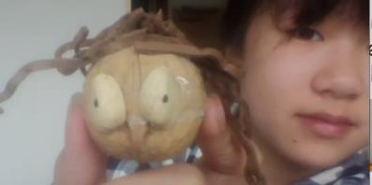
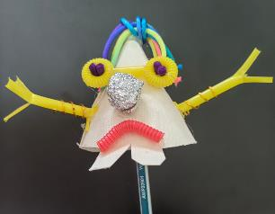
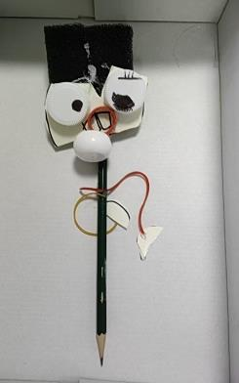
Smart Pencil
It’s difficult to think different.
Laura
Yueyue
Build-It-Yourself.com

Slide 11
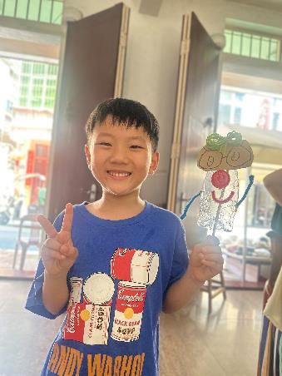
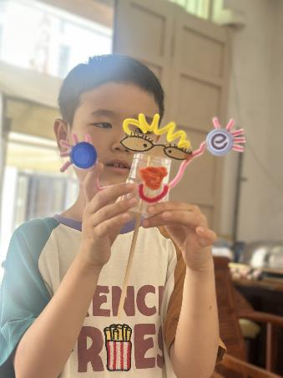

Smart Pencil
What skills will be needed in an AI world?
An ability to FANTSIZE!
Tantan
Build-It-Yourself.com

Slide 12
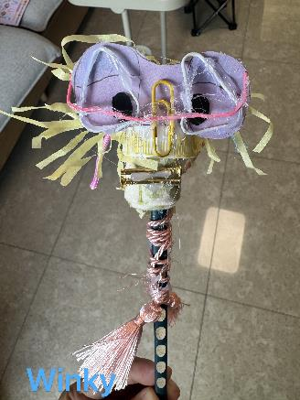
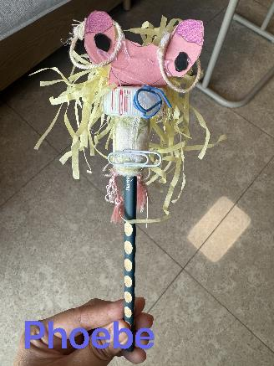
Smart Pencil
One person’s trash is another person’s treasure.
Build-It-Yourself.com

Slide 13
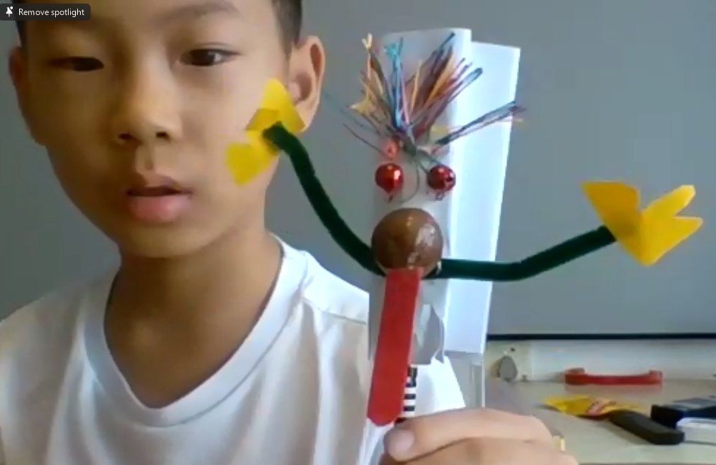
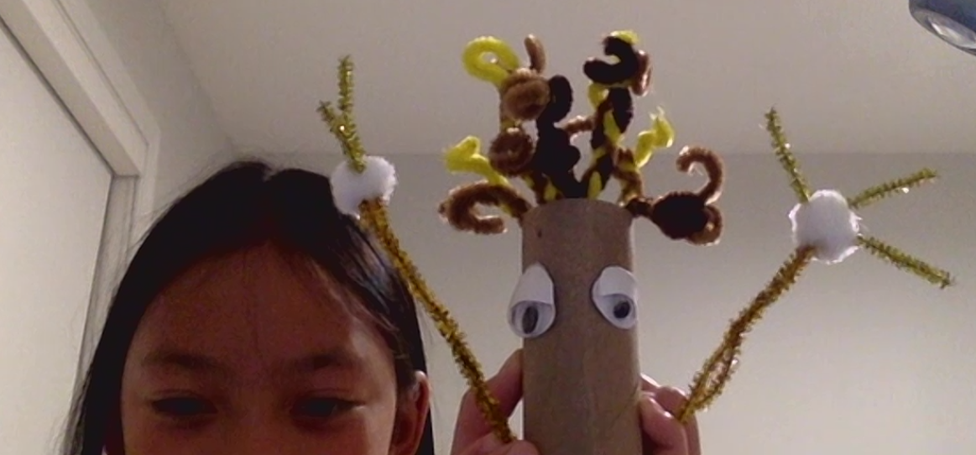
Smart Pencil
One person’s trash is another person’s treasure.
sophia
Brian
Build-It-Yourself.com

Slide 14
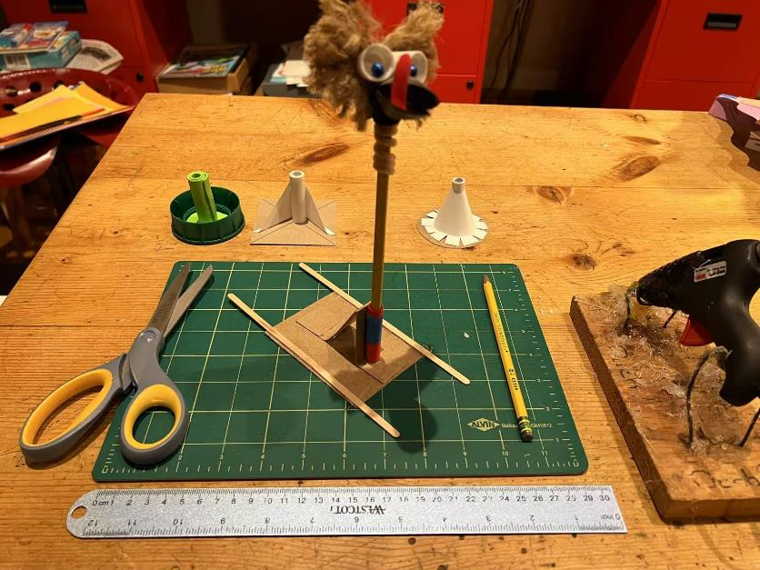
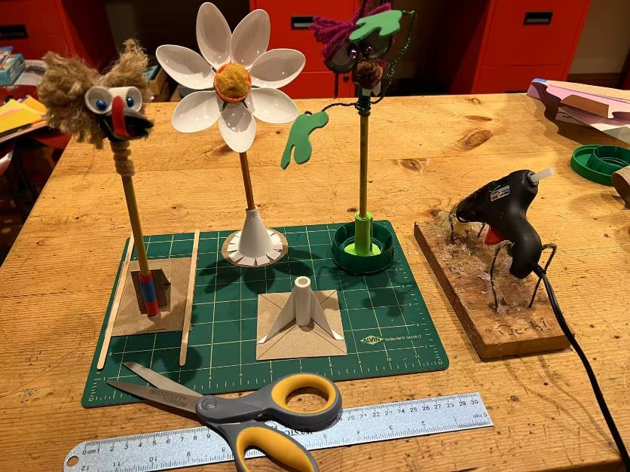
Smart Pencil Holder
A proper invention should have a strong foundation.
Build-It-Yourself.com

Slide 15
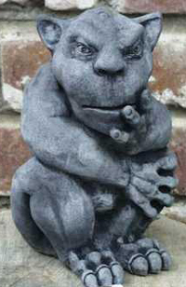
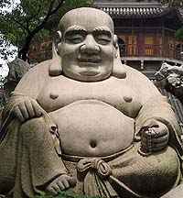
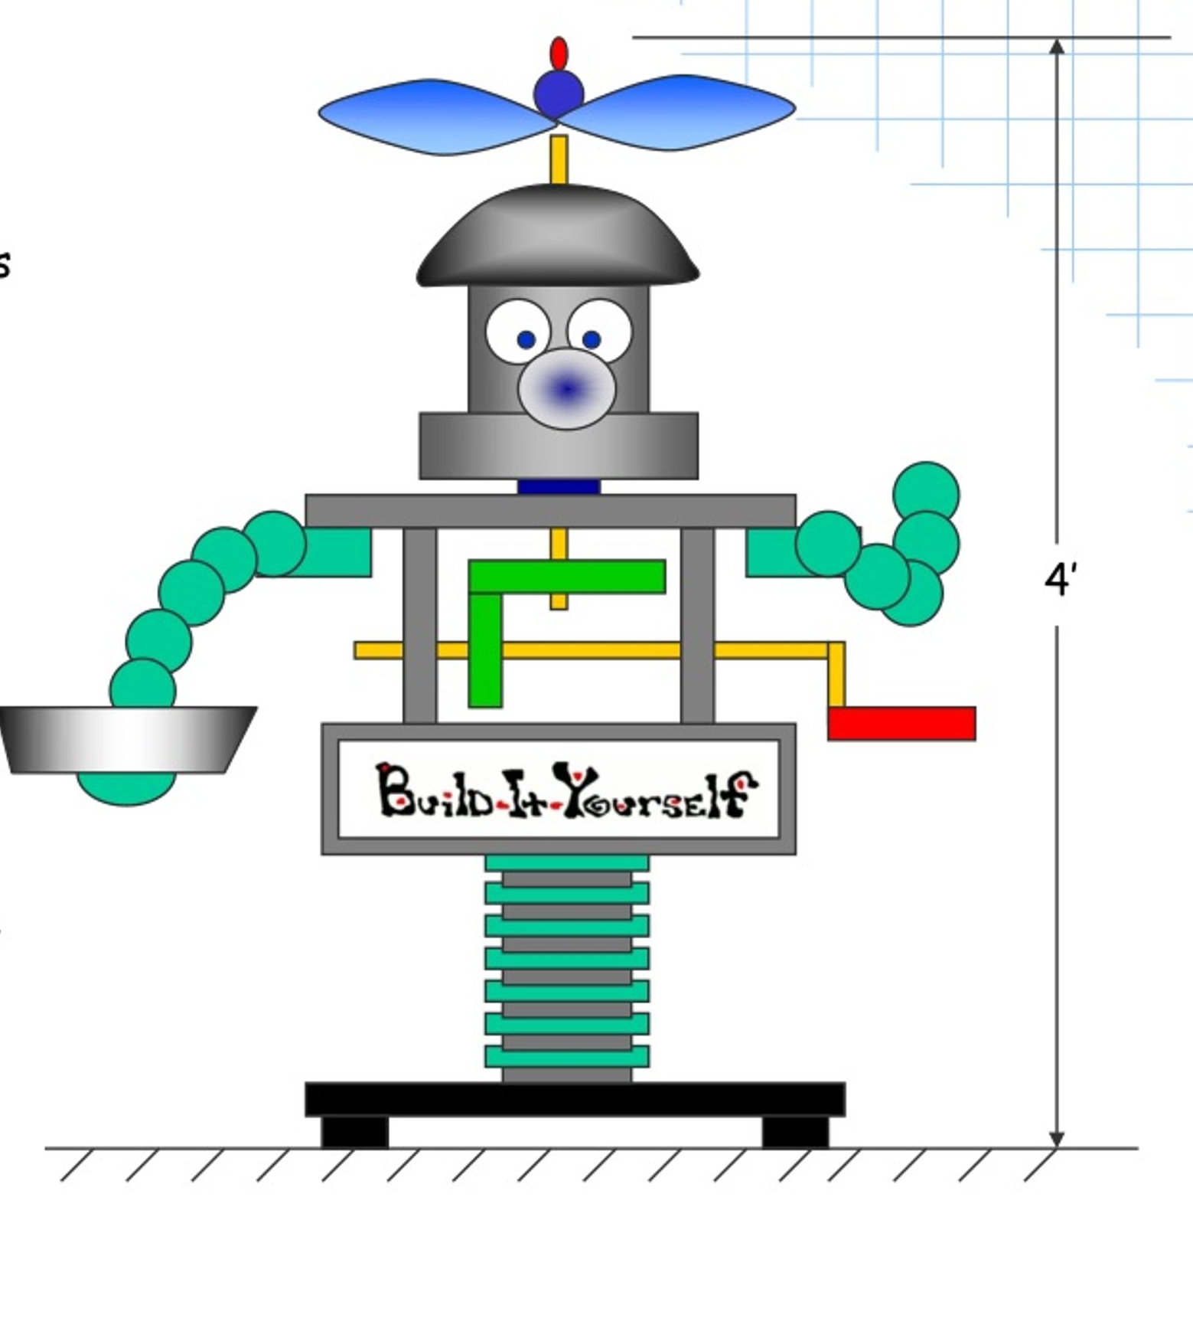
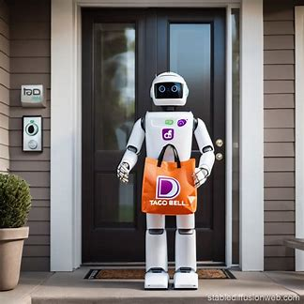
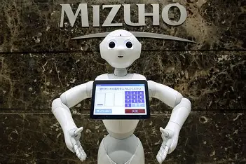
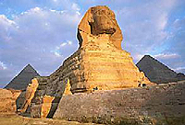
Research Door Greeters
Build-It-Yourself.com

Slide 16
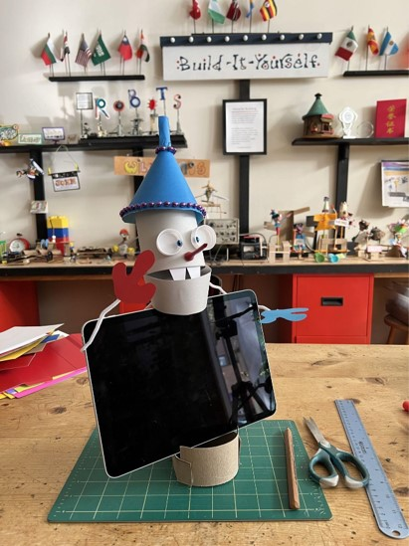
Robot Door Greeter
Build-It-Yourself.com

Slide 17
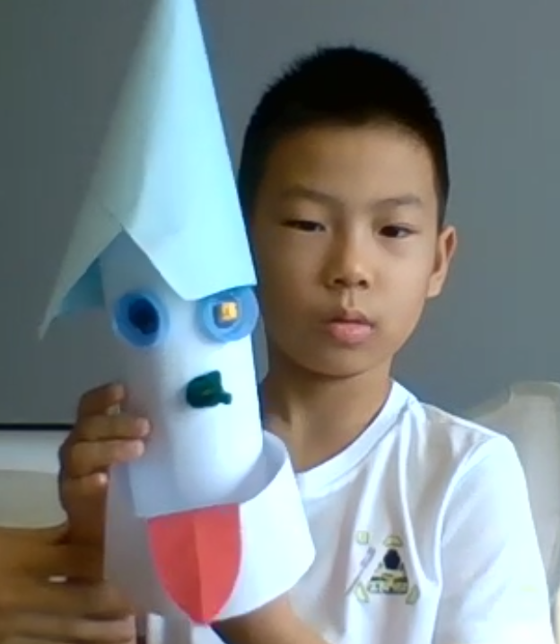
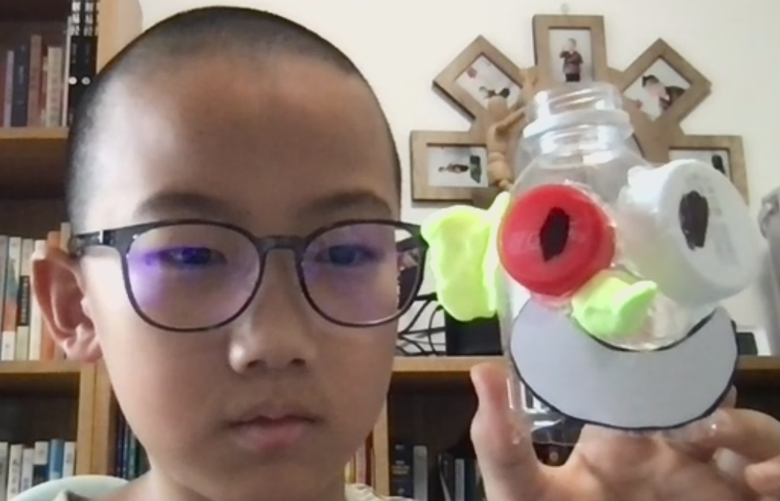
Robot Door Greeter
Yueyue
Bryan
Build-It-Yourself.com

Slide 18
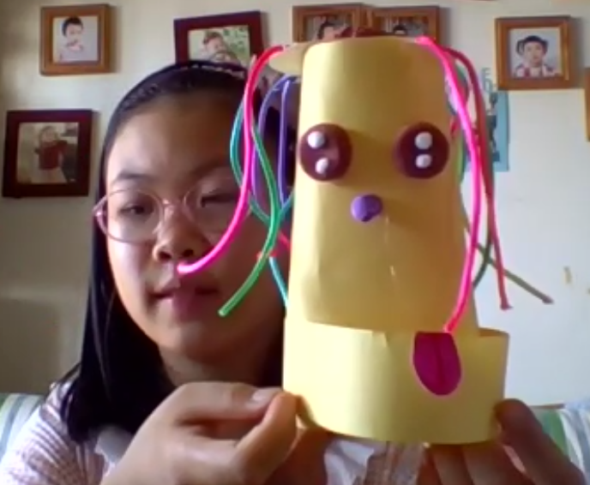
Robot Door Greeter
Laura
Lina
Build-It-Yourself.com

Slide 19
Robot Door Greeter
We want to program our robot to tell a joke and play music when the front door opens.
One solution is to build a mechanism that presses a key on your computer when a string attached to the door pulls.
Another solution is to use your computer mic to detect sound.
Another solution is to use your computer camera to detect motion.
Dancing Robot Video:
https://www.youtube.com/watch?v=fn3KWM1kuAw
Build-It-Yourself.com

Slide 20
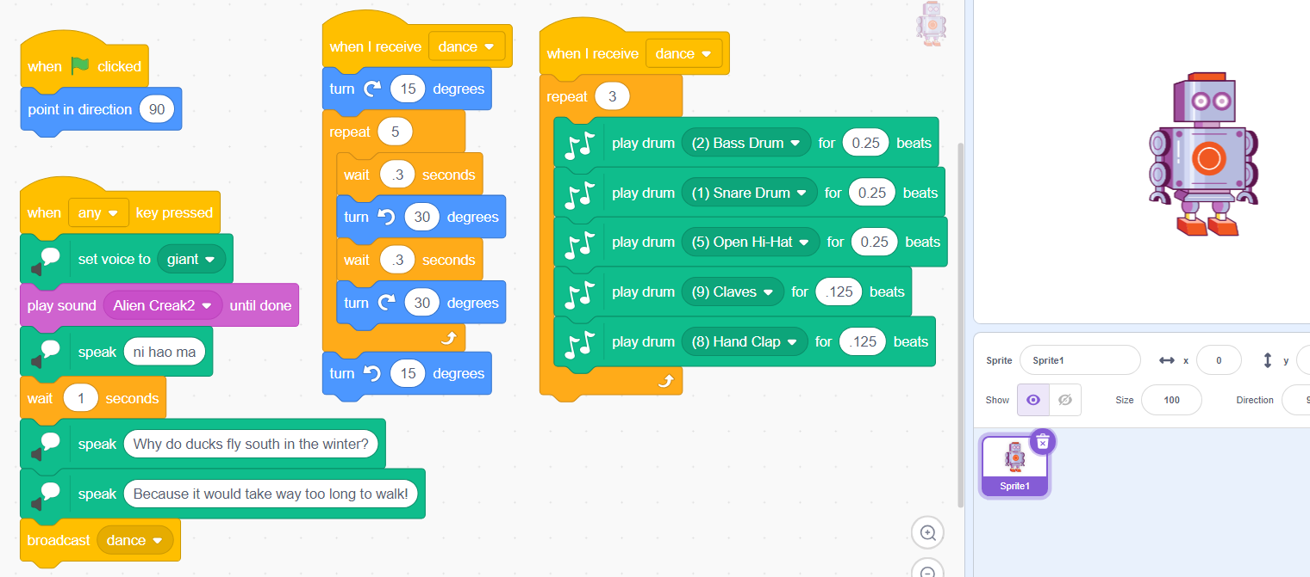
Robot Door Greeter
https://scratch.mit.edu/projects/1201913684/
Build-It-Yourself.com

Slide 23
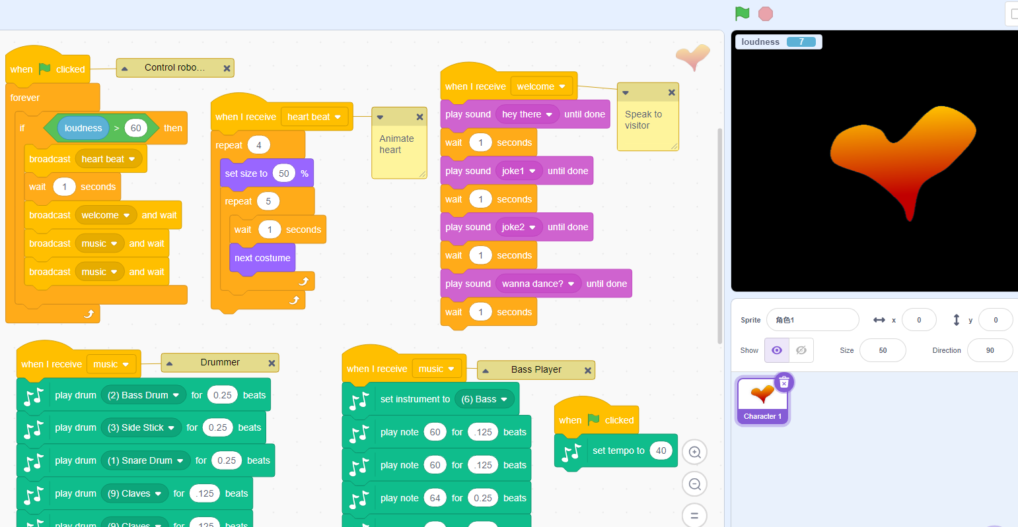
Robot Door Greeter
https://scratch.mit.edu/projects/1203370945
Build-It-Yourself.com

Slide 24

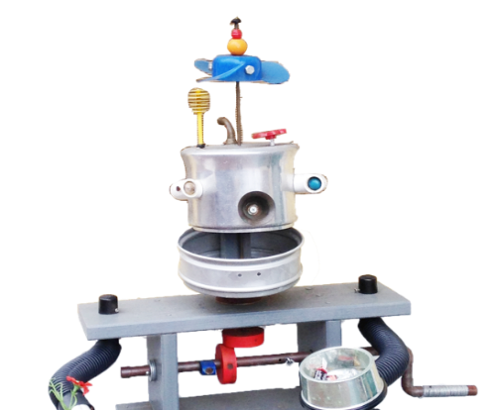
Welcome to the
Laboratory
We will start at 9 AM
On the agenda:
Review lab books.
Code your robot to tell a joke.
Please rename your Zoom picture.
Write your first name.
Build-It-Yourself.com

