Slide 1
Minecraft 104
Server Setup
Lab Book
Daniel, Vincent, Thomas and John
Build-It-Yourself.com

Slide 2
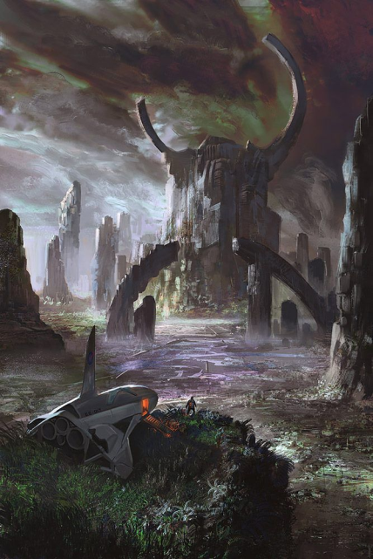
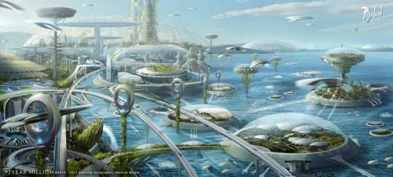
Problem
Being a Minecraft superhero or god can bring you much power, fame and fortune.
But POWER can be dangerous!
Many have used great powers to create evil worlds.
Mission
Use your new power to create a utopian Minecraft world that will make you and your buddies very happy.
Be the enlightened one!
Build-It-Yourself.com

Slide 3
Research
Evolution of Life:
1. Survive.
Learn how to navigate.
2. Build Tools.
Amazing inventions.
3. Play GOD, Be enlightened.
Control the environment.
Play
God
Build
Survive
Build-It-Yourself.com

Slide 4
Internet Safety
We must use our superpowers responsibly.
Risk vs. Reward
Risks:
Viruses can mess up your computer.
Bullies can make your life miserable.
People can spy on you.
???
Rewards:
Learn cool stuff.
Have fun.
Make friends.
Buy cool stuff.
???
Responsibility:
Don’t do anything you would be embarrassed to tell your parents.
Set up virus protection.
Open files that are certified.
Build-It-Yourself.com

Slide 5
Clients and Servers
Computer Architecture
Minecraft Client 1
URL Request
Domain Name Server
IP address
Minecraft Client 2
Routers and Switches
Request
Minecraft Server
Minecraft information that will be displayed on the Client screen
Minecraft Client 3
Build-It-Yourself.com

Slide 6
Install Minecraft Server
Install JAVA
https://www.java.com/en/download/
Install Minecraft Server
https://getbukkit.org/get/5OCD8708ewSALn1aNwprgECfb2DGhLhq
YouTube Video to install MC server on Mac iOS or Windows
https://www.youtube.com/watch?v=fpRzODyhrew
Build-It-Yourself.com

Slide 7
Research
10 Minecraft Servers
https://www.pcgamesn.com/minecraft/15-best-minecraft-servers
Build-It-Yourself.com

Slide 8
Minecraft Server Terminology
What is Java?
Java is a programming language. Minecraft is an application written in the Java programming language.
What is CraftBukkit?
CraftBukkit is a modified version of the basic Minecraft server files. CraftBukkit allows for plugins that can enhance the basic Minecraft server.
What is a Plugin?
Plugins allow you to expand what is possible with a vanilla server.
Plugins
https://www.curseforge.com/minecraft/bukkit-plugins
What is the difference between MODs and Plugins?
Plugins are enhancements to a program, usually on the client side.
MODs are modifications to the structure of a client/server application. Mods may be made to any combination of the server and the client.
Plugins and MODs tend not to work well together.
MODs may mean that everyone who uses the application may need to install software on both the client and the server.
Build-It-Yourself.com

Slide 9
Minecraft Server Terminology
What is an .EXE File?
.EXE files are executable files or program files.
What is a .BAT file? (or .command on Mac)
.EXE program files often use a .BAT text file to configure and set up links.
What is the difference between a .TXT and an .RTX file?
.TXT file is pure text. No font, size, color modifiers.
.RTX files contain size, color and font modifiers.
Build-It-Yourself.com

Slide 10
Minecraft Server Functionality
Minecraft Server Functionality
World edit
Protection Plugin
Bedwars (new materials)
Parkour Plugin
Skywars world
Plugins
https://www.curseforge.com/minecraft/bukkit-plugins
Build-It-Yourself.com

