Slide 1
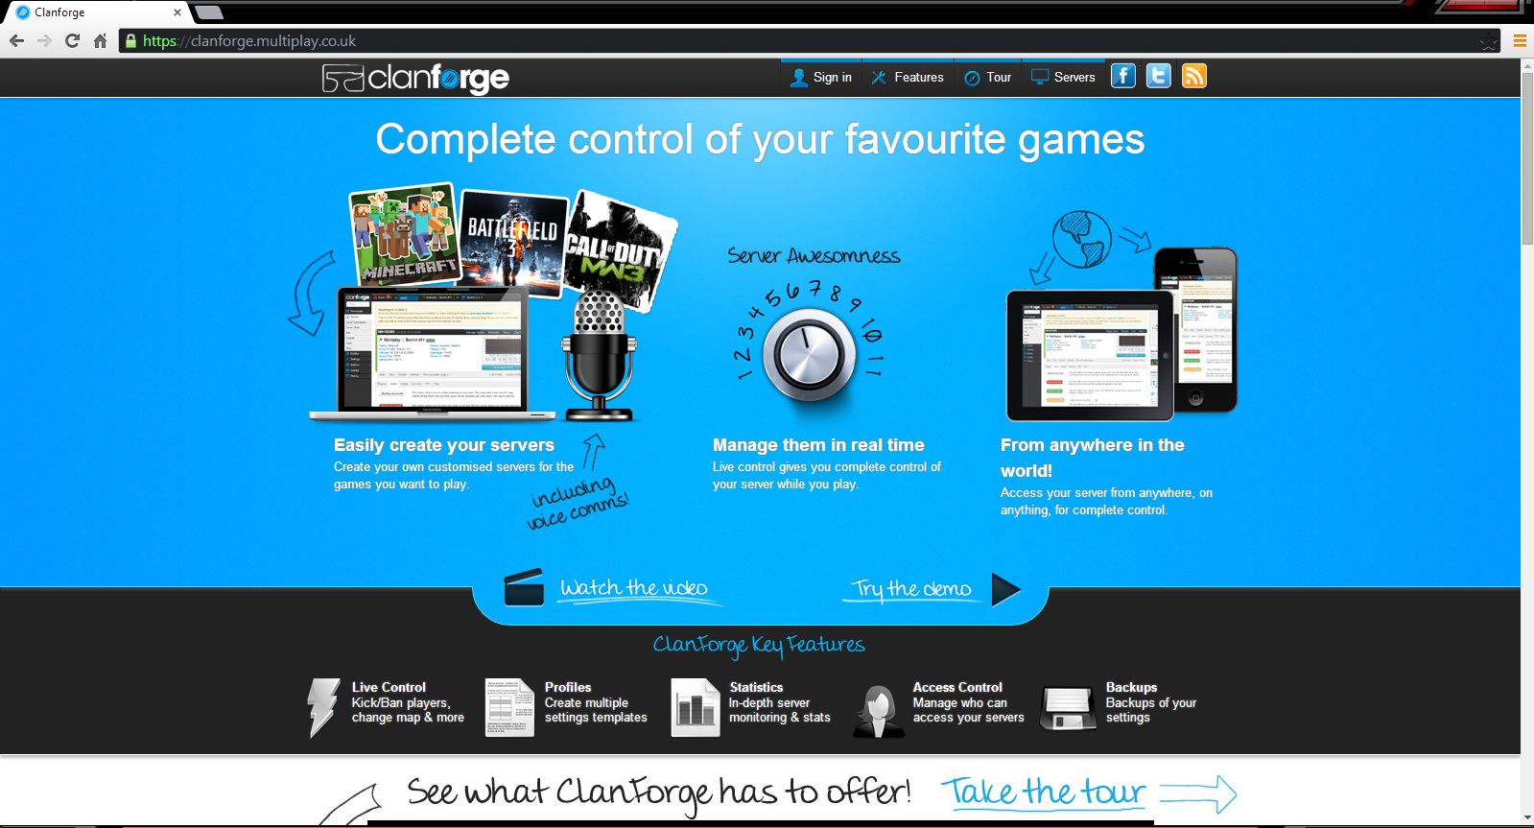
Logging in:
-Go to: clanforge.multiplay.co.uk
-Click Sign in

Slide 2
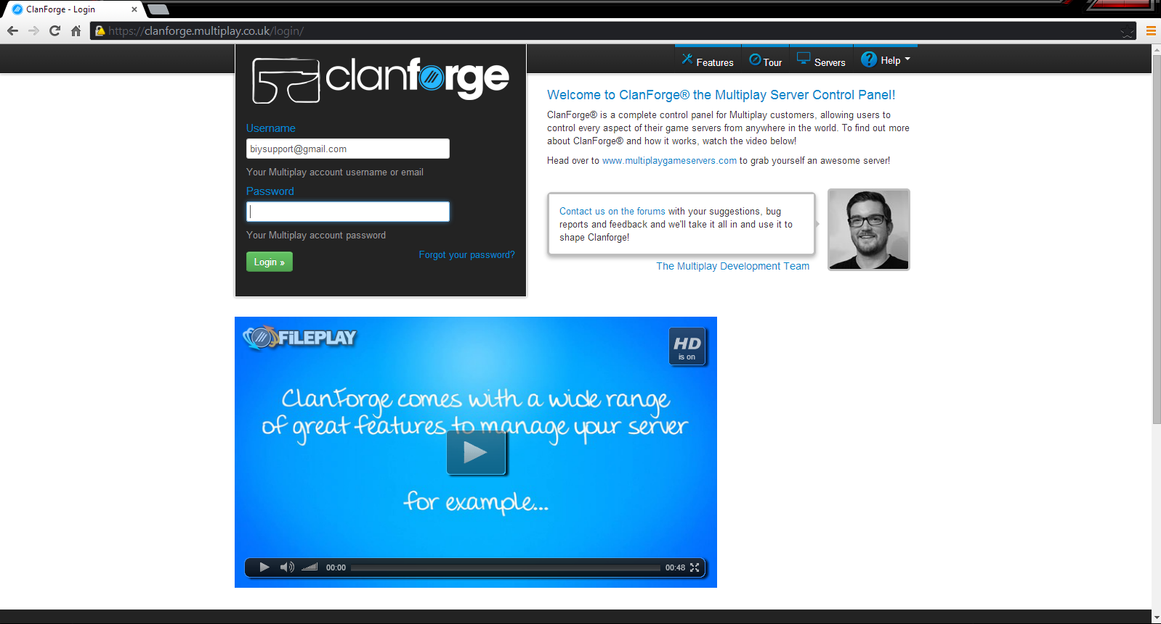
Username: biysupport@gmail.com
Password: RobotSushi1

Slide 3
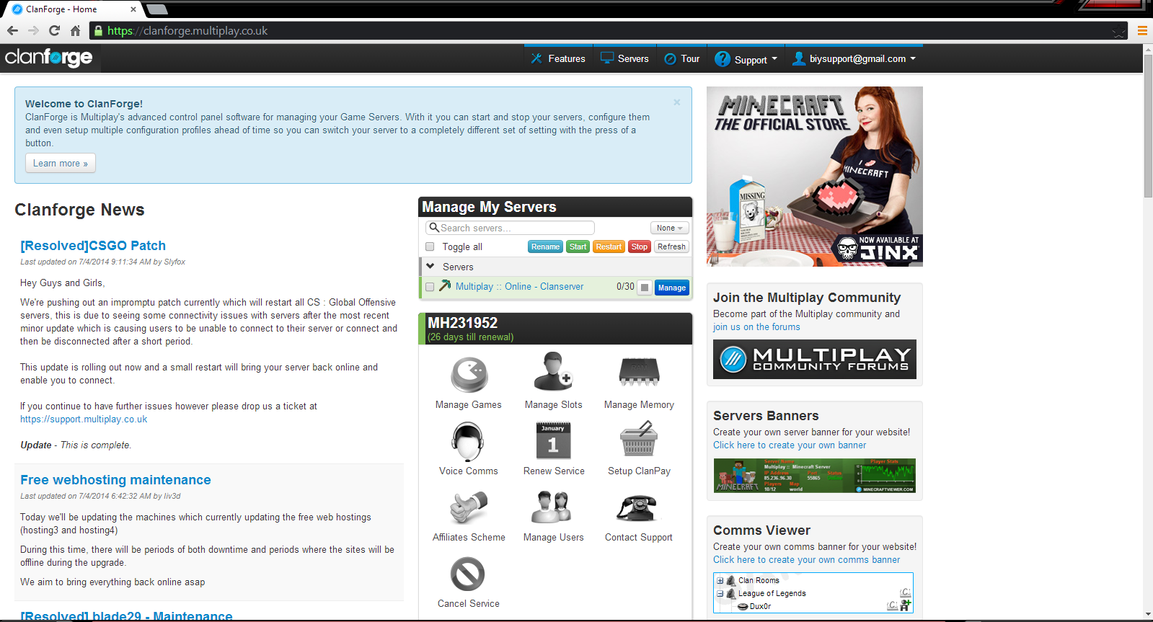
-Click: Manage

Slide 4
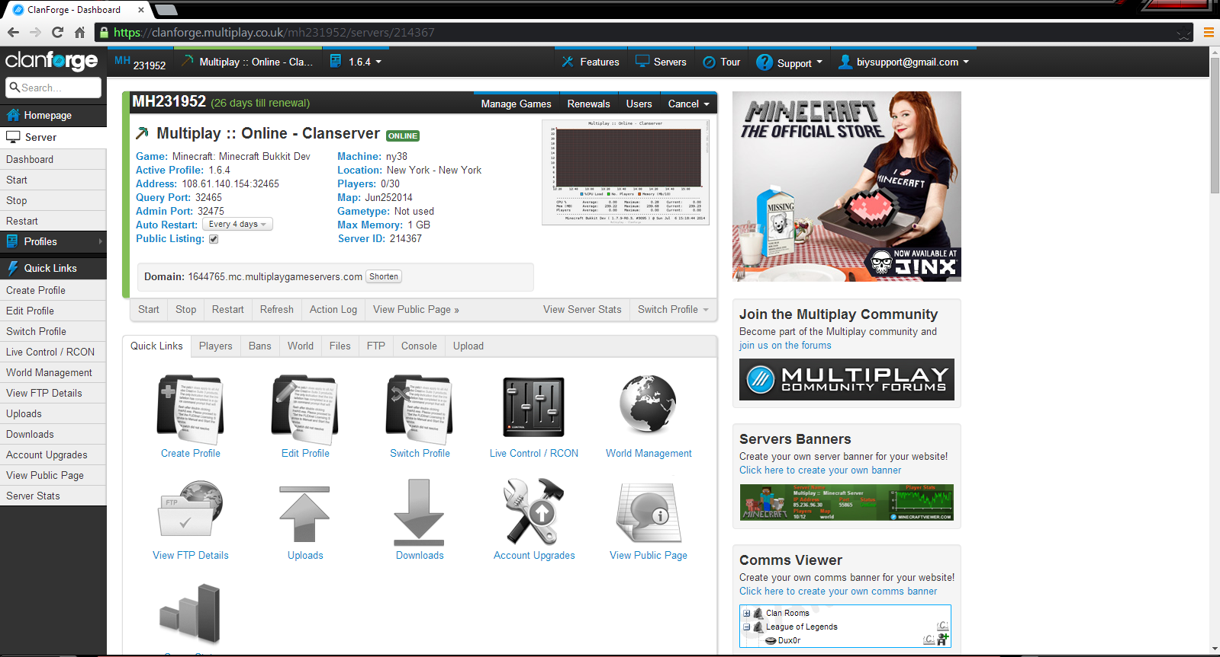
Start, Stop, and Restart: the “on/off” switch to the server.
Press Server on the right hand side if you cannot locate it.

Slide 5
RCON: is used for live control of the server (kicking/banning players, broadcasting,etc.)
World Management: used for backing up files and reloading those backups.

