Slide 1
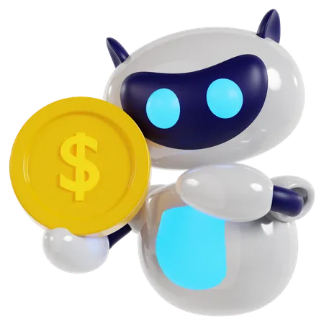
Robots That Earn Money
Lab Book
Kacey and Audrey

Slide 2
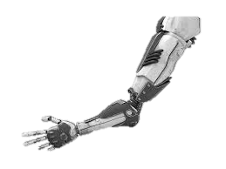
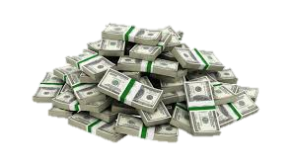
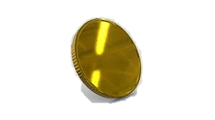
Problem
The economy is in big trouble! Many people don’t have enough money to support their families. Some big businesses and a handful of very greedy people are the only ones who have enough.
Mission
Our mission is to build a robot that brings value to the community
and earns money.

Slide 3
LAWS OF THE LAB
Be respectful to teammates (notice we didn’t say teammates ONLY)
Respect your materials
Don’t do dumb stuff…

Slide 4
Tool Rules
Don’t cut off your finger
Hold work firmly
Keep away from all eyes
Think about what will happen if you slipped
Clean up

Slide 5
Problem Solving Tricks
Focus-ID the problem and set goals.
Research and dream-don’t reinvent the wheel.
Teamwork-share ideas.
Simplify-break your solution into simple parts.
Document-keep a lab book.

Slide 6
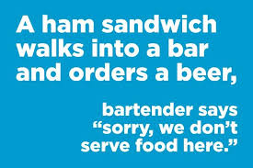
JOKES
(for the program)

Slide 7
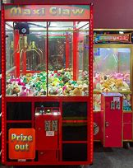
Robots that earn $$ research
Vending machine-snacks, drinks, or both. $2000 to $5000 price. Components: a cabinet to hold all internal components, a coin mechanism, a bill validator, a card reader, a control board like the “brain” of the machine, the storage, the dispensing mechanism, a refrigeration unit, a delivery bin and a display panel.
Cotton candy machine-made of heating element to melt sugar into sugar floss, a spinning head to stretch melted sugar, a collecting bowl to collect the sugar strands, and a motor to power a spinning head.
Gumball machine has a globe that holds the gumballs, a coin mechanism that detects the coin to dispense a gumball (coin slot, coin return, verification of authenticity), a dispensing mechanism to release a gumball when the coin is inserted, consists of a rotating disk w/ holes to align to the chute (the knob you turn is connected). A gumball machine also has a chute that guides the gumball to the customer (like a track for the gumball), and a base to keep the machine stable.
arcade machines-$1,000 to $5,000. Usually has “cabinet”, main housing has every internal component, a screen/monitor to display stuff, a control panel (joysticks, buttons, spinners, steering wheels, etc.) a power supply, Printed Circuit Boards which is the hardware, it’s hidden in the cabinet. Arcade Machines also have a coin mechanism or card reader.
ATMs-earn money from transaction fees, $2000 to $8000.

Slide 8
Robot Ideas-service for 25 cents
Spray cool water on a hot summer day
Fortune teller
Music player

Slide 9
SOCIALISM
Socialism is more forgiving. Everybody gets the same pay, no matter the amount of effort. However, talented people may go unnoticed, and some might grow lazy just waiting for their daily pay. This is more relaxing if you are fine with only average pay, because this gives people more time.
Capitalism is more competitive. However, capitalists have bigger chances and are rewarded more for more effort, so that seems fair. This is less forgiving though, since a mistake could result in way less pay. Kacey and Audrey would rather live In this kind of world!
Vs.
CAPITALISM

Slide 10
Presenting Your Ideas
UGLY/ball of lint
Average…snore
Very Cool (the Kacey and Audrey way)

Slide 11
THE END

