Slide 1

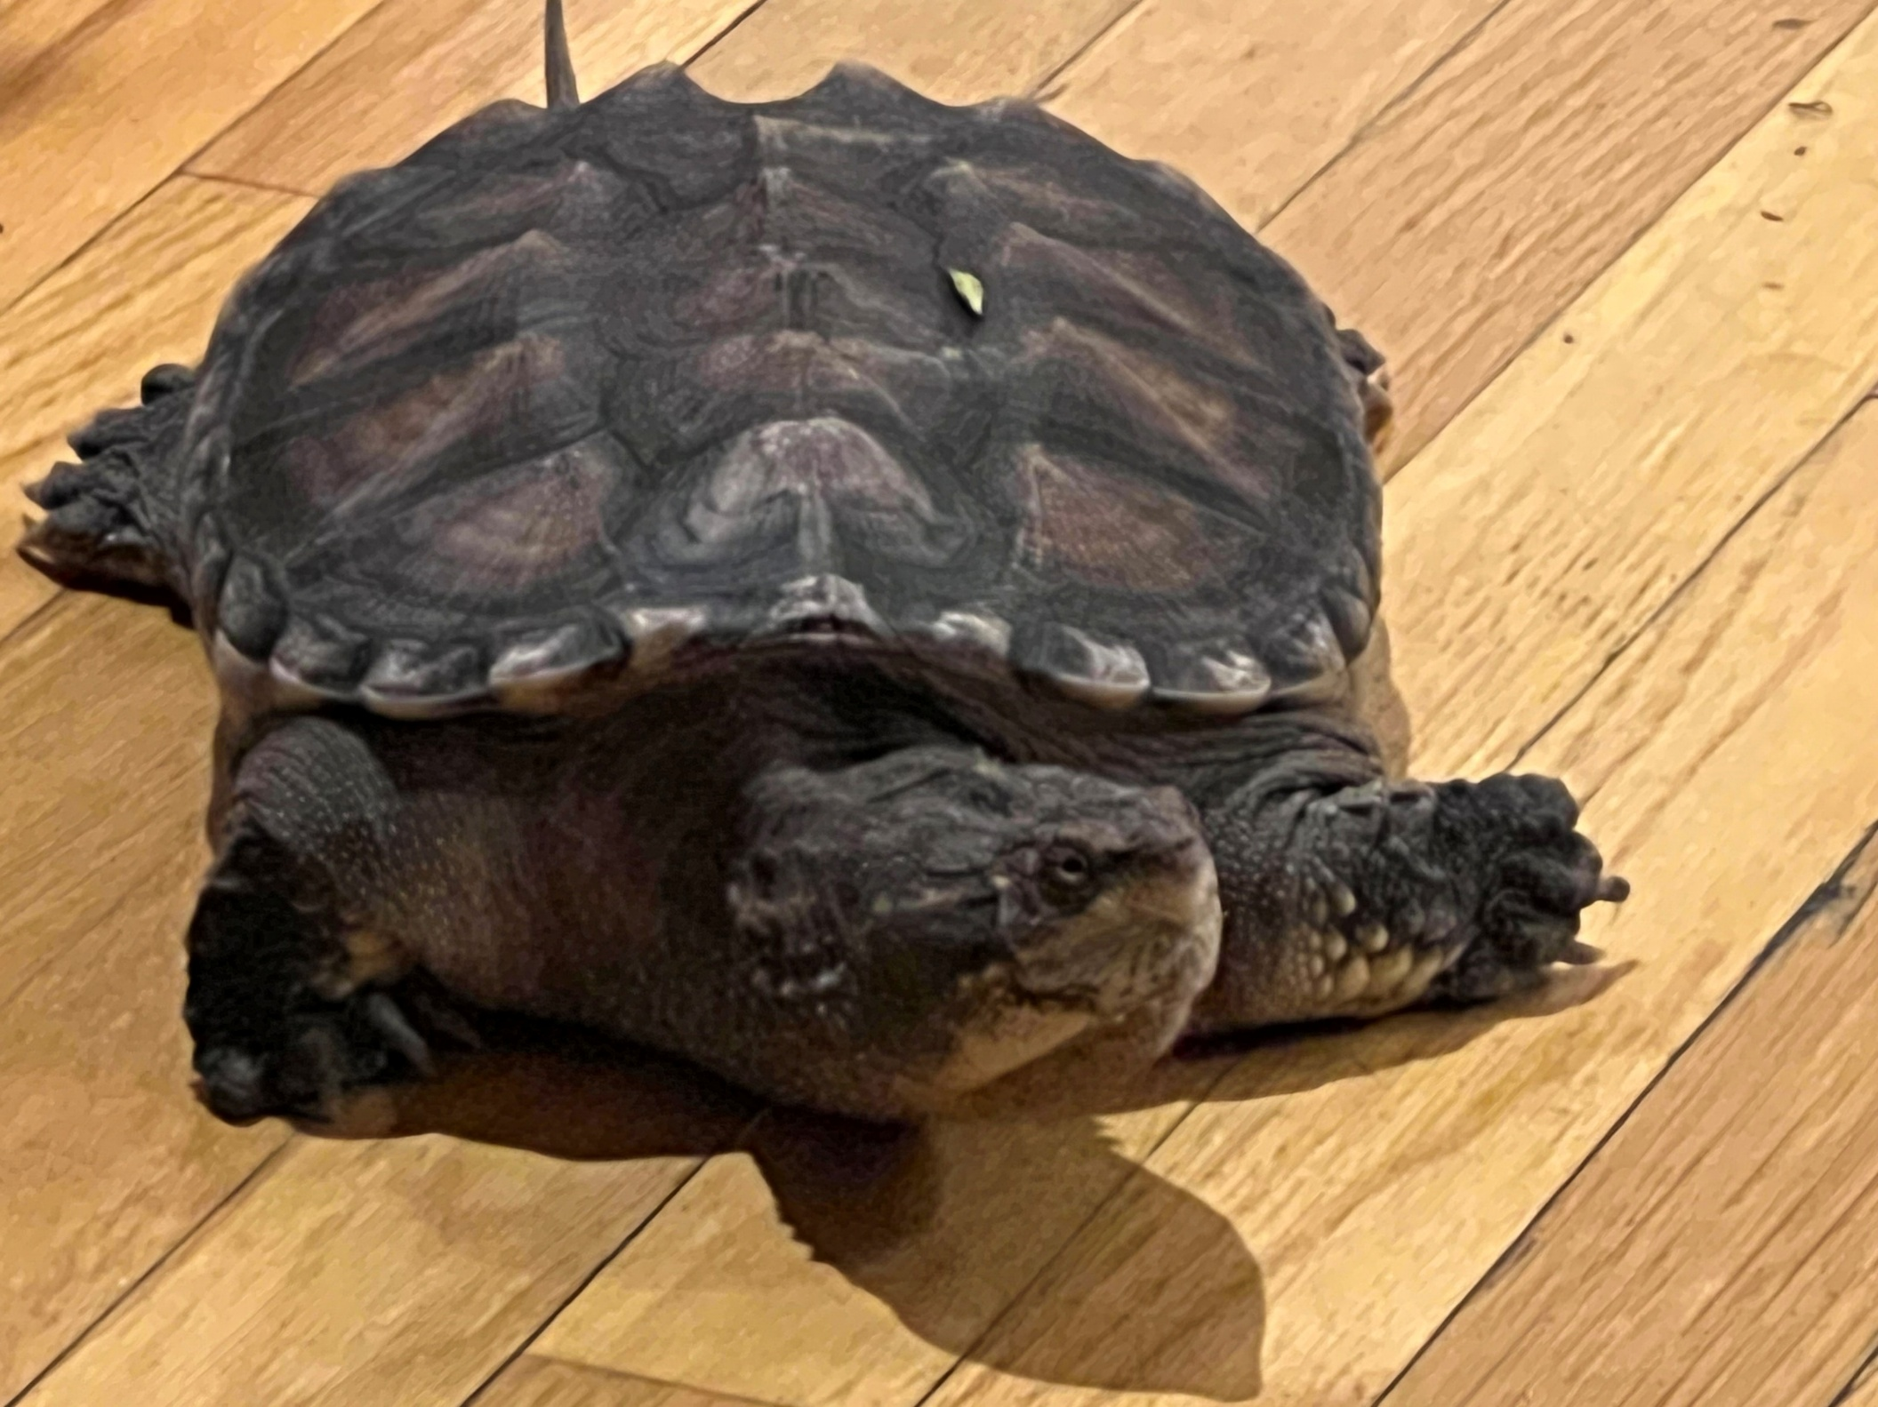

Laboratory
Meet Dino Slomo — the Build‑It‑Yourself resident snapping turtle and part‑time philosopher.
www.build-it-yourself.com

Slide 2
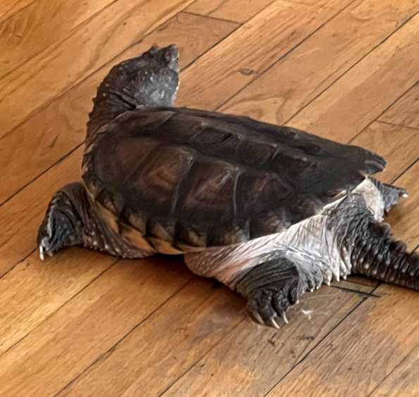
Laboratory
Dino is a lover, not a fighter.
www.build-it-yourself.com

Slide 3
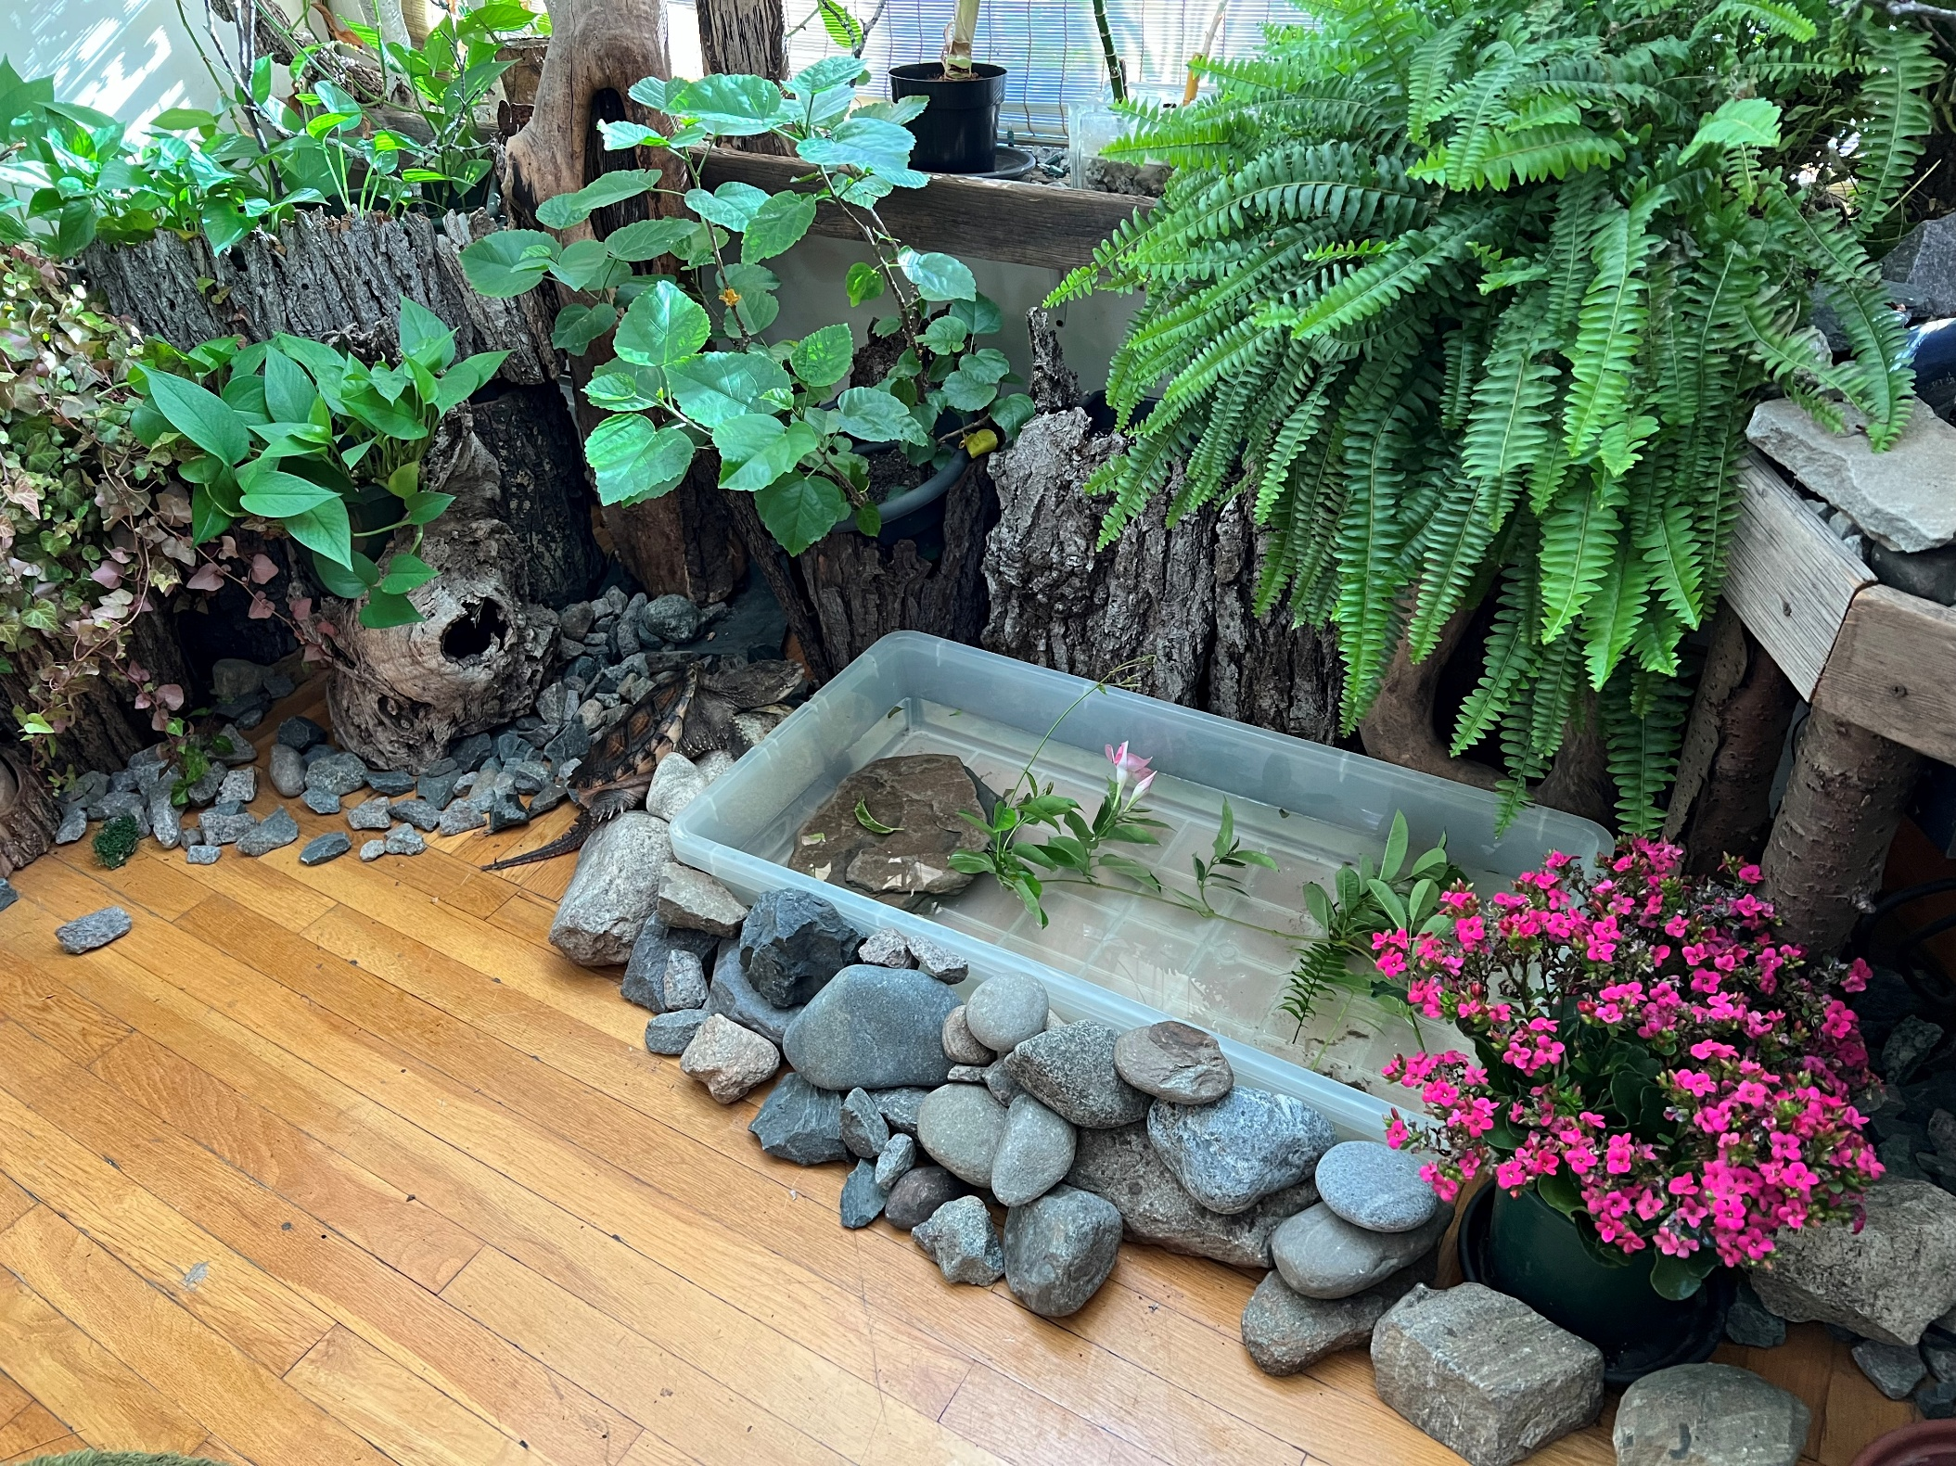
Laboratory
He spends most days chilling in the BIY jungle garden, contemplating life, lettuce, and why humans walk so fast when slow‑and‑steady clearly works just fine.
www.build-it-yourself.com

Slide 4
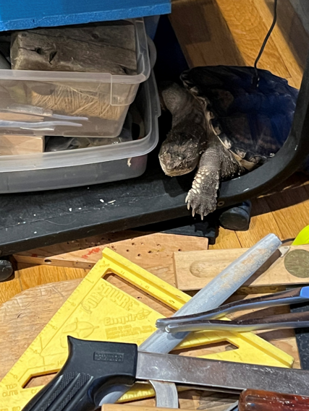
Laboratory
Sometimes Dino roams the BIY lab, where he inspects all the way‑cool projects with the calm authority of a turtle who has seen many things.
www.build-it-yourself.com

Slide 5
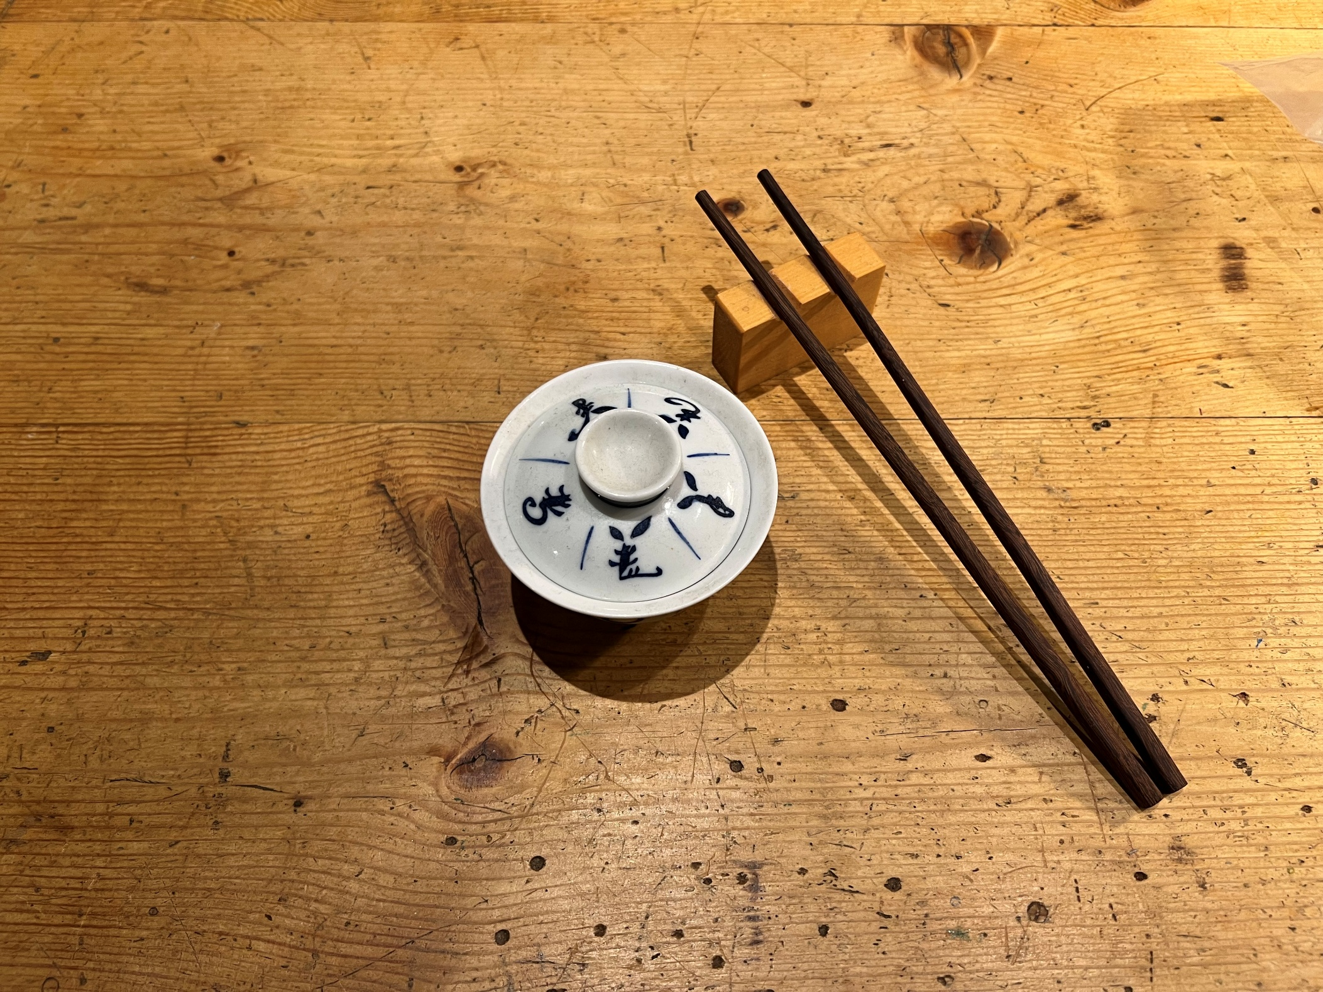
Laboratory
Dino has access to a fine menu of elegant crickets and gourmet worms…
www.build-it-yourself.com

Slide 6
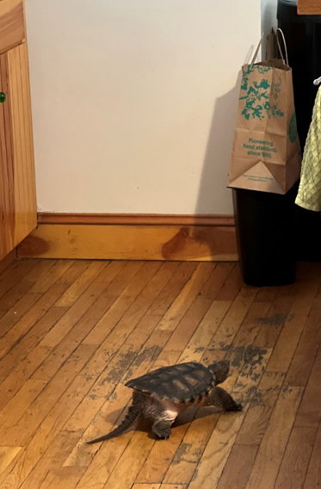
Laboratory
…but being a proper snapping turtle, he prefers the garbage barrels. Nothing says “five‑star dining” like yesterday’s leftovers.
www.build-it-yourself.com

Slide 7

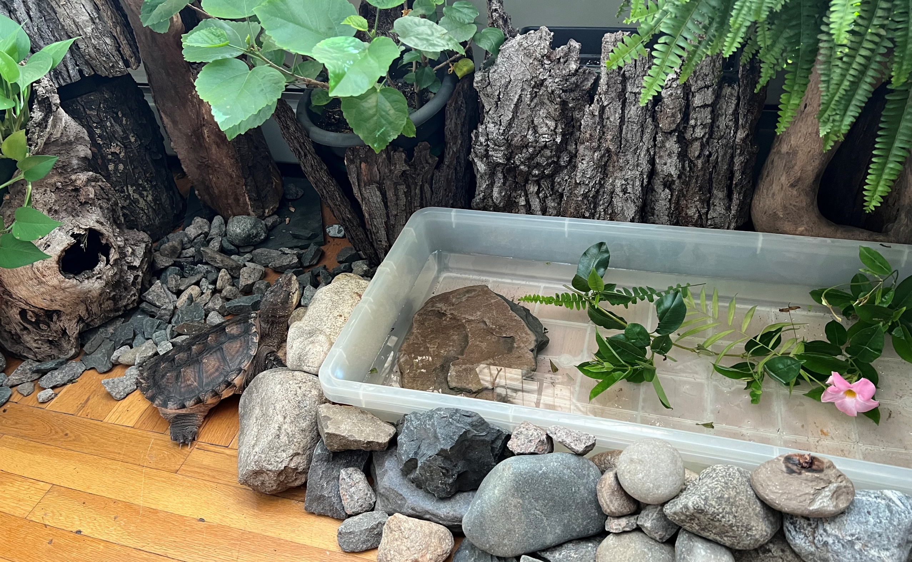
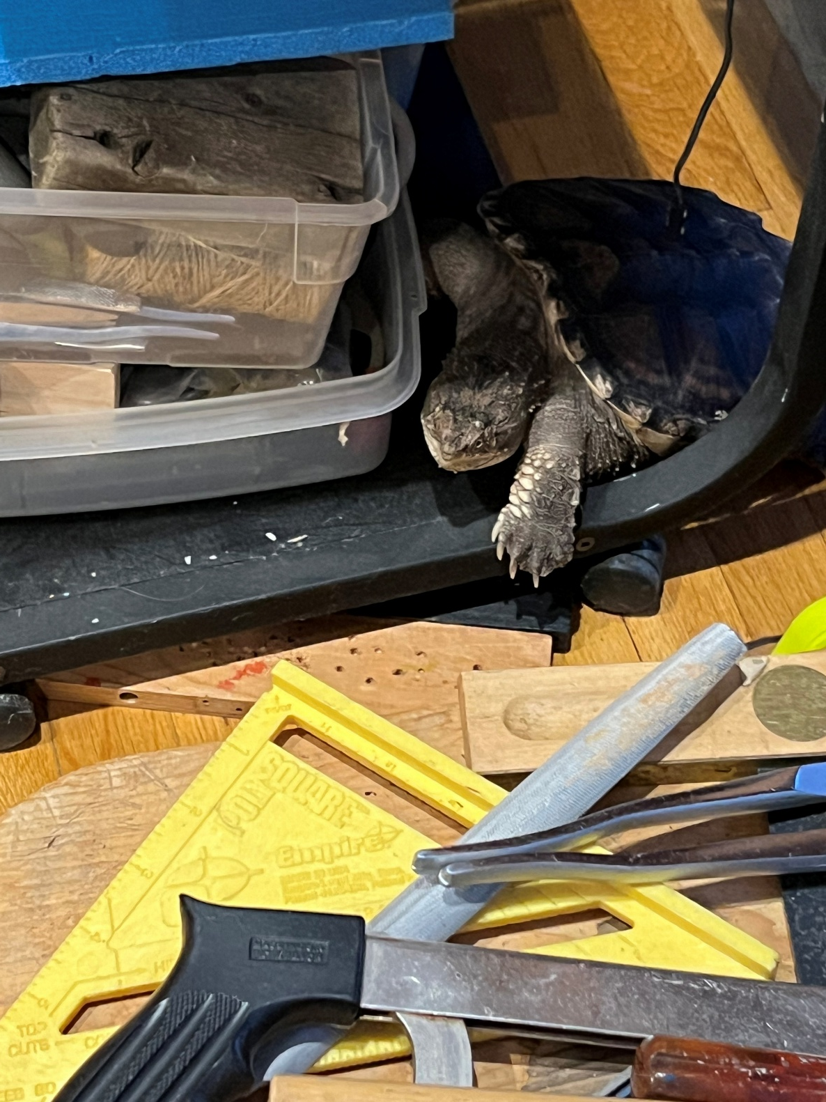
Laboratory
And after a long, meaningful day of supervising creativity, snacking heroically, and moving at the speed of wisdom, Dino Slomo returns to his pond and cozy hole—his happy place, his fortress of solitude, his turtle spa.
www.build-it-yourself.com

