Slide 1
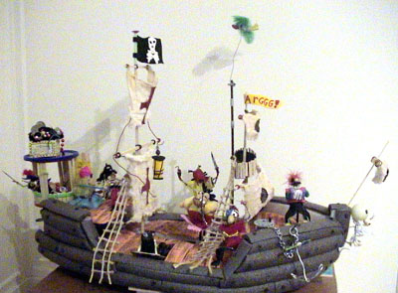
RC Pirate Boats
“Avast, ye yellow scallywag”

Slide 2
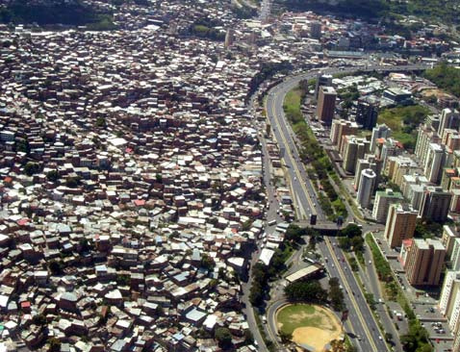
The Problem
Some people complain that the rich are too rich and the poor are too poor.

Slide 3
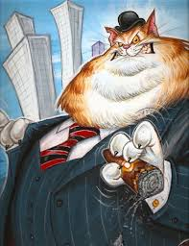
The Mission
Your mission is to search the seas for fat bankers
have too much money and redistribute the wealth.
"Avast ya bloody, nat brain, pigeon gut, lying weasel,
double talking politician! Yer money or yer life."
Document the problem and the mission in your lab book in your own words.

Slide 4
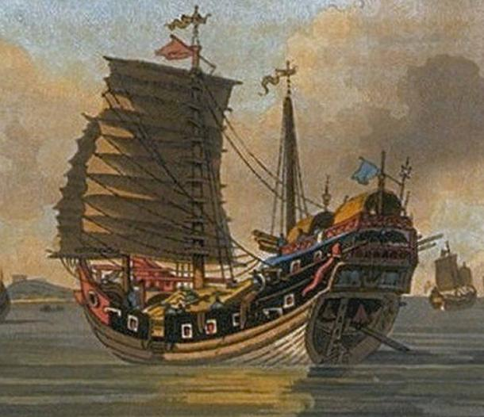
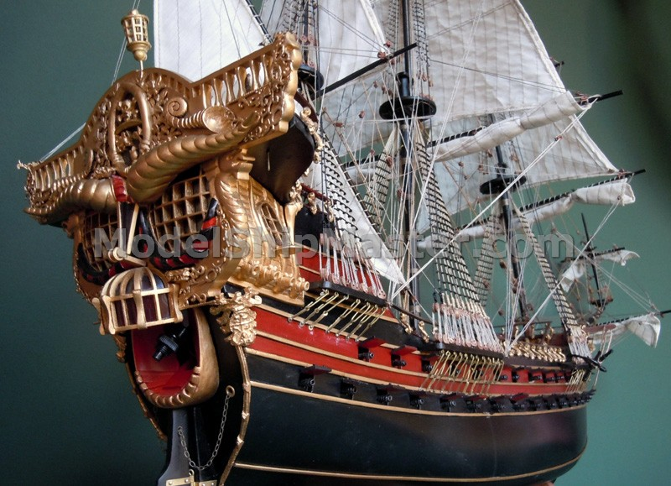
Research
Search the Google seas for proper pirate boats.

Slide 5
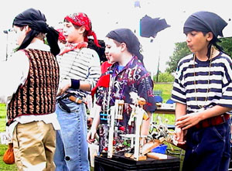
Research
If you want to be a pirate, you have to look and talk like a pirate.
Talk like a pirate:
Google and document 5 pirate expressions in your lab book
Look like a pirate:
Make notes in your lab book about what you will make at home to look like a pirate.

Slide 6
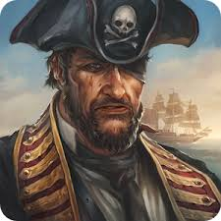
Project Plan and Skills Needed
Project Plan:
Document work in a PowerPoint lab book.
Learn to talk and look like a pirate
Become a master model ship builder.
Skills Needed:
PowerPoint Guru
Problem Solver
Master Designer
Modular Constructor
Hot Shot Programmer
Pirating

Slide 7
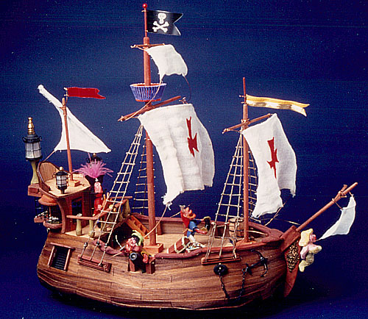
Hall of Fame
Built by Captain John

Slide 8
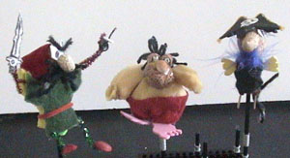
Break Mission Into Simple Parts
Pirates
Base
Sides
Decks
Masts
Sails
Captain’s Cabin
Flags
Treasure Chest
Gang plank
Lanterns
Climbing ropes
Crow’s Nest
Birds
Masthead
Cannons
Dragon
Mermaid

Slide 9
Break Mission Into Simple Parts
Pirates
Base
Sides
Decks
Masts
Sails
Captain’s Cabin
Flags
Treasure Chest
Gang plank
Lanterns
Climbing ropes
Crow’s Nest
Birds
Masthead
Cannons
Dragon
Mermaid
1’ x 2.5” x 1/8” Basswood
Hot glue pieces together.

Slide 10
Break Mission Into Simple Parts
Pirates
Base
Sides
Decks
Masts
Sails
Captain’s Cabin
Flags
Treasure Chest
Gang plank
Laterns
Climbing ropes
Crow’s Nest
Birds
Masthead
Cannons
Dragon
Mermaid
Top view
Side view
3’ pipe insulation cut in half
Hot glue pipe insulation pieces

Slide 11
Break Mission Into Simple Parts
Pirates
Base
Sides
Decks
Masts
Sails
Captain’s Cabin
Flags
Treasure Chest
Gang plank
Lanterns
Climbing ropes
Crow’s Nest
Birds
Masthead
Cannons
Dragon
Mermaid
Top view
Hot glue foam rubber pieces to support the decks
Side view

Slide 12
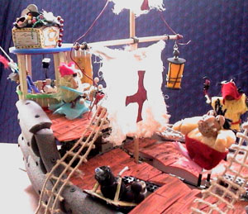
Break Mission Into Simple Parts
Pirates
Base
Sides
Decks
Masts
Sails
Captain’s Cabin
Flags
Treasure Chest
Gang plank
Lanterns
Climbing ropes
Crow’s Nest
Birds
Masthead
Cannons
Dragon
Mermaid

Slide 13
Break Mission Into Simple Parts
Pirates
Base
Sides
Decks
Masts
Sails
Captain’s Cabin
Flags
Treasure Chest
Gang plank
Lanterns
Climbing ropes
Crow’s Nest
Birds
Masthead
Cannons
Dragon
Mermaid
Use chop sticks for vertical pieces. Use coffee stirrer sticks for horizontal pieces. Hot glue and wrap string around joints for strength.
Glue 2 chop sticks for main mast
Stick masts into foam rubber.
Stick masts into foam rubber.

Slide 14
Break Mission Into Simple Parts
Pirates
Base
Sides
Decks
Masts
Sails
Captain’s Cabin
Flags
Treasure Chest
Gang plank
Lanterns
Climbing ropes
Crow’s Nest
Birds
Masthead
Cannons
Dragon
Mermaid
wire
3” x 6” cloth
Fold cloth and hot glue over wire.

Slide 15
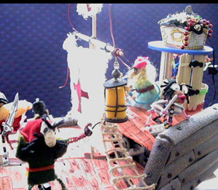
Break Mission Into Simple Parts
Pirates
Base
Sides
Decks
Masts
Sails
Captain’s Cabin
Flags
Treasure Chest
Gang plank
Lanterns
Climbing ropes
Crow’s Nest
Birds
Masthead
Cannons
Dragon
Mermaid
Laminate 2 or 3 pieces of foam rubber for the top and bottom of the captain’s cabin.
Hot glue coffee stirrer sticks for the sides of the captain’s cabin.
The height of the cabin should be just enough so your pirates can stand inside.
Decorate you cabin with flowers, signs, a Persian rug and treasure chest

Slide 16
Break Mission Into Simple Parts
Pirates
Base
Sides
Decks
Masts
Sails
Captain’s Cabin
Flags
Treasure Chest
Gang plank
Lanterns
Climbing ropes
Crow’s Nest
Birds
Masthead
Cannons
Dragon
Mermaid

Slide 17
What we should know
How to think outside the box
How to make people laugh
Benefits of modular construction
How to tell a compelling story
Advanced Projects:
Design graffiti signs
Build more elaborate modules
Create a video

