Slide 1
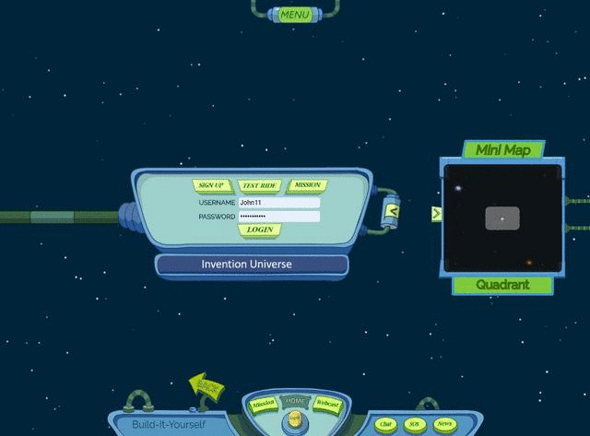
Invention Universe
Maker Portfolio
An alternate cosmic showcase
where ordinary is an alien concept.
Notes:
Welcome to the Build-It-Yourself Laboratory

Slide 2
The Problem
There are 8,000,000,000
(8 Billion)
people on our good earth!
Everyone has smarts.
Is it important to stand out from the masses?
How can we get the attention we deserve?
Approved
JG
Date
Apr 2024
Project
Portfolio V1.0
Notes:
Imagine you have invented a magical formula for peanut butter that makes one smarter.
You need to get a ton of money from a bank to bring your peanut butter to market.
But many inventors are asking banks for their money.
How do you impress the bank that they should bet on you?
Recently 1100 applicants to Harvard University with perfect SAT scores were rejected.
Schools and companies are looking for talent beyond good test takers.
How can you present your ideas and passions so you get the attention you deserve?

Slide 3
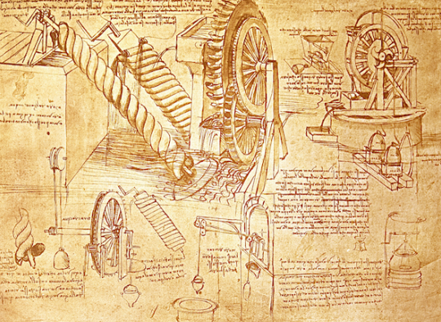
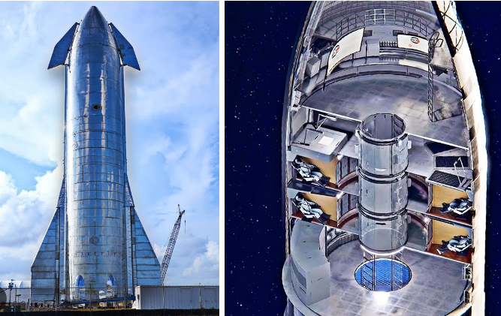
The Mission
Be different …
Create a planet on Invention Universe that celebrates and promotes your differences.
Show off your portfolio of accomplishments.
Approved
JG
Date
Apr 2024
Project
Portfolio V1.0
Notes:
Before building, a good engineer will define the problem and set goals.
This is an opportunity to talk about
being an entrepreneur
the pros and cons of capitalism and socialism.

Slide 4
Copilot response to the prompt:
Hi Copilot ... Please help me make this game introduction more playful, dramatic, and engaging for kids 8 - 12
---------------------------------------
The Planet of Infinite Uniqueness in a Cosmic Showcase
Attention, cosmic trailblazers! Buckle up your stardust boots and adjust your celestial goggles, for we’re embarking on a voyage to the extraordinary—a place where individuality reigns supreme, and every quirk, talent, and spark of brilliance is celebrated like a meteor shower on New Year's Eve!
The Cosmic Conundrum
Picture this: In the vast expanse of the Invention Universe, where galaxies twirl like cosmic ballet dancers, there exists a planet unlike any other. It’s called Zygoterra, and it’s where the cosmic rulebook gets tossed out the spaceship window. Why? Because on Zygoterra, being ordinary is as rare as finding a unicorn sipping moonbeam tea.
The Eight Billion Symphony
Yes, my fellow star-hoppers, Zygoterra is home to precisely eight billion inhabitants—each one a dazzling note in the grand symphony of existence. From the intergalactic poets who compose sonnets using quasars as ink to the nebula-navigators who pirouette through wormholes, everyone here has a cosmic calling card.
The Celestial Showcase
Step onto Zygoterra’s kaleidoscopic soil, and you’ll encounter beings as diverse as the constellations themselves:
The Chromatic Chameleons: These shape-shifting artists morph into their favorite colors—sometimes simultaneously! Their gallery exhibits hues unknown to our earthly eyes: Quantum Plum, Stardust Teal, and Nebula Fuchsia.
The Harmonious Hummers: These musical maestros don’t just hum—they harmonize with solar winds, compose symphonies using pulsars, and turn asteroid collisions into percussive beats. Their hit single? “Cosmic Crescendo.”
The Botanical Dreamweavers: Their gardens bloom with sentient flowers that recite poetry, vines that dance the foxtrot, and bonsai trees that tell bedtime stories. Their motto: “Photosynthesis and whimsy go hand in hand.”
The Quasar Quillscribes: Their libraries overflow with scrolls written in starlight ink. They pen sagas about black hole romances, time-traveling librarians, and the lost art of folding origami supernovae.
Your Mission: Create a cosmic portfolio
Now, dear traveler, it’s your turn! As you step onto Zygoterra, bring forth your cosmic portfolio—a holographic scroll that unfurls your quirks, passions, and accomplishments:
🌌 The Nebula Whisperer: Did you tame a rogue nebula with a lullaby? Share it!
🚀 The Quantum Tinkerer: Built a warp drive out of recycled stardust? Show it off!
🌈 The Aurora Choreographer: Choreographed a dance of auroras across the polar skies? Bravo!
🌟 The Comet Cartographer: Mapped constellations using glitter pens? Stellar work!
Remember, on Zygoterra, standing out isn’t just encouraged—it’s mandatory. So, fellow cosmic wanderer, let your uniqueness unfurl like a cosmic tapestry. And when the interstellar spotlight finds you, twirl, pirouette, and wink at the moon. 🌠✨
Welcome to Zygoterra—the planet where ordinary is an alien concept!

Slide 5
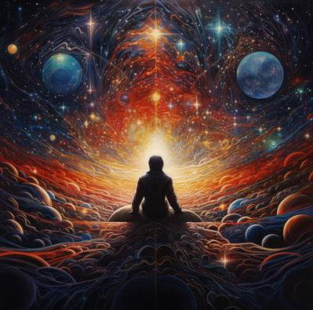
Overview
Attention, cosmic trailblazers!
Buckle up your stardust boots and adjust your celestial goggles.
We’re embarking on a voyage to an alternate universe, a place where individuality reigns supreme, and every quirk, talent, and spark of brilliance is celebrated like a meteor shower on your birthday.
Approved
JG
Date
Apr 2024
Project
Portfolio V1.0
Notes:
Imagine you have invented a magical formula for peanut butter that makes one smarter.
You need to get a ton of money from a bank to bring your peanut butter to market.
But many inventors are asking banks for their money.
How do you impress the bank that they should bet on you?
Recently 1100 applicants to Harvard University with perfect SAT scores were rejected.
Schools and companies are looking for talent beyond good test takers.
How can you present your ideas and passions so you get the attention you deserve?

Slide 6
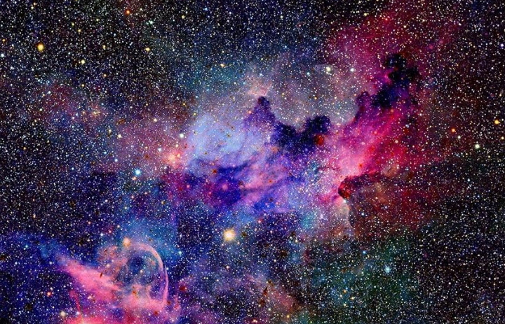
Overview
Picture this: In the vast expanse of space, there exists an alternate universe.
It’s called Invention Universe, and it’s where the cosmic rulebook gets tossed out the spaceship window.
Why? Because in this special place, being ordinary is as rare as finding a unicorn sipping moonbeam tea.
Approved
JG
Date
Apr 2024
Project
Portfolio V1.0
Notes:
Imagine you have invented a magical formula for peanut butter that makes one smarter.
You need to get a ton of money from a bank to bring your peanut butter to market.
But many inventors are asking banks for their money.
How do you impress the bank that they should bet on you?
Recently 1100 applicants to Harvard University with perfect SAT scores were rejected.
Schools and companies are looking for talent beyond good test takers.
How can you present your ideas and passions so you get the attention you deserve?

Slide 7
The Problem
An 8 Billion Cosmic Conundrum.
Yes, my fellow star-hoppers, our planet earth is home to over eight billion inhabitants.
Sometimes, there is unbearable pressure to follow traditional, silly rules that tend to make us all look the same.
Approved
JG
Date
Apr 2024
Project
Portfolio V1.0
Notes:
Imagine you have invented a magical formula for peanut butter that makes one smarter.
You need to get a ton of money from a bank to bring your peanut butter to market.
But many inventors are asking banks for their money.
How do you impress the bank that they should bet on you?
Recently 1100 applicants to Harvard University with perfect SAT scores were rejected.
Schools and companies are looking for talent beyond good test takers.
How can you present your ideas and passions so you get the attention you deserve?

Slide 8
The Mission
Now, dear fellow traveler, it’s your turn!
Beam yourself up to Invention Universe and you’ll encounter beings as diverse as the constellations themselves. A Celestial Showcase.
Discover a new planet and turn it into your own utopia. Bring forth your cosmic portfolio—a holographic scroll that unfurls your quirks, passions, and accomplishments.
Welcome to Invention Universe, where ordinary is an alien concept!
Approved
JG
Date
Apr 2024
Project
Portfolio V1.0
Notes:
Before building, a good engineer will define the problem and set goals.
This is an opportunity to talk about
being an entrepreneur
the pros and cons of capitalism and socialism.

Slide 9
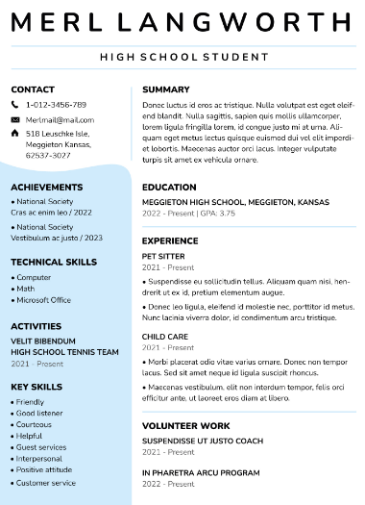
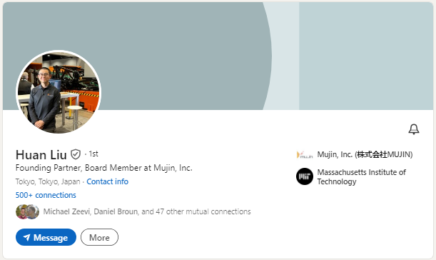
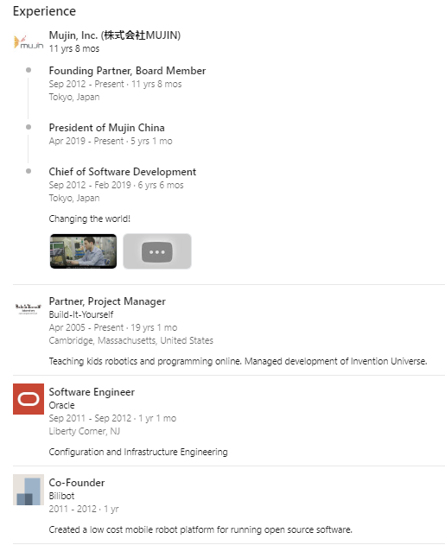
Research
Resume
LinkedIn.
Approved
JG
Date
Apr 2024
Project
Portfolio V1.0
Notes:
Before building, a good engineer will research what others have done.
Don’t reinvent the wheel. Improve on the ideas of others.

Slide 10
Research
Brown Maker Portfolio (Funky music and lyrics)
https://www.youtube.com/watch?v=pC9cF7waU1E
MIT Maker Portfolio (Creation and social good)
https://www.youtube.com/watch?v=qNCb0IJzTts
Brown Maker Portfolio (Playful technology)
https://www.youtube.com/watch?v=N5A96_r5nwM
Steve Jobs on what it takes to work for Apple
https://www.youtube.com/watch?v=fj0hpsJvrko
https://www.youtube.com/watch?v=9lg2L9xW8Sw
Approved
JG
Date
Apr 2024
Project
Portfolio V1.0
Notes:
Before building, a good engineer will research what others have done.
Don’t reinvent the wheel. Improve on the ideas of others.

Slide 11
Hall of Fame Solutions
Invention Universe
Hall of Fame
Approved
JG
Date
Apr 2024
Project
Portfolio V1.0
Notes:
Before building, a good engineer will research what others have done.
Don’t reinvent the wheel. Improve on the ideas of others.

Slide 12
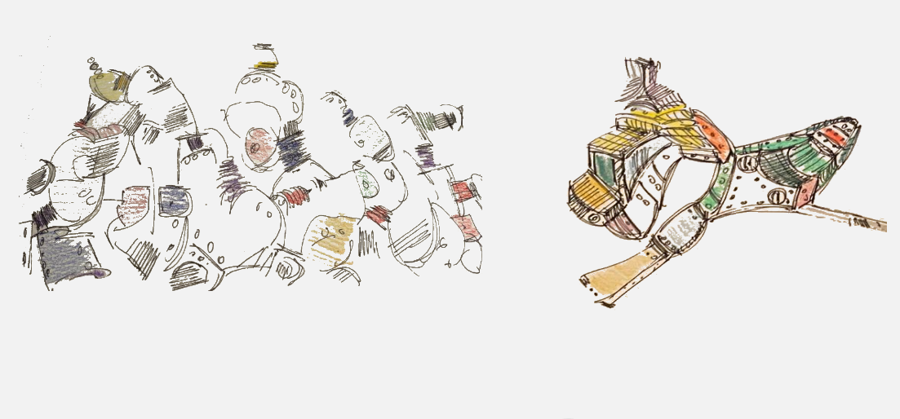
Hall of Fame Solutions
Link to Invention Universe Hall of Fame
Approved
JG
Date
Apr 2024
Project
Portfolio V1.0
Notes:
Before building, a good engineer will research what others have done.
Don’t reinvent the wheel. Improve on the ideas of others.

Slide 13
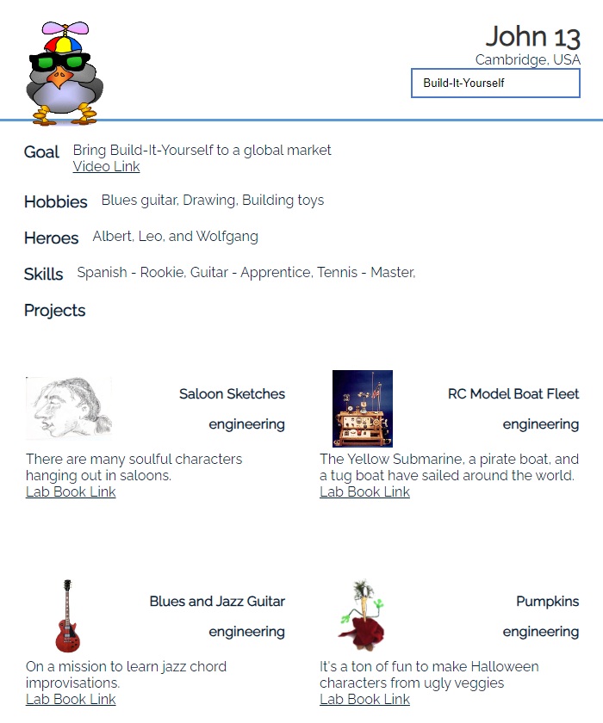
Hall of Fame Solutions
Turn your planet into a PDF file you can use in your college applications as a maker portfolio.
Link to MIT Maker Portfolios
Approved
JG
Date
Apr 2024
Project
Portfolio V1.0
Notes:
Before building, a good engineer will research what others have done.
Don’t reinvent the wheel. Improve on the ideas of others.

Slide 14
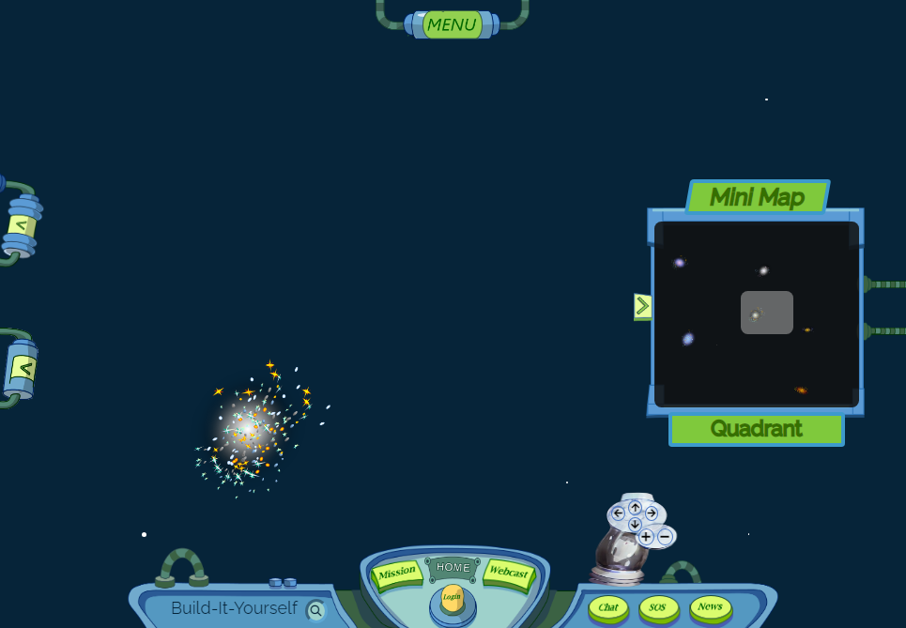
The Plan
Intro to Invention Universe
Signup and Login
Claim and create a planet
Create custom planet graphics
Upload your projects
Create a PDF portfolio
Meet inventors who share your passions.
Approved
JG
Date
Apr 2024
Project
Portfolio V1.0
Notes:
Plan your solution after you have defined the problem and researched the field.

Slide 15
Development
Tell your story (Dreams, Skills)
Research what others have done.
Draw Planet
Draw Rocket
Draw Lab
Draw Avatar
Animate
Export PPT and Google slides to xparent bkgnd PNGs
Import to IU
Complete Bio and Skills
Upload projects
Approved
JG
Date
Apr 2024
Project
Portfolio V1.0
Notes:
Plan your solution after you have defined the problem and researched the field.

Slide 16
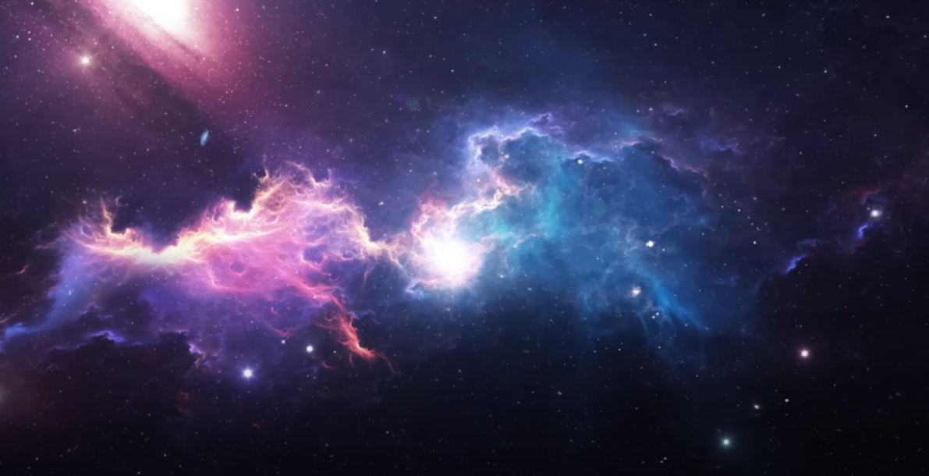
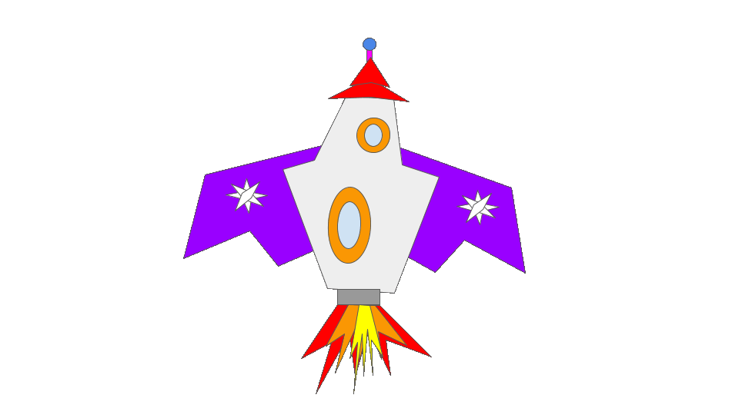

Slide 17
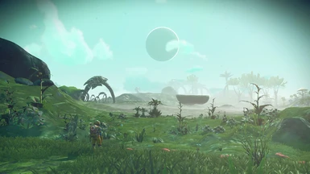
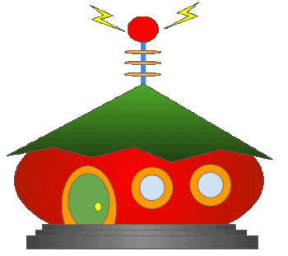

Slide 29
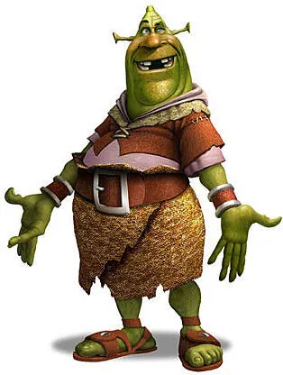

Slide 34
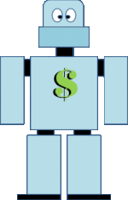
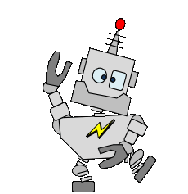

Slide 35
Support Materials

Slide 36
What We Will Learn
How to think creatively
How technology can make people happy
Benefits of modular construction
PowerPoint or Google Slides
Process for solving problems
How to present your work
How to tell a story about your ideas
Project Plan Agenda
Session 1 Set up PowerPoint lab book.
1. Document problem and mission.
2. Research.
3. Brainstorm and plan.
Session 2,3 Draw planet, rocket
Session 4,5 Draw lab and avatar
Session 6,7 EZGif (Make bkgnd transparent, animate, crop, size, save)
Upload to IU.
Session 8 Create and Download PDF maker bio.
Approved
JG
Date
Apr 2024
Project
Portfolio V1.0

Slide 37
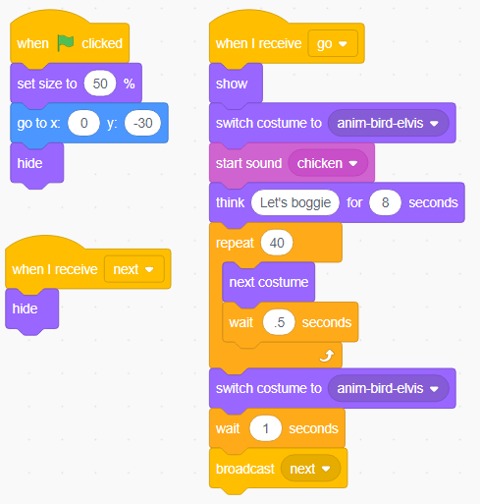
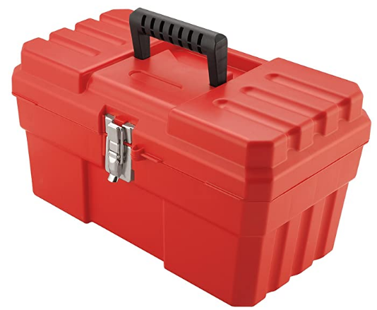
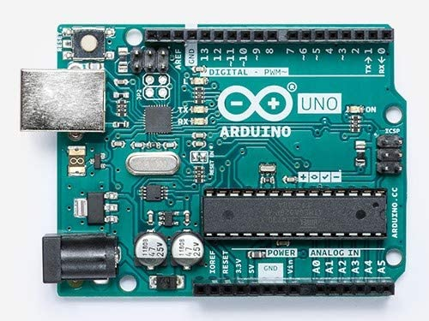
Parts, Tools, Supplies, Software
You'll need:
PowerPoint or Google Slides
EZGif.com
Project Intro
Lesson Plan
Build-It-Blocks
Drawing with PPT
Cartooning
Problem Solving Tricks
Presenting Ideas
Modular Construction
Graffiti
Approved
JG
Date
Apr 2024
Project
Portfolio V1.0

Slide 38
Workshop discussion questions
What are examples of how technology has improved life?
What are examples of how technology has made life worse?
What do you think are the most amazing man-made inventions?
Why is teamwork important?
What do you think are the biggest problems in the world and how could technology help solve these problems?
Advanced Projects
Build more elaborate graphics
Create a PPT video
Approved
JG
Date
Apr 2024
Project
Portfolio V1.0

