Slide 1
Towers of Power
Lab Book
Great civilizations want to be inspired. Build tall, strong, beautiful towers.
Notes:
Welcome to the Build-It-Yourself Laboratory

Slide 2
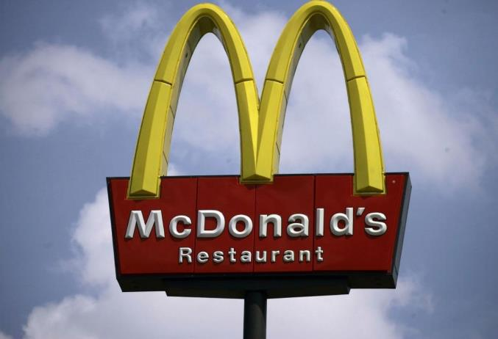
The Problem
Advanced civilizations want to be inspired but too often, our towers are …
wicked ugly!
We can do better
Approved
JG
Date
Oct 2021
Project
Towers of Power
Notes:
Before building, a good engineer will define the problem and set goals.
What symbols inspire you to think?

Slide 3
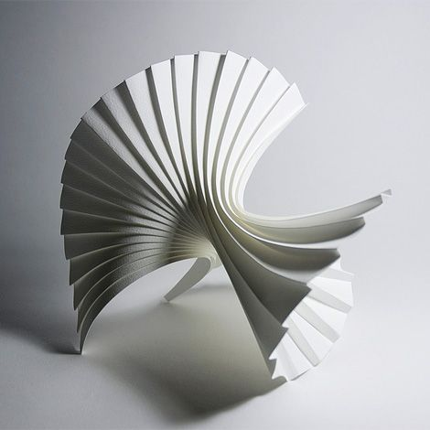
The Mission
Build strong, tall, beautiful towers from printer paper and scotch tape
A strong tower that can support at least 20 books 8” above the floor.
A tall tower that is as tall as you are.
A beautiful tower that makes your friends say, ‘Wow!”
Approved
JG
Date
Oct 2021
Project
Towers of Power
Notes:
Before building, a good engineer will define the problem and set goals.
What symbols inspire you?

Slide 4
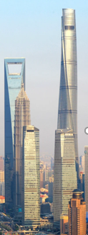
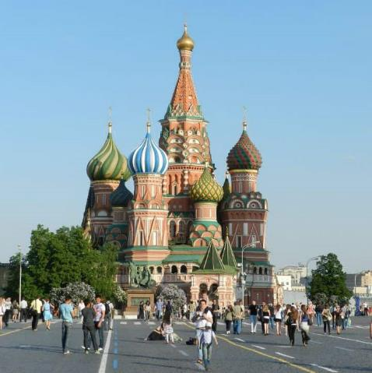
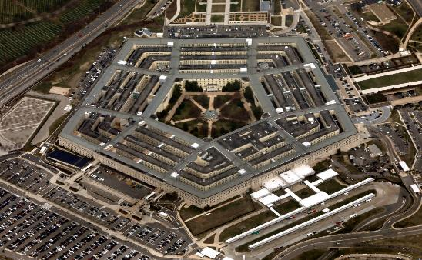
Research
Strong
Tall
Beautiful
Approved
JG
Date
Oct 2021
Project
Towers of Power
Notes:
After a good engineer defines the problem and the mission, the next step is to research how others have tried to solve the problem.
Don’t reinvent the wheel.
Build on top of the ideas of others.
Improve the ideas of others.
Inspire your own solutions.

Slide 5
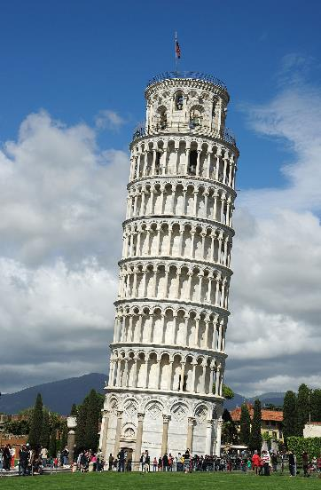
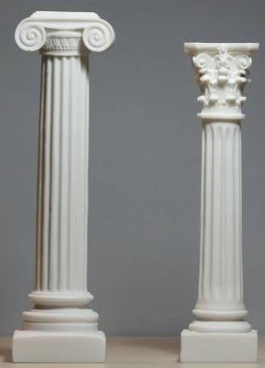
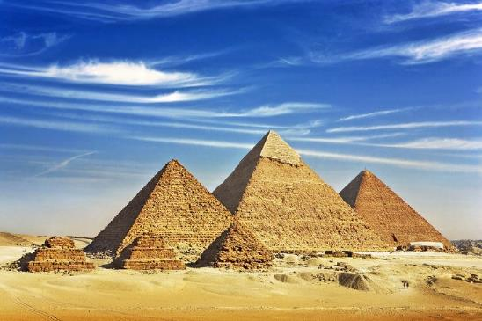
Research
What can we learn from these Towers of Power?
Approved
JG
Date
Oct 2021
Project
Towers of Power
Notes:
After a good engineer defines the problem and the mission, the next step is to research how others have tried to solve the problem.
Don’t reinvent the wheel.
Build on top of the ideas of others.
Improve the ideas of others.
Inspire your own solutions.

Slide 6
Design Tips
Strong
Which shape can support the most weight?
Approved
JG
Date
Oct 2021
Project
Towers of Power
Notes:
Inspire ideas and excitement

Slide 7
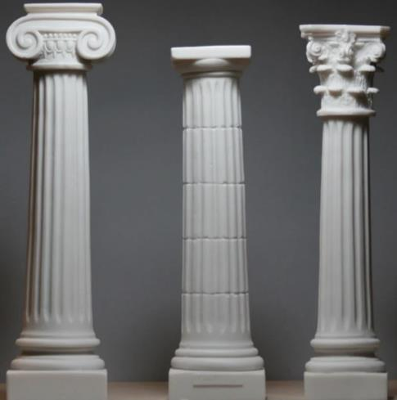
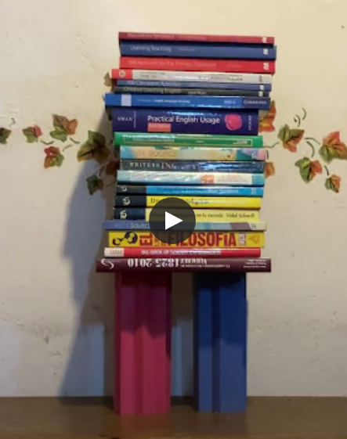
Design Tips
Can you support > 10 books 8” above the floor
using printer paper and scotch tape?
23 Number of books
9 Number of sheets of paper
2.6 Number of books / Number of paper sheets
Approved
JG
Date
Oct 2021
Project
Towers of Power
Notes:
Inspire ideas and excitement

Slide 8
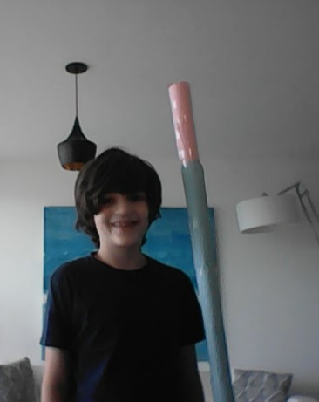
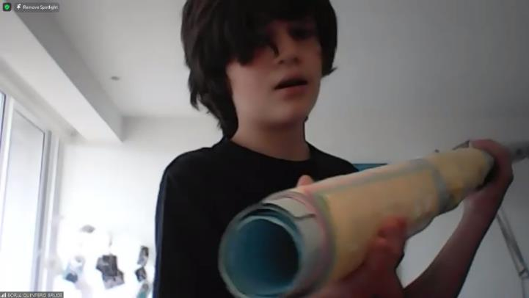
Hall of Fame: Borja, King of Tall Towers 0f Power
1 meter 63 cm tall
44 pieces of paper
Approved
JG
Date
Oct 2021
Project
Towers of Power
Notes:
Inspire ideas and excitement

Slide 9
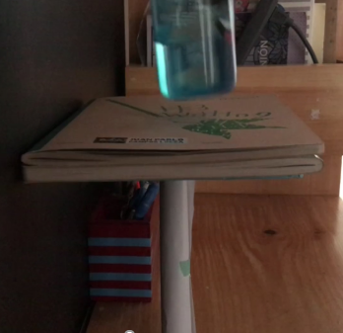
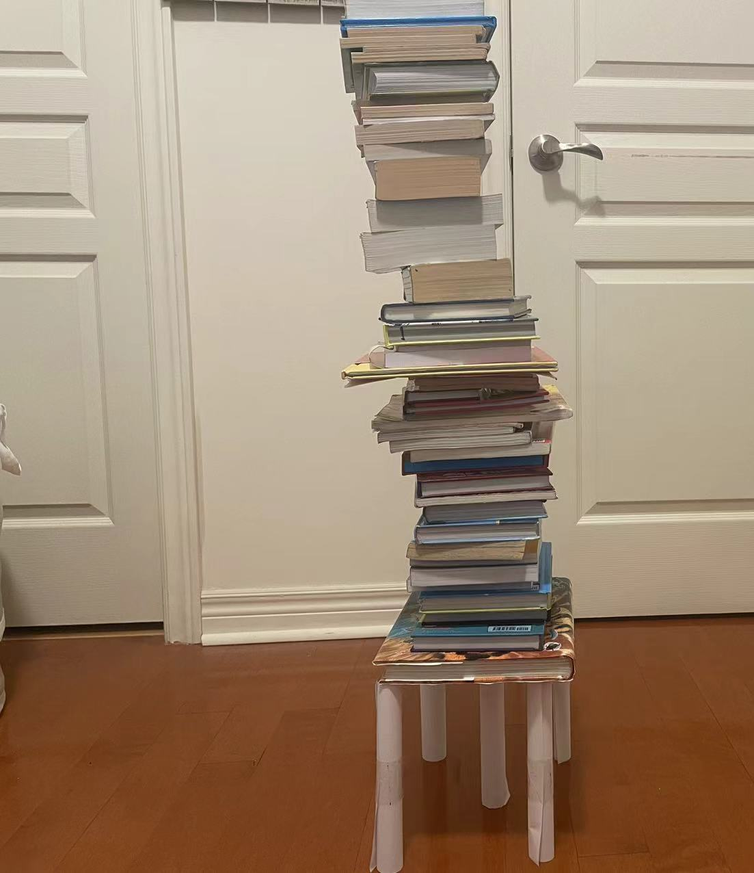
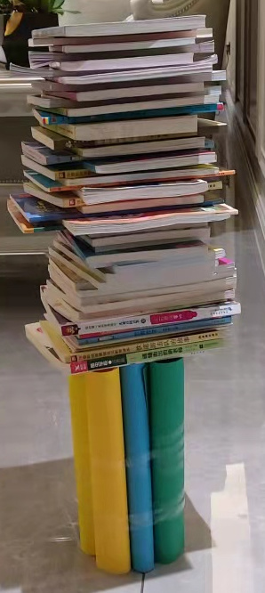
Hall of Fame: Gods of strong Towers of Power
Rodri, Mexico
Jayden, Detroit
37
Howard, Beijing
47 books
Check out Rodri’s Strength Test Video
https://youtu.be/QZWM4iigSJU
Approved
JG
Date
Oct 2021
Project
Towers of Power
Notes:
Inspire ideas and excitement

Slide 10
Design Tips
Some smarty pants say that counting the number of books is not a fair way to measure. For those of you who are above average and don’t have a bathroom scale, what if you build a scale to measure the weight of your books?
Balance 2 or 3 books with 1 kilo or 2.2 pounds of apples.
Then multiply the number of times you balance the scale with 2.2 pounds of apples to get the total weight of the all the books before your tower buckles.
Approved
JG
Date
Oct 2021
Project
Towers of Power
Notes:
Inspire ideas and excitement

Slide 11
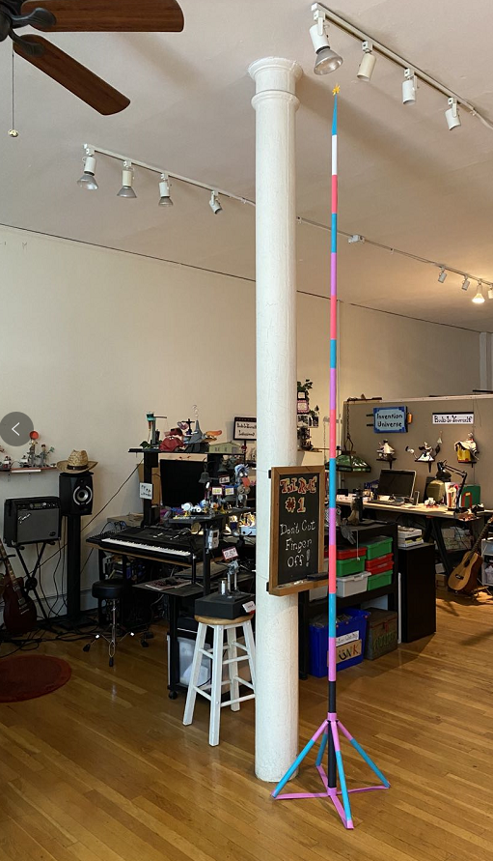
Design Tips
Can you build a tower taller than you
using printer paper and scotch tape?
Heavy, wide base
Light, small top
Height : 125 inches, 10.4 feet, 317cm
Number of paper sheets: 25
Sheets per foot: 2.4
Approved
JG
Date
Oct 2021
Project
Towers of Power
Notes:
Inspire ideas and excitement

Slide 12
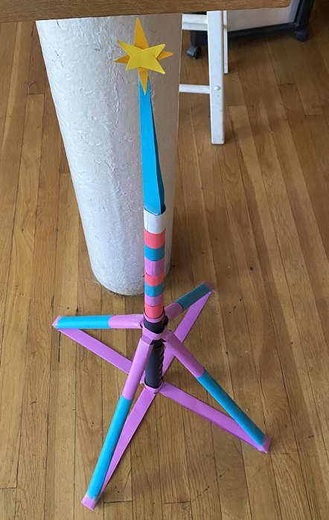
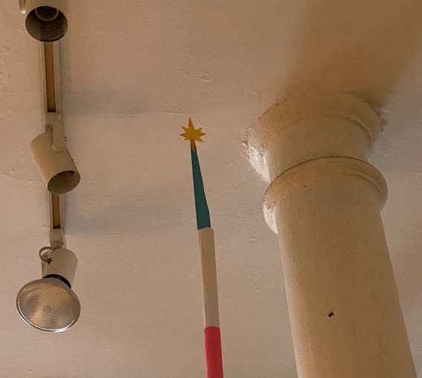
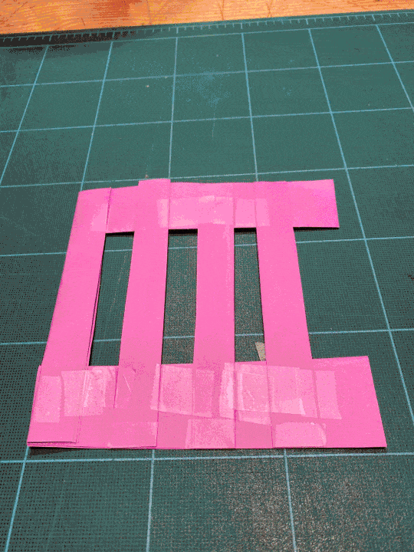
Design Tips
Can you build a tower taller than you
using printer paper and scotch tape?
Tall Tower of Power Video
https://youtu.be/2jFewBgLI4E
Height : 125 inches, 10.4 feet, 317cm
Number of paper sheets: 25
Sheets per foot: 2.4
Approved
JG
Date
Oct 2021
Project
Towers of Power
Notes:
Inspire ideas and excitement

Slide 13
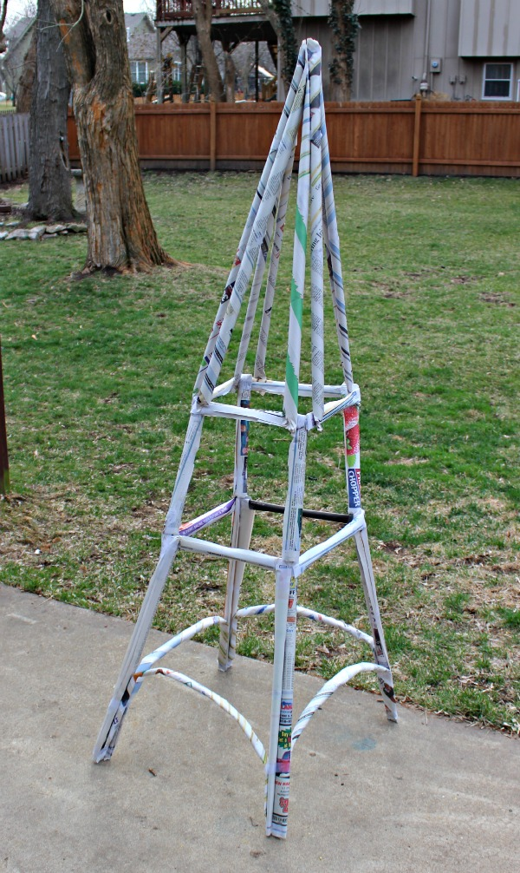
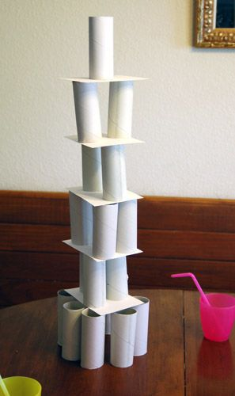
Design Tips
Brute force solution.
Waste of paper.
Ale’s solution Video
Approved
JG
Date
Oct 2021
Project
Towers of Power
Notes:
Inspire ideas and excitement

Slide 14
Design Tips
Build a way cool looking tower
that makes your friends say, “Wow?”
Qualities of beautiful towers
Unusual shapes
Colorful
Rhythm
Focal point
Repetition
Approved
JG
Date
Oct 2021
Project
Towers of Power
Notes:
Inspire ideas and excitement

Slide 15
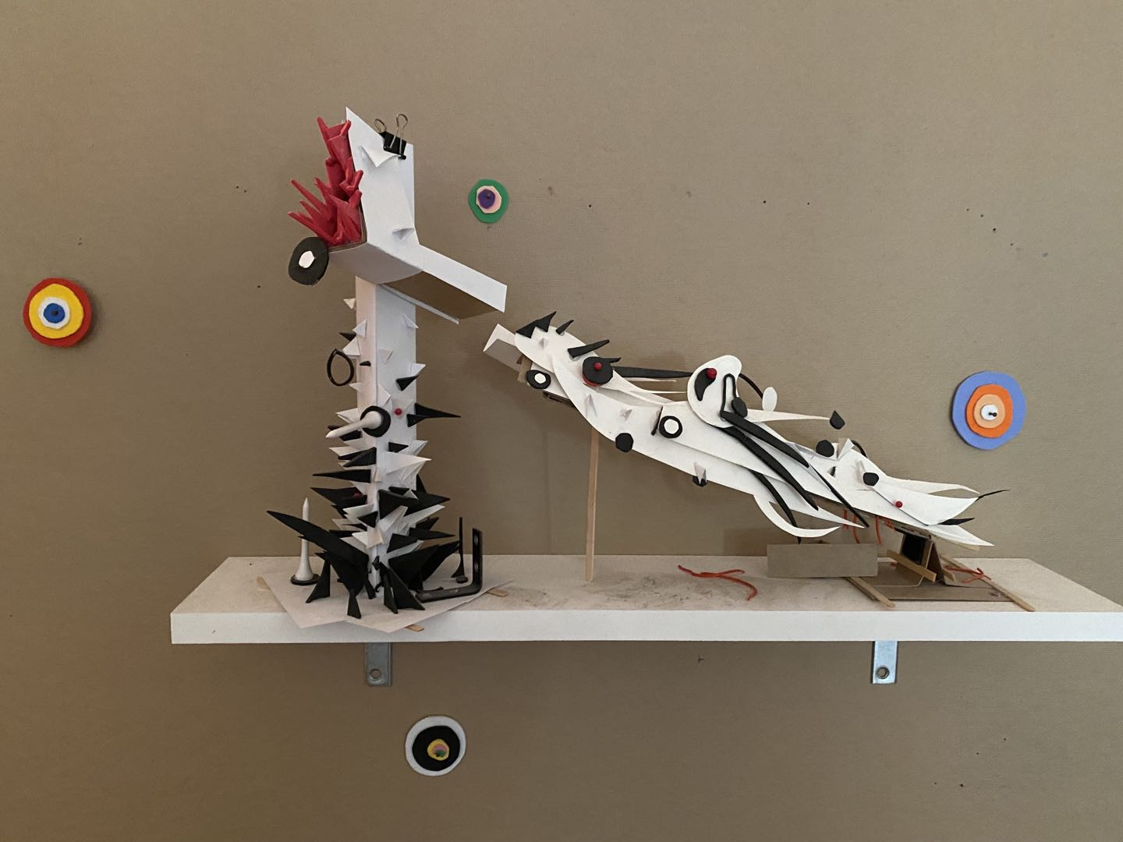
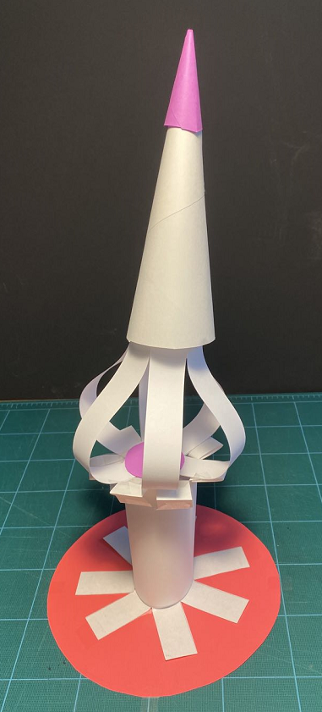
Design Tips
Build a way cool looking tower
that makes your friends say, “Wow?”
Approved
JG
Date
Oct 2021
Project
Towers of Power
Notes:
Inspire ideas and excitement

Slide 16
WANTED: FUNKY ARTISTS AND BUILDERS
Build online with art and engineering college students.
Grown ups need not apply.
build-it-yourself.com/apply
Copyright 2022
Notes:
Welcome to the Build-It-Yourself Laboratory

Slide 17
Support Materials

Slide 18
Project Plan Agenda
Session 1 Create a Lab Book
Problem / Mission
Research famous towers around the world
Research tall and strong paper towers
Measures of success
Test structural elements (cylinder vs. triangle)
Session 2, 3 Build a tower that supports > 10 books.
Analyze and document strength factors.
Session 4,5 Build a paper tower taller than you.
Analyze and document height factors.
Session 6,7 Design a tower that makes your friends say, “Wow!”
Session 8 Document and present your solutions on Invention Universe.
Approved
JG
Date
Oct 2021
Project
Towers of Power

Slide 19
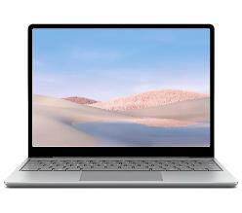
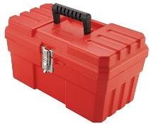
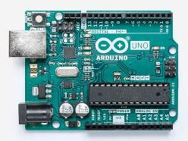
Parts, Tools, Supplies, Software
You'll need:
Power Point (or Google Slides)
Printer paper (Colored paper)
Scotch tape
Scissors
Ruler
Pencil
Build-It-Blocks:
Problem solving tricks
Presenting ideas
Structural members
Telescope
Quad-pod
Approved
JG
Date
Oct 2021
Project
Towers of Power

Slide 20
What We Will Learn
How to think creatively
Benefits of modular construction
PowerPoint or Google Slides
Process for solving problems
How to present your work
Structural engineering
How to build efficiently
Construction craftsmanship
Advanced Projects
Design graffiti signs.
Build towers from premium quality junk.
Create a video.
Post project on Invention Universe
Calculate design efficiency.
Weight / #sheets of paper
Height / # sheets of paper
Approved
JG
Date
Oct 2021
Project
Towers of Power

Slide 21
Workshop discussion questions
What are examples of how architecture has improved life?
What are examples of how architecture has made life worse?
What do you think are the most amazing man-made structures?
Why is teamwork important?
What do you think are the biggest problems in the world and how could architecture help solve these problems?
Measures of Success
Is your project presentation clear, concise and compelling?
Did you solve the problem?
Did you solve the problem efficiently and creatively?
Least number of lines of code?
Cheapest materials?
Approved
JG
Date
Oct 2021
Project
Towers of Power

