Slide 1

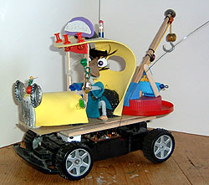
Laboratory
Creative Inventions and Robotics
www.build-it-yourself.com
Keep on Truck'n
Notes:
Welcome to the Build-It-Yourself Laboratory.
I’m Seth, chief computer programmer at Build-It-Yourself.
I’m John, chief inventor at Build-It-Yourself.

Slide 2
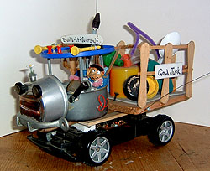
Keep on Truck'n
The Problem
Messy "no-gooders" are mucking up our good earth by creating mountains of yucky garbage.
Your mission is to build a fleet of trucks to help haul away the mess.
The Mission
www.build-it-yourself.com
Notes:
Who would like to read The Problem?
Who would like to read The Mission?

Slide 3
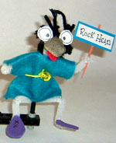
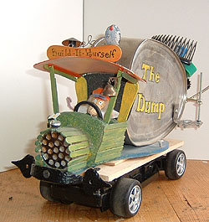
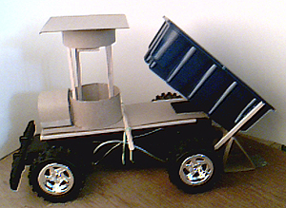
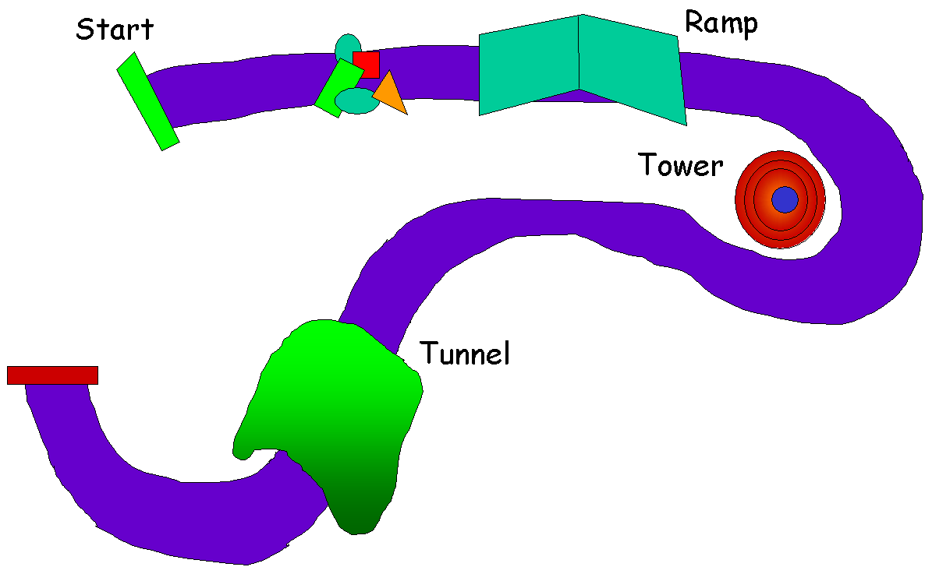
Keep on Truck'n
Main Menu
Each team member will build their own trucker.
Each team will build a truck top, which we’ll mount on a remote control chassis.
Each team will build a back for their truck, follow the dump truck designs or create your own.
The whole class will build an obstacle course to test your trucks.
Take your projects to the next level and learn more about trucks and the work they do.
Trucks
www.build-it-yourself.com
Notes:
Each team member will build a trucker.
Each team will build a truck top.
We’ll mount your trucks on a remote control chassis.

Slide 4
Keep on Truck'n
Every dump truck needs a trucker.
How to make a trucker
www.build-it-yourself.com
Notes:
First, let’s build a trucker so we can get the scale of things.
Each member of the team can build a trucker.
Go to Build-It-Blocks.
Click on ‘Presenting Projects’
Download the Hard Heads PPT.
Follow the instructions. Make your trucker look Way Cool!

Slide 5
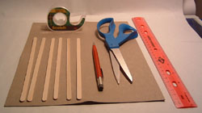
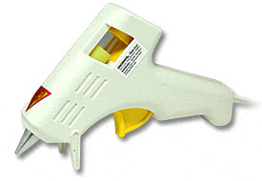
Keep on Truck'n
Let’s build a truck cab structure first.
You’ll need these tools and supplies.
6 coffee stirrer sticks
8.5”x11” cardboard
Scotch tape
Pencil
Scissors
Rulers
Low temp hot glue gun
Low Temp Hot Glue Gun
and glue sticks
www.build-it-yourself.com
Notes:
Now we’re ready to start on the truck top.

Slide 6
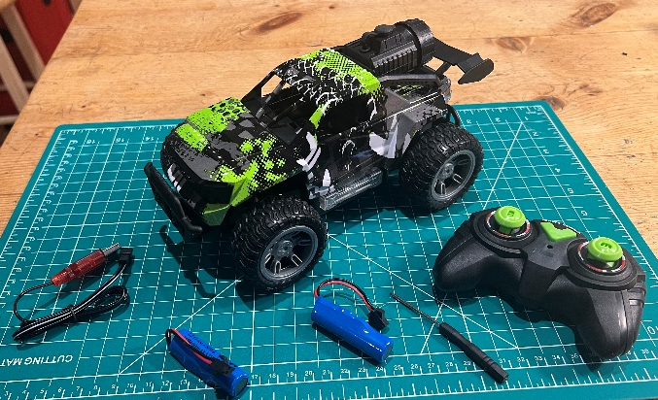
Keep on Truck'n
You will need an RC chassis if you want to control your truck through an obstacle course.
This chassis cost $40 on Amazon.
WRTWRT 1:18 RC Monster Truck
We recommend a low-cost truck with big wheels. Scale 1:18
www.build-it-yourself.com
Notes:
Now we’re ready to start on the truck top.

Slide 7
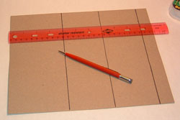
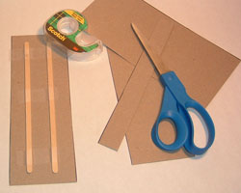
Keep on Truck'n
Measure 4’’, 3’’, 3” and 1” sections on the brown cardboard sheet.
Cut out the pieces.
Scotch tape 2 coffee stirrer sticks to keep a 3”x8.5” strip stiff.
3”
www.build-it-yourself.com

Slide 8
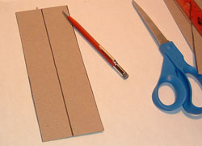
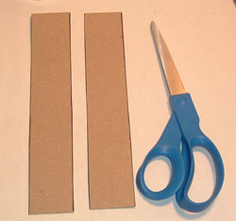
Keep on Truck'n
Cut the other 3”x8.5” strip into two pieces.
3”
1.5”
www.build-it-yourself.com

Slide 9
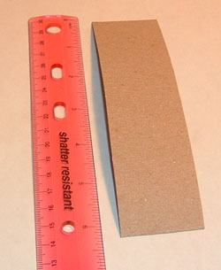
Keep on Truck'n
Cut one of the 1.5”x8.5” strips down to 1.5”x6”.
You should have 5 cardboard strips:
1.5”x6”
1”x8.5”
1.5”x8.5”
4”x8.5”
3”x8.5”
6”
1.5”
www.build-it-yourself.com

Slide 10
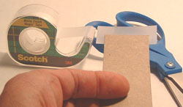
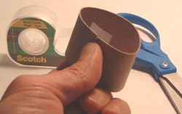
Keep on Truck'n
Put Scotch tape on one end of the 1.5”x6” strip.
Wrap the other end in a cylinder and tape the ends together.
Press the tape to the cardboard tightly to make a good bond.
www.build-it-yourself.com

Slide 11
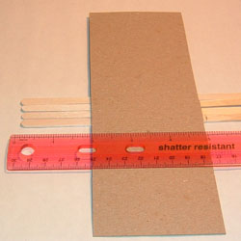
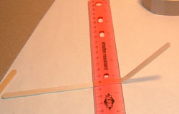
Keep on Truck'n
Lay out 4 coffee stirrer sticks so the ends are exactly even. Measure 5”. Draw a line across all sticks.
Place the sticks under a ruler and bend each one so it breaks cleanly.
5”
www.build-it-yourself.com

Slide 12
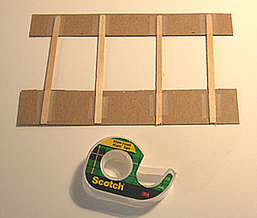
Keep on Truck'n
Tape the coffee stirrer sticks to the cardboard strips as shown.
www.build-it-yourself.com

Slide 13
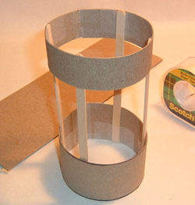
Keep on Truck'n
Wrap the cardboard and coffee stirrer sticks into a cylinder and tape it together.
www.build-it-yourself.com

Slide 14
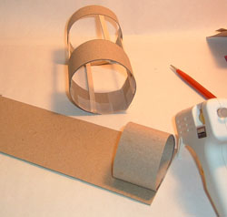
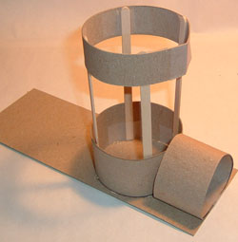
Keep on Truck'n
Hot glue the 6”x1.5” cylinder to the 3” platform.
Hot glue the cylinder with the coffee stirrer sticks to the platform.
www.build-it-yourself.com

Slide 15
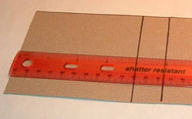
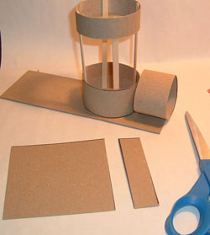
Keep on Truck'n
Cut the 4”x8” strip of cardboard as shown.
4”
1”
www.build-it-yourself.com

Slide 16
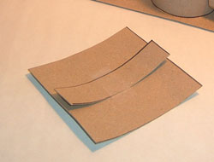
Keep on Truck'n
Tape the 1” strip to the 4” strip.
This will be a clamp for the top of the truck cab.
www.build-it-yourself.com

Slide 17
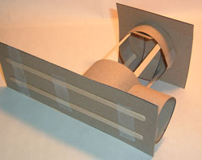
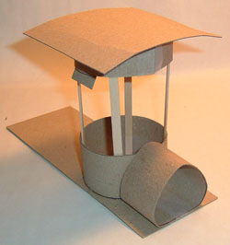
Keep on Truck'n
Clamp the cab top by slipping the 1”x4” strip under the top cylinder.
Now you are ready to decorate your truck!
www.build-it-yourself.com

Slide 18
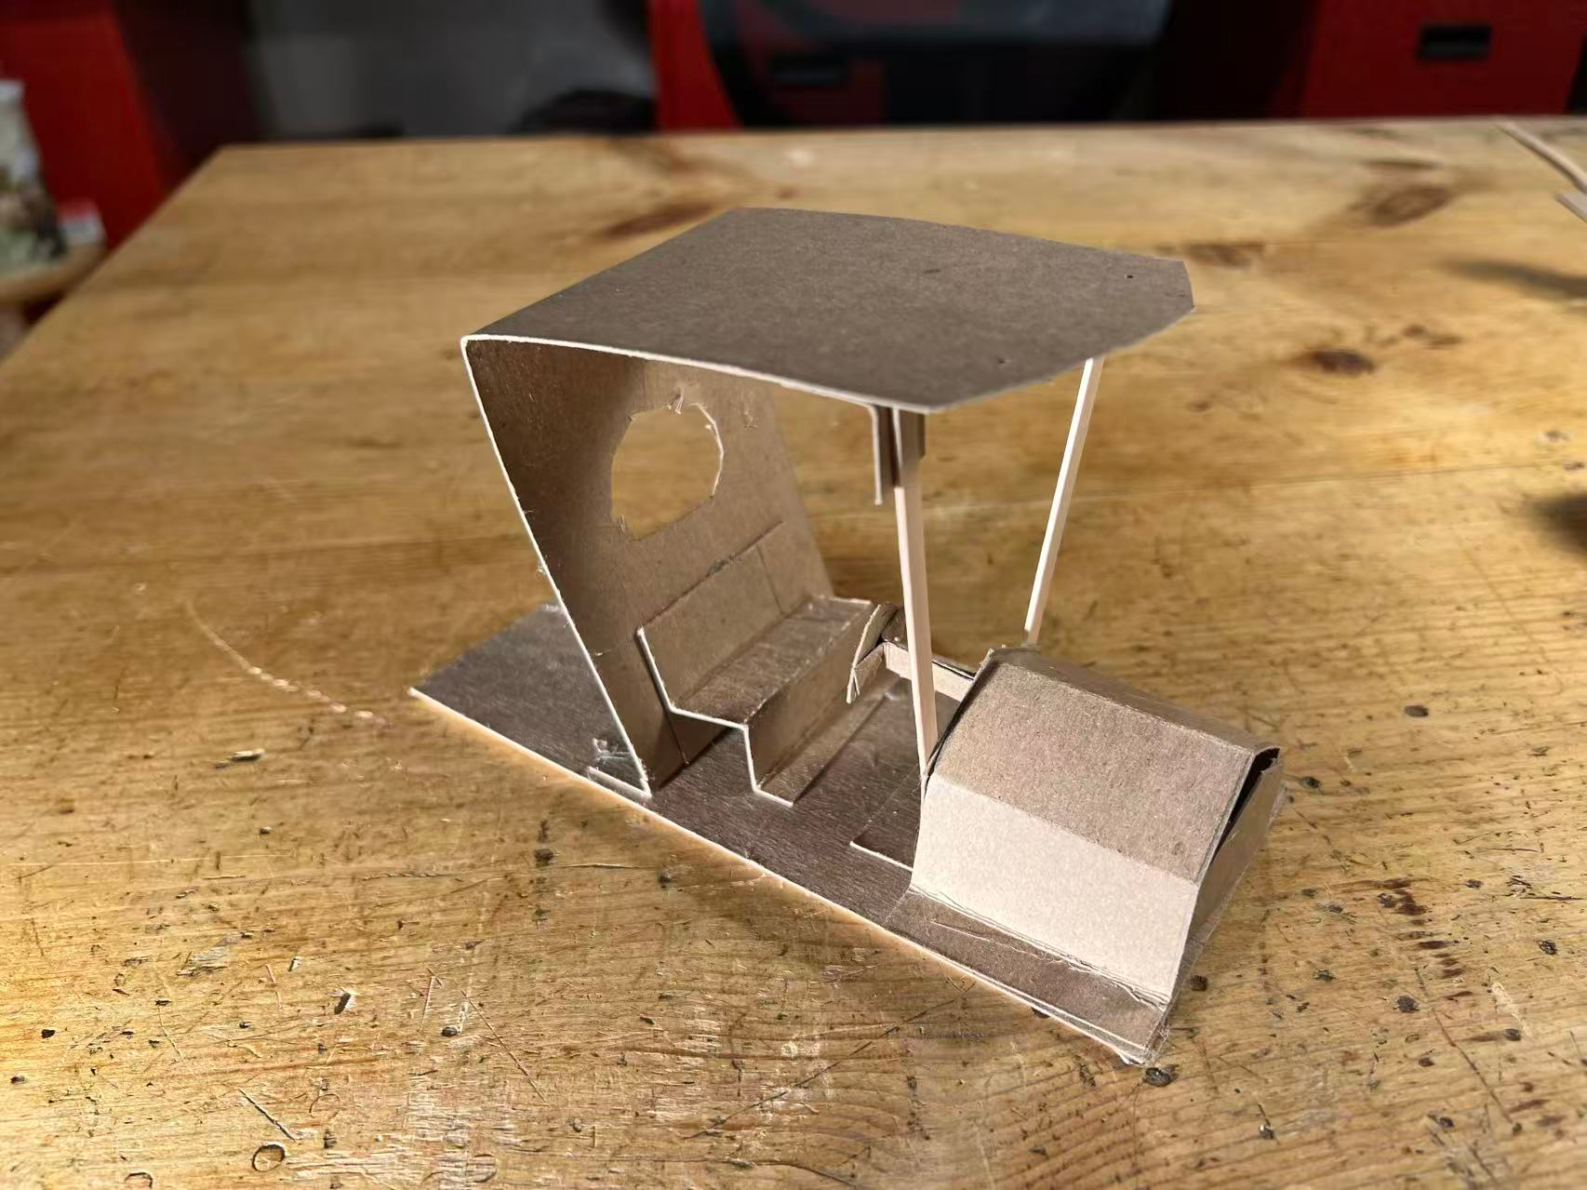
Keep on Truck'n
Here is another truck top design.
https://build-it-yourself.com/members/biy-blocks/resources/bib-truck-top-straight.pptx
Watch how this truck top is built.
https://youtu.be/F_JkfUmWyys
www.build-it-yourself.com

Slide 19
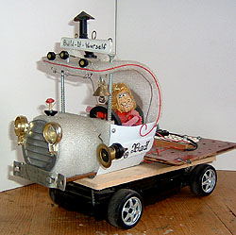
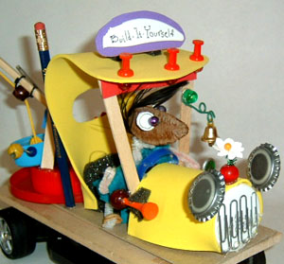
Keep on Truck'n
You’ll need to collect some premium quality junk to decorate your truck.
See if you can identify all the good stuff used in these trucks.
www.build-it-yourself.com

Slide 20
Keep on Truck'n
After you build and decorate the truck cab, then build the back of your dump truck.
Scrounge around your premium quality junk box for parts.
Return to Main Menu
www.build-it-yourself.com

Slide 21
Keep on Truck'n
Dump Truck
When you back the truck into a triangular piece taped to the ground, the truck back will dump the contents.
Return to Main Menu
www.build-it-yourself.com

Slide 22
Keep on Truck'n
To test your truck, build an obstacle course.
Candy
Start
Ramp
Decorate your obstacle course with rocks, tree branches, flowers, and a big junk yard.
Tower
Garbage Dump
Tunnel
Some ideas:
Plow candy or junk off the road.
Pass through a tunnel.
Go around a sharp curve without knocking over a tower.
www.build-it-yourself.com
Notes:
Then we’ll set up an obstacle course.
In our world, candy will represent garbage.
To test how good your truck is, you will steer your truck around the course. And unload a mess of candy in the garbage dump or plow a pile of candy into the dump.

Slide 23
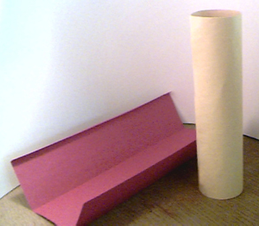
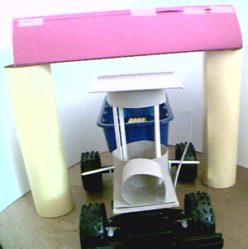
Keep on Truck'n
Bridge Obstacle
Start with three pieces of construction paper and a role of tape.
Role two of the pieces into columns and secure with tape.
Fold the third piece into a long triangular tube and secure with tape.
Add graffiti signs to the bridge.
www.build-it-yourself.com

Slide 24
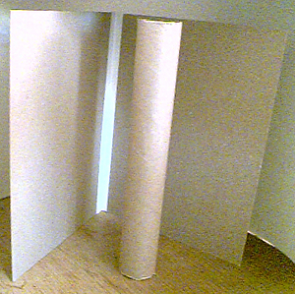
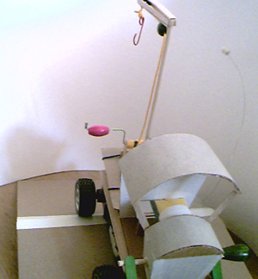
Keep on Truck'n
Ramp Obstacle
Start with an empty paper towel role, two pieces of cardboard, and a role of tape.
Tape the two pieces of cardboard together along the long edge.
Support the cardboard by placing the paper towel role under the taped seam to complete the ramp.
Make the ramp look way cool by adding rocks and grass from outside.
www.build-it-yourself.com

Slide 25
Keep on Truck'n
Candy Dispenser
Build a rotating pin wheel that dumps candy into your truck when you hit a leg of the wheel.
www.build-it-yourself.com

Slide 26
Keep on Truck'n
The Obstacle Course
Set up the obstacles and mark the course with strips of tape.
www.build-it-yourself.com

Slide 27
Keep on Truck'n
Scoring Table
Team:
1
2
3
4
Coolest looking
Number of towers still standing
Number of candy pieces collected
Number of candy pieces dumped into box
???
Return to Main Menu
www.build-it-yourself.com

Slide 28
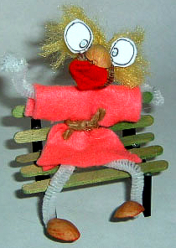
Keep on Truck'n
Suggestions for older or more advanced students.
www.build-it-yourself.com

Slide 29
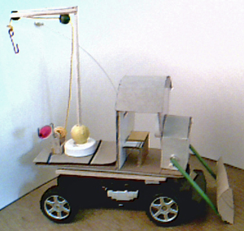

Keep on Truck'n
More Truck Ideas
Hook up wire
See if you can turn a toilet paper role into a plow or design a tow truck from paper clips and premium quality junk. You could have a contest to see who can plow the most candy into a circle or who can hook a box of raisins and bring it home.
www.build-it-yourself.com

Slide 30
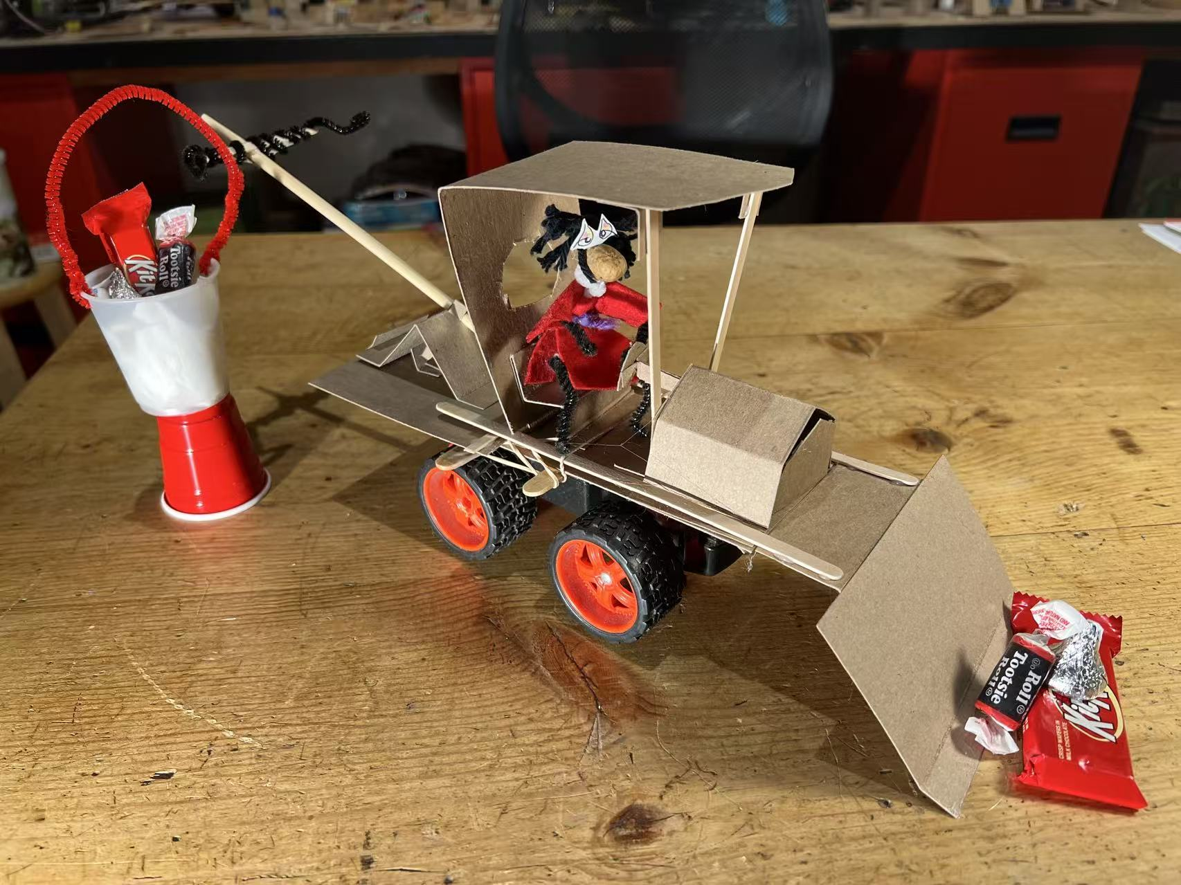
Keep on Truck'n
More Truck Ideas
Pipe Cleaner
Test your driving skills. Steer it around an obstacle course. Who can collect the most candy?
Check out this truck run. Success!!!
https://www.youtube.com/watch?v=rGY3Pa9bd1Q
www.build-it-yourself.com

Slide 31
Keep on Truck'n
Research:
Can you imagine what the world would be like without trucks?
# bags of garbage / week per person?
# people in America?
# bags of garbage a good dump truck can haul / week?
# dump trucks needed in America
www.build-it-yourself.com
Notes:
The first phase of building a way cool project is to research the problem.
Get to work!

Slide 32
Keep on Truck'n
Write a poem, song or story about your truck.
Take pictures.
Record a video.
Set up a project website.
Return to Main Menu
www.build-it-yourself.com

