Slide 1
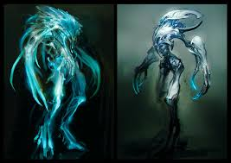
Lab Book
Porter and Charlie

Slide 2
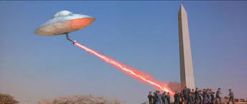
Problem / Mission
Aliens are looking signs of signs of intelligent life.
Make aliens fall in love with our web pages so they do not destroy us.

Slide 3
Home
Paintball
Video games
halo!!!

Slide 4
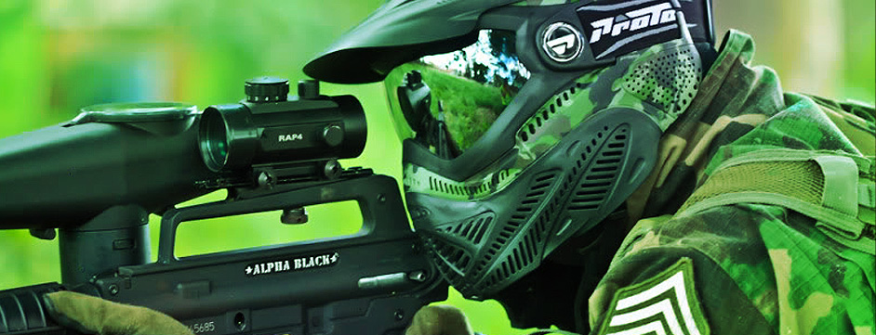
Paintball
Paintball is a sport where people shoot paint pellets at their opponents

Slide 5
Video games
Games are things that you play on electronics.

Slide 6
halo

