Slide 1
Web Design 102
Advanced Design Using HTML, CSS & Javascript!
Notes:
Welcome to the Build-It-Yourself galactic laboratory! We are going to teach you advanced web site programming!

Slide 2
The Problem
The aliens that found our websites have decided to trade code with us!
We fear our code will not impress on closer inspection. GULP!
Notes:
Aliens are scanning the universe for signs of intelligent life. If they find a civilization of dummies they will blow it to smithereens. They found our websites (web design 101) and want to trade!
We have a problem! While we passed the first filter, our code may not be advanced enough to be of value to advanced being from around the universe and beyond!

Slide 3
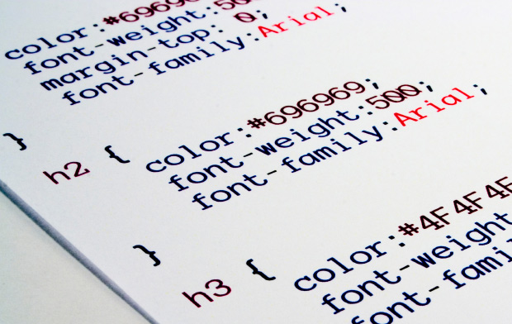
The Mission
Develop advanced code to prove we are worthy of trading with advanced life forms!
Notes:
Our mission is to become even more advanced programmers! We need to use DIVS instead of TABLES – We need to use CSS instead of FONT tags – We need to write Javascript and Jquery!

Slide 4
Research
List 5 web sites with advanced features.
Examples:
Mobile Responsive
Video Players
Games
Contact Forms
…
Notes:
Before a builder builds it is important to research what others have done!
What websites that you use or have visited demonstrate advanced features?
How do they use these features?
***Show invention universe as an example of advanced websites***

Slide 5
Project Plan
Project Plan:
Lab Book Cover
Problem/Mission
Research
Site Map
HTML/DIVS Templates
Edit Content
CSS (Style Sheet)
Javascript/Jquery
FTP Site Upload
Presentations
Notes:
Set expectations for next 8 weeks and/or project

Slide 6
Skills Needed
Skills Needed:
PowerPoint Guru
Problem Solver
Master Designer
Modular Constructor
Hot Shot Programmer
Celebrity Presenter
Notes:
These are the skills you will acquire or further develop.

Slide 7
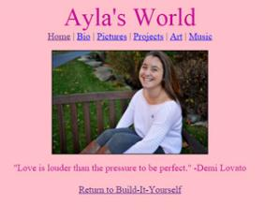
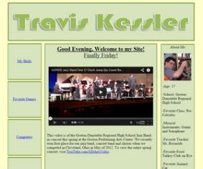
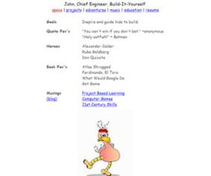
Hall of Fame
Hot Shot Web Designers!
Ayla, Travis, Val & John
Notes:
Here are some hot shot examples of what others have done in the past!

Slide 8
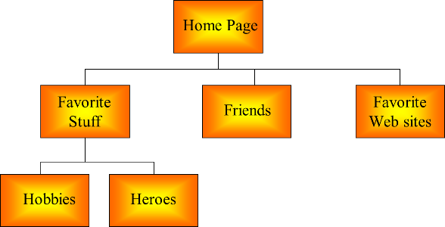
Break Mission Into Simple Parts
Site Map
Notes:
Create a site map! A site map is a map of all the pages of your website and how connect.
Drive the kids to create a site map. Have a kid share their screen and guide them to make a site map. Start with the home page and branch out.
Draw a box for each page that will appear in the navigation. Connect the home page to each other page.

Slide 9
Break Mission Into Simple Parts
Folder Structure/File Naming
documents
your name
images
Notes:
Folder structure is critical to success!
Create a folder with your name for your website in your documents folder. This is where your html files will be saved.
Create an images folder in root folder. This is where all of your images will be saved.
All files must use lower case letters, no spaces or underscores, and hyphens where needed.
All file names must be descriptive. Use common categories and zero in on unique

Slide 10
Break Mission Into Simple Parts
Div/CSS Template
Notes:
We start with an advanced layout written with proper HTML and CSS.
We are ditching table tags for div tags.

Slide 11
Break Mission Into Simple Parts
CSS(Cascading Style Sheets)
Notes:
Then we add in out content and modify our CSS.

Slide 12
Break Mission Into Simple Parts
Javascript/Jquery
Notes:
Once this is finished we will implement advanced features using a combination of Javascript, Jquery and CSS3

Slide 13
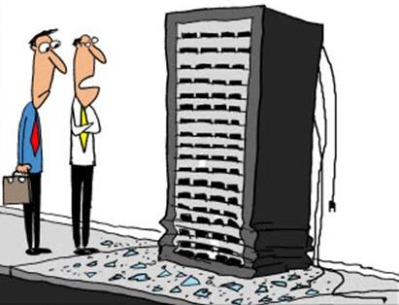
Break Mission Into Simple Parts
Upload to Web Server
Notes:
And finally upload it to our server! You can access this anywhere in the world!

Slide 14
What we should know
How to think outside the box
How to make people laugh
Benefits of modular construction
How to tell a compelling story
Advanced Projects:
Design more animated GIFs
Build more elaborate code modules
Reduce image file size by cropping, resizing and compression
Create a video of your site, or a video for your site
Use a text file as a database
Code in PHP
Notes:
By the end of the project you should know the following.
If you get ahead or have the time and interest here are some way cool ideas to expand your website!

