Slide 1

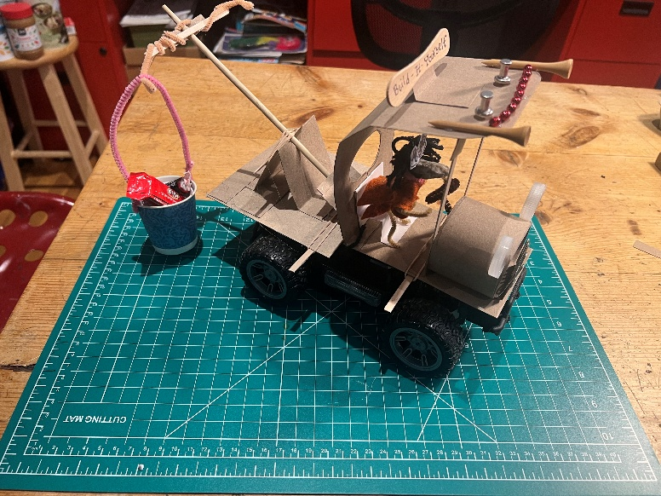
Catapult
Video

Slide 2
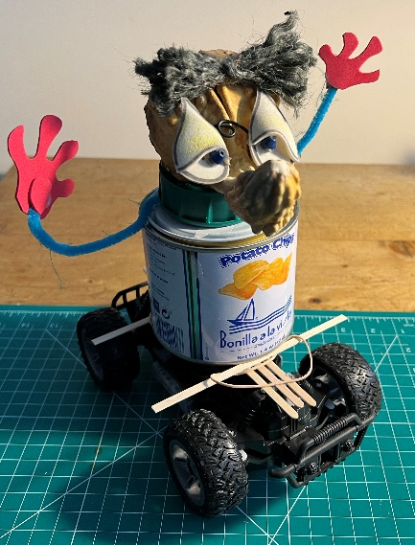
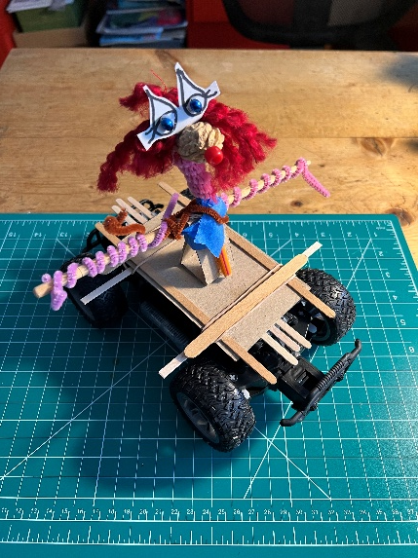
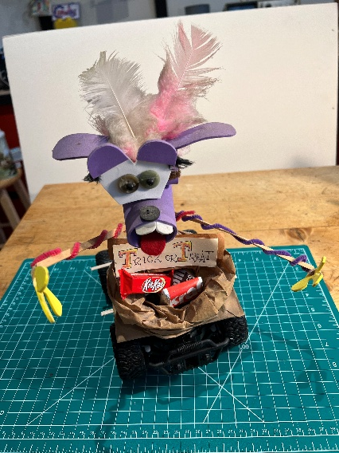
BIB RC Chassis - Applications

Slide 3

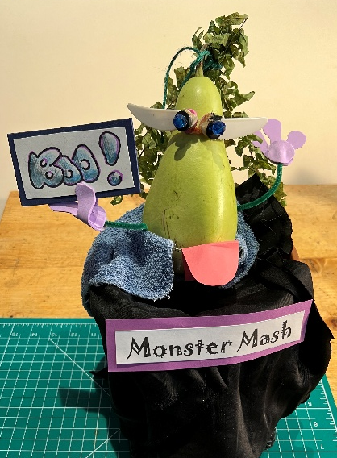
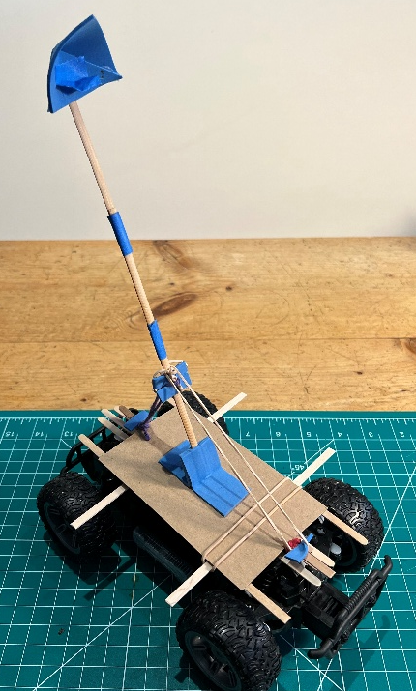
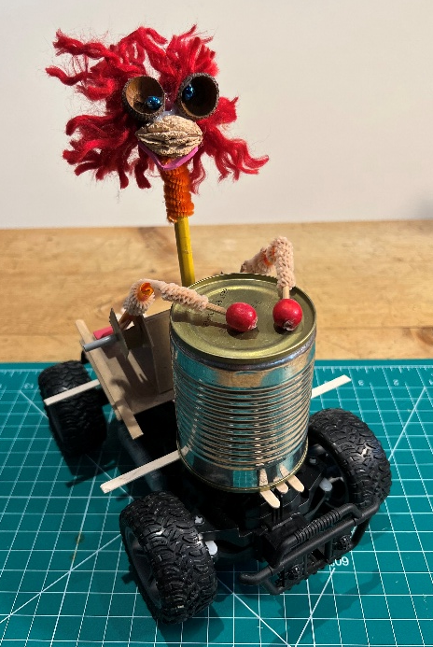
BIB RC Chassis - Applications

Slide 4
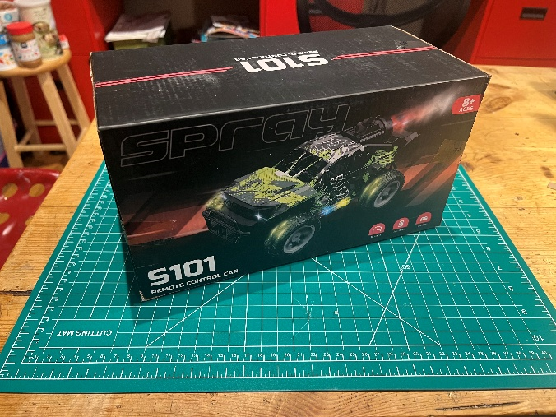
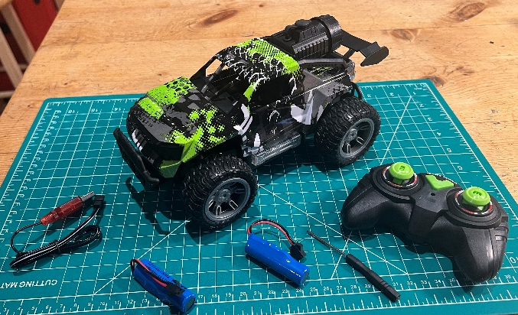
BIB RC Chassis - Instructions
Buy RC Chassis
This chassis cost $40 on Amazon.
WRTWRT
1:18 RC Monster Truck
We recommend a low-cost truck with big wheels.
Scale 1:18

Slide 5
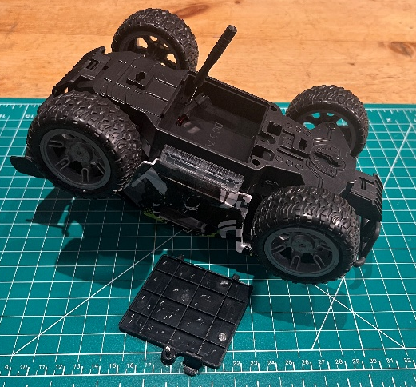
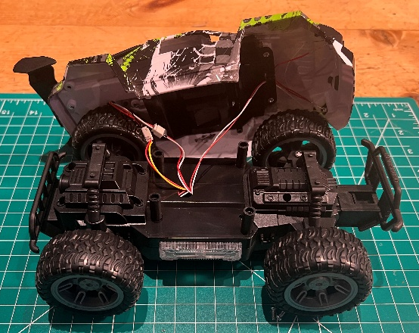
BIB RC Chassis - Instructions
Remove Truck Top
Usually there are 4 screws that hold the top to the chassis. You may find some screws in the battery compartment.
There may be wires from the chassis to the top for lamps. You can try to unhook the lamps if you want to use them in your project.
Or just cut the wires.

Slide 6
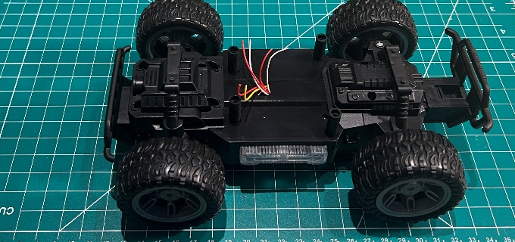
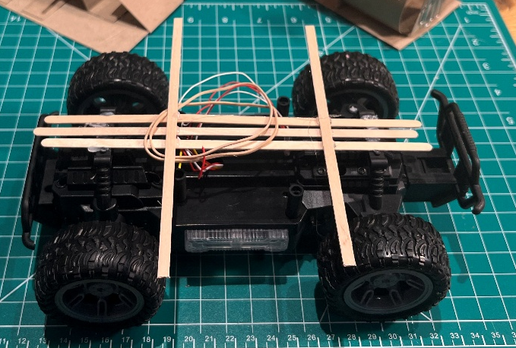
BIB RC Chassis - Instructions
Build a mounting platform
Hot glue popsical sticks, coffee stirrer sticks, chop sticks or cardboard strips to the truck top.
These will be used to mount your invention on the chassis and connect it with rubber bands so you can quickly interchange chassis tops.

