Slide 1
Module Scale Circuit Switch
Battery
Motor
Notes:
Welcome to the BIY Laboratory …
Where Art and Technology Rule.

Slide 2
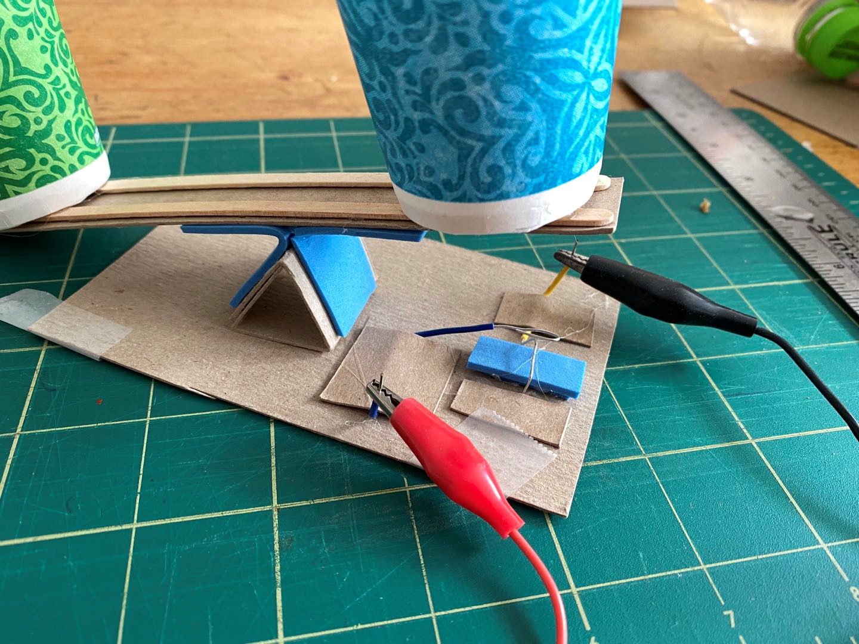
Scale Circuit Switch
Notes:
In the next 6 slides, you will learn how you can …
Aaa
Bbb
Ccc

Slide 3
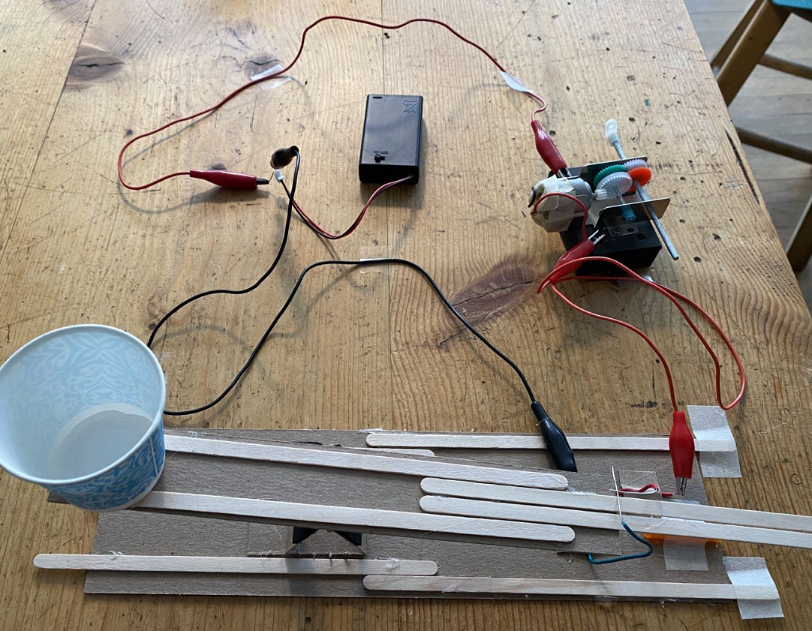
Scale Circuit Switch
Notes:
In the next 6 slides, you will learn how you can …
Aaa
Bbb
Ccc

Slide 4
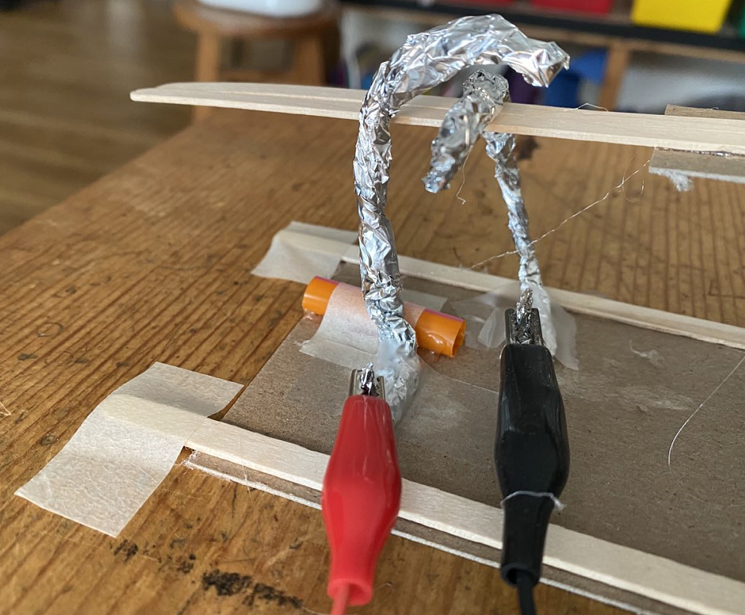
Scale Circuit Switch
Notes:
In the next 6 slides, you will learn how you can …
Aaa
Bbb
Ccc

Slide 5
Scale Circuit Switch
Battery
Motor
Notes:
In the next 6 slides, you will learn how you can …
Aaa
Bbb
Ccc

Slide 6
Scale Circuit Switch
Battery
Motor
Notes:
In the next 6 slides, you will learn how you can …
Aaa
Bbb
Ccc

Slide 7
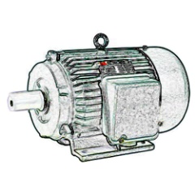
Make a spillway
Many modules could trigger a ball to roll down a spillway to start a chain reaction.
Pipe cleaner
wire

Slide 8
Make a spillway
Many modules could trigger a ball to roll down a spillway to start a chain reaction.
Cardboard
‘hammer’
Motor
With
cam

Slide 9
Make a spillway
Many modules could trigger a ball to roll down a spillway to start a chain reaction.
Cardboard
‘hammer’
Motor
With
cam

