Slide 1

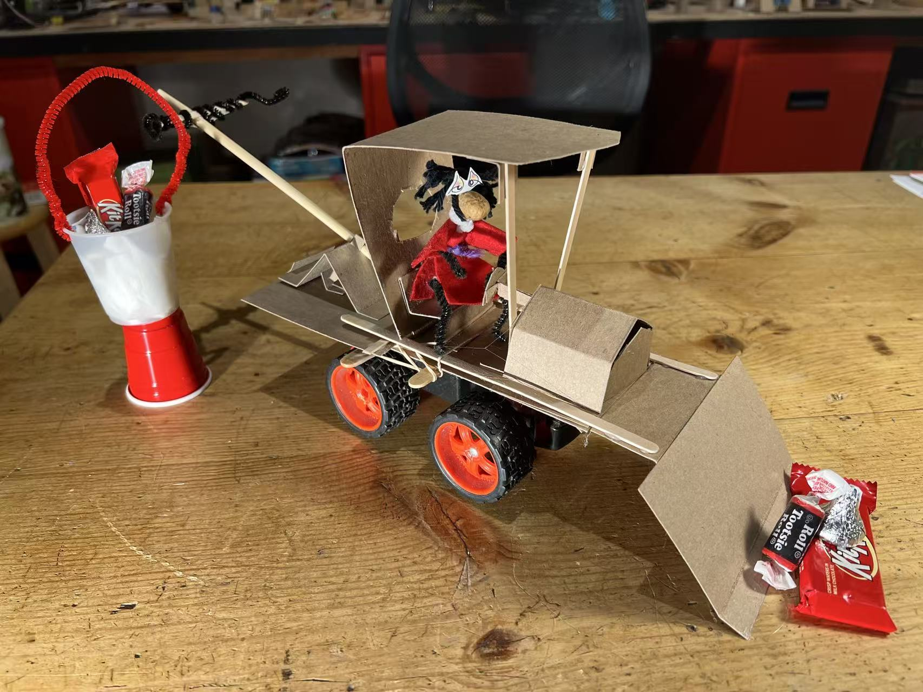
Remote Control Truck
Test your driving skills.
Steer it around an obstacle course.
And see who can collect the most candy.
Instructions:
https://youtu.be/F_JkfUmWyys
Build-It-Yourself.com

Slide 2
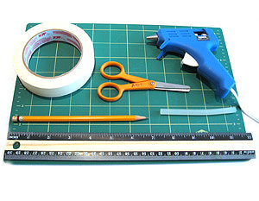
Tools
Tape
Scissors
Pencil
Hot glue gun and glue sticks or Elmer’s
Ruler
Cutting matt (or piece of cardboard)
Materials
8.5” x 11” Cardboard, 24 Pt. or light, about the thickness of a cereal box. Easy to cut.
Cereal boxes
Coragated cardboard boxes
Card stock
Coffee stirrer sticks, chop sticks, barbeque sticks
Build-It-Yourself.com

Slide 3
Truck Base
Engine assembly
Build-It-Yourself.com

Slide 4
Truck Cab
Truck Seat
Build-It-Yourself.com

Slide 5
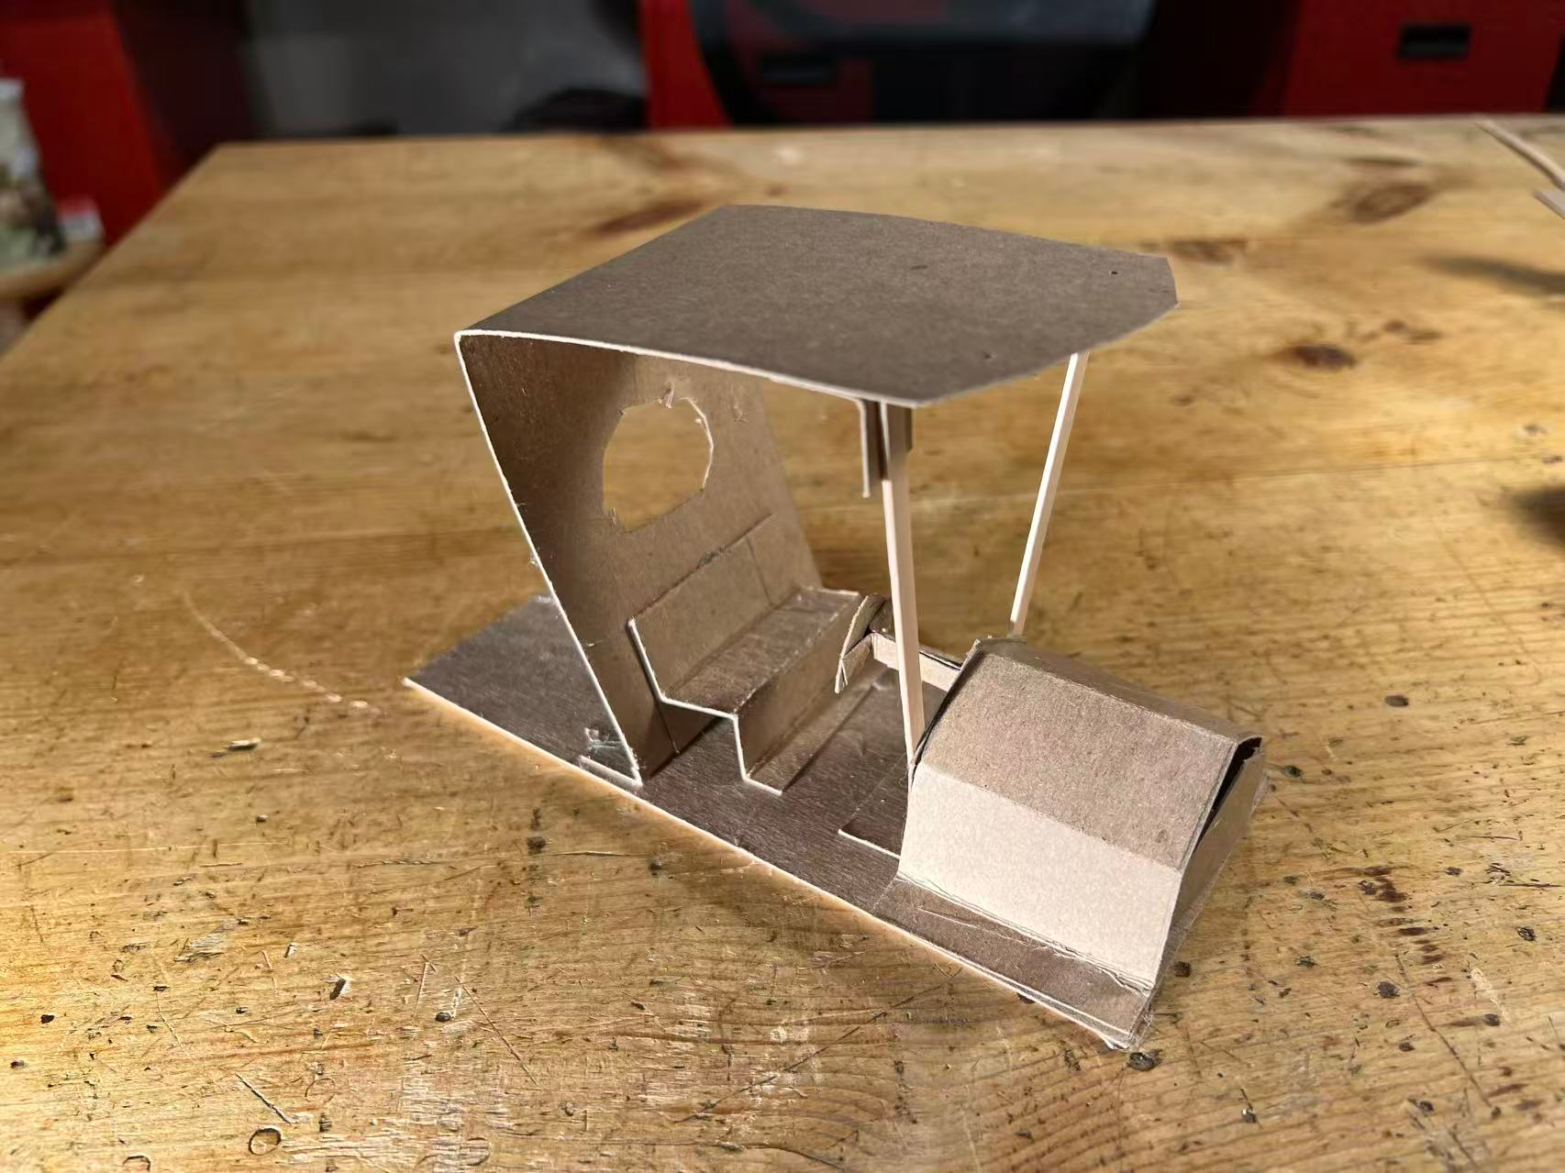
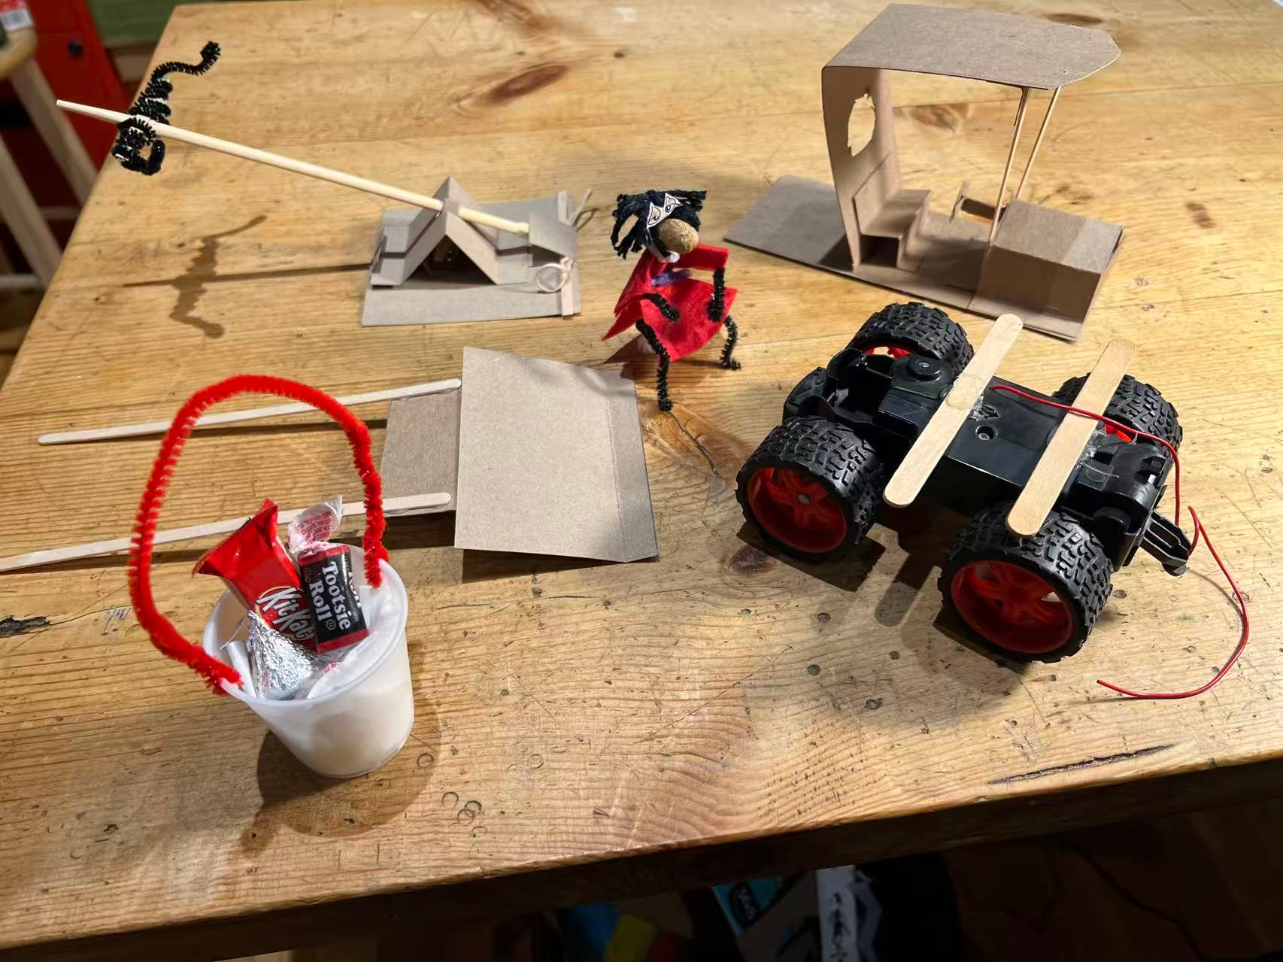
Build-It-Yourself.com

Slide 6
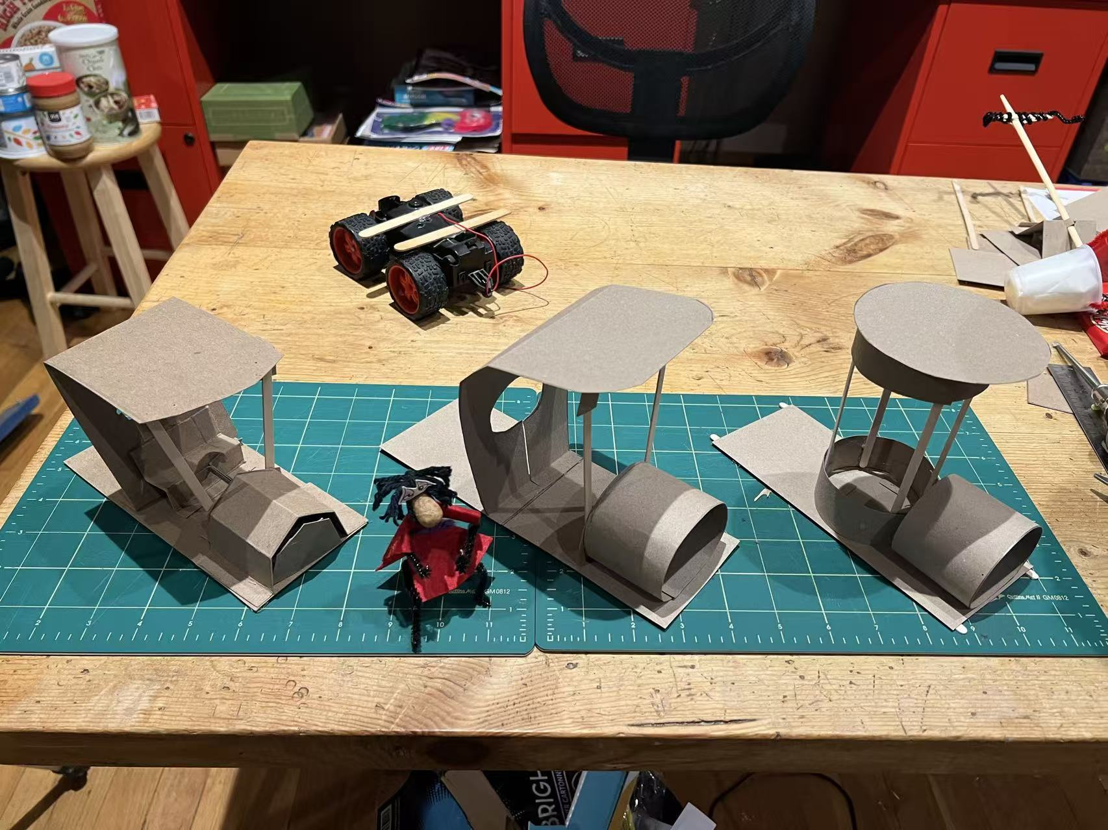
Once you get good at measuring, cutting, scoring, and gluing, try making your own truck top from premium quality junk.
Build-It-Yourself.com

