Slide 1
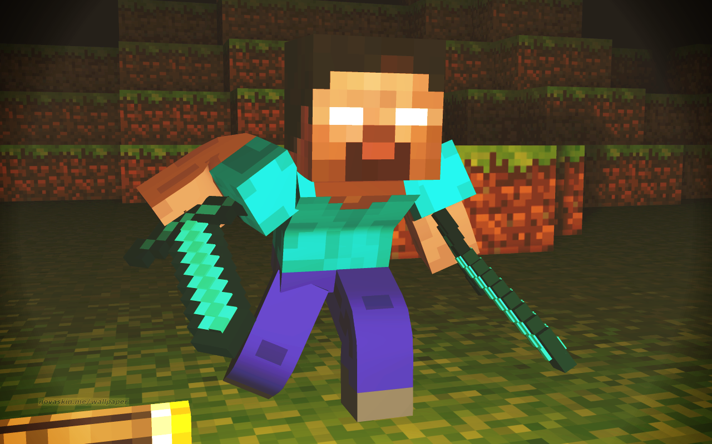
Lab book
KOPYU7643
Team
: Enemy Iengengdary
name:Jay,Kevin,Eric,Micky-kky

Slide 2
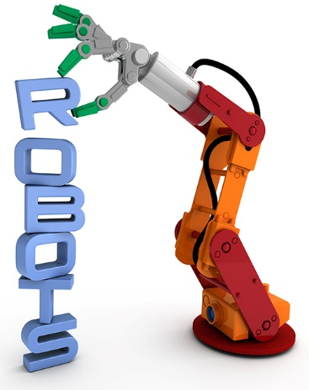
Problem
Many TV programs and movies are booooooring !
Mission
Your mission is to produce and direct your super hero story! (a way cool experimental, computer controlled robotic).

Slide 3
Program Primitives
1)Sequence vs. parallel
2)Iteration
3)Conditional Statements
4)Variables
5)Messages
6)Modular Programming

Slide 4
Problem Solving Tricks
Focus-Identify the problem and set goals.
Research –Don’t re-invent the wheel.
Teamwork-Share ideas.
Simplify-Break your solution into simple parts.
Document-Keep a lab book.

Slide 5
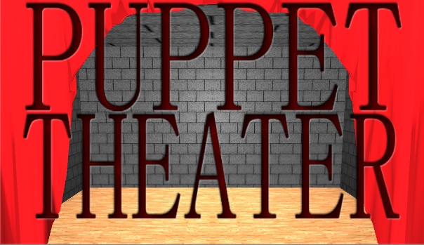
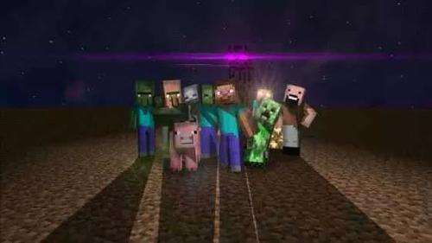
Research

Slide 6
time:3064 year 9 months
Character: Him
Him and monster school
Him woke up at a falling stone in the year of 3064.
He went to the earth and MC City.
At the beginning, all the monsters fight with him.
But Him was stronger than the monsters.
Problem
Him wanted to rule the MC City. And he started the Monster school to train the monsters to be better criminals.

Slide 7
Solution
But he exploded the Monster school.
He wanted to put a TNT above the MC City.

Slide 8
What I learned this week!
Kevin: My strongest impression is built robot. And scratch program it is very easy. And it is very convenient to code. And we make a computer Lab book, it’s very good!
Jay: My building robot and scratch program the building robot is very easy.
Kevin And Jay

Slide 9
What I learned this week
Name: Eric micky-kky
Micky-kky: My strongest impression is building a robot and make a computer lab book.
Eric: teamwork, communication and programming is so easy for me!

Slide 10
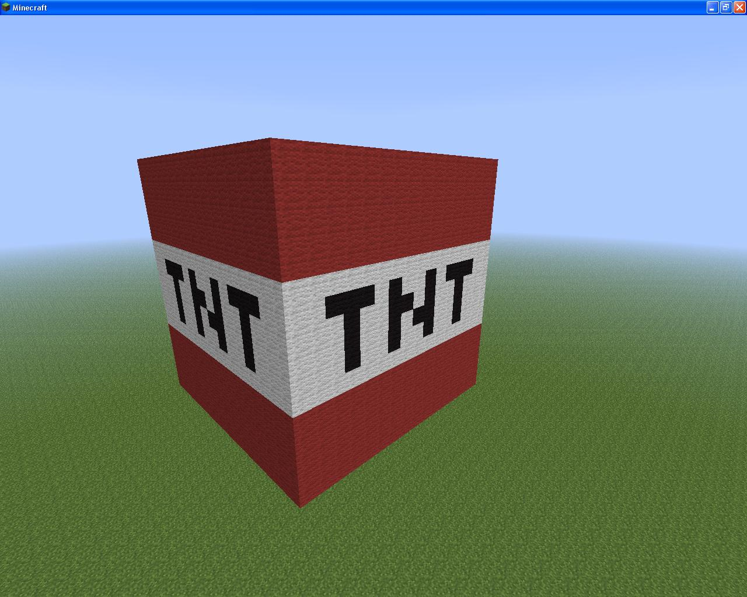
THANK YOU

