Slide 1
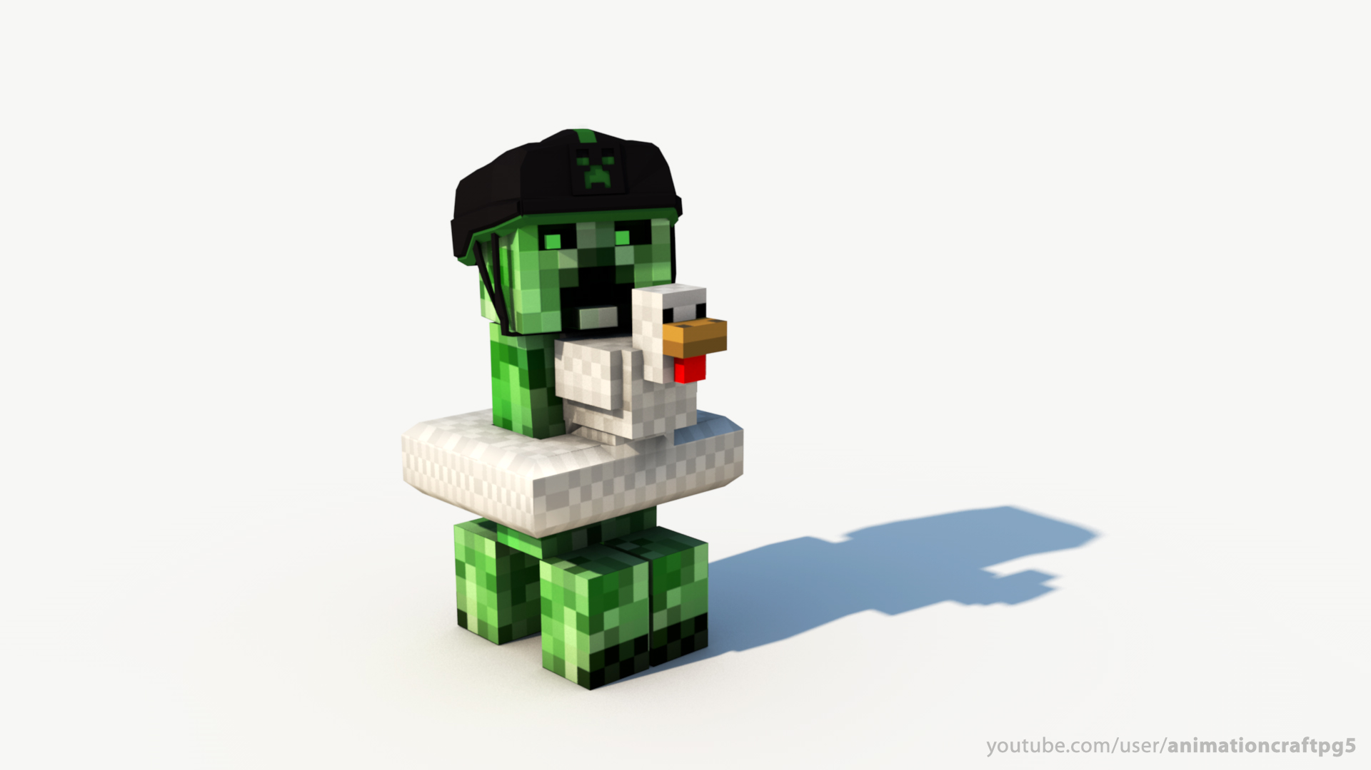
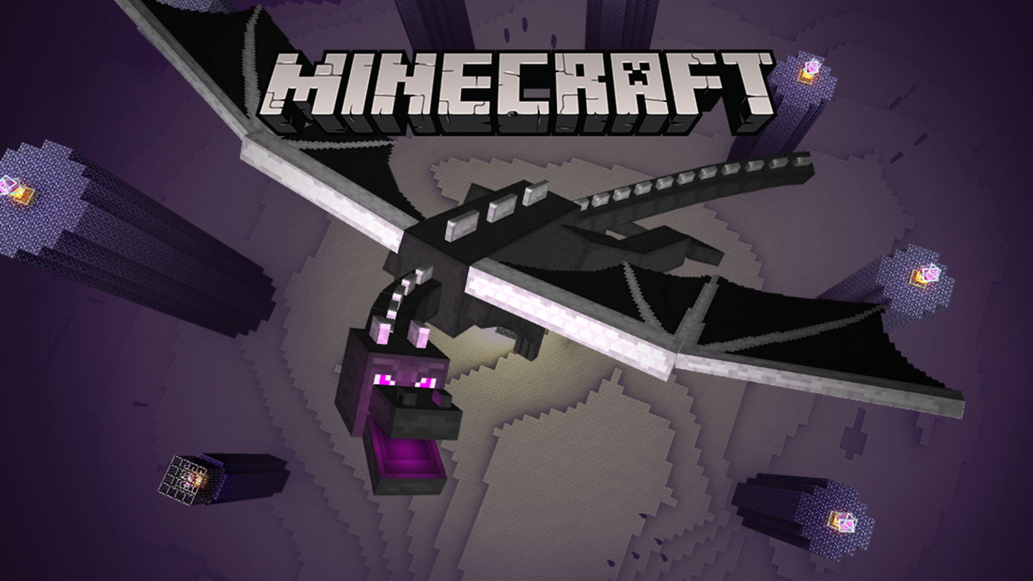
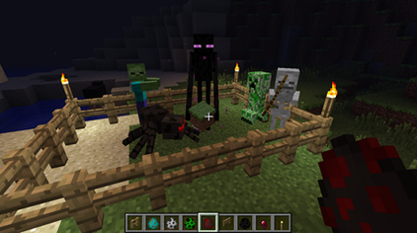
LAB BOOK
[MineCraft] Jack Able Simon Jerry

Slide 2
Program Primitives
1]Sequence VS. parallel
2]Iteration
3]Conditional statements
4]Variables
5]Messages
6]Modular Programming

Slide 3
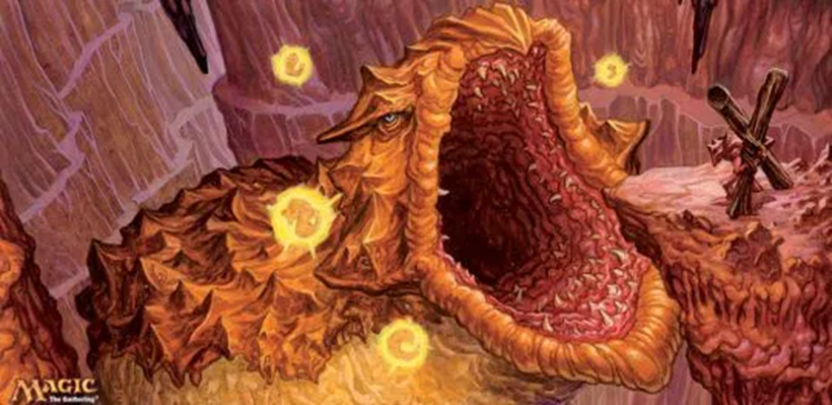
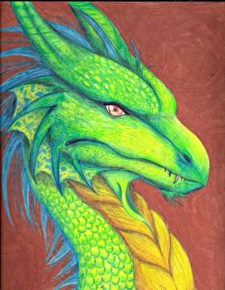
Research

Slide 4
Problem
Many TV programs are boooooooooooooooooooooooring!
MISSION
My mission is to produce and direct my super hero story! [a way cool way]

Slide 5
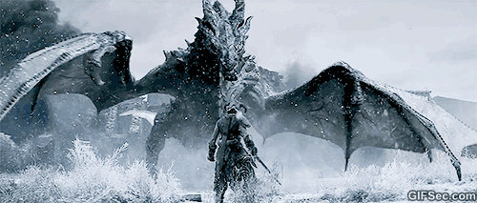
UNDER-DRAGON’S STORY!!!
Once upon a time, an under-dragon lived in the under-land in their world. Under dragon is the hero and a good guy.
Him is the king of the monsters and he wants to steal the dragon’s egg. So he sent the wizard (bad guy) to kill the under-dragon.

Slide 6
UNDER-DRAGON’S STORY!!!
The next day the wizard and the under-dragon fought and the under-dragon won.

Slide 7
Tool Rules
1. Don`t cut Your finger off’
2. Hold work firmly
3. Wear goggles
4. Think what happens if you slide
5. Clean up

Slide 8
Problem Solving Tricks
1,Fous Identity the problem and set the goals.
2,Research Don’t re invent the wheels.
3,Teamwork Share ideas.
4,Simplity Break your solution into simple parts.
5,Document Keep a lab book.

Slide 9
Ender Dragon Eyes

Slide 10
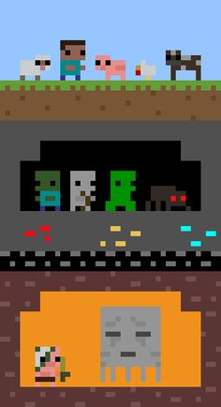
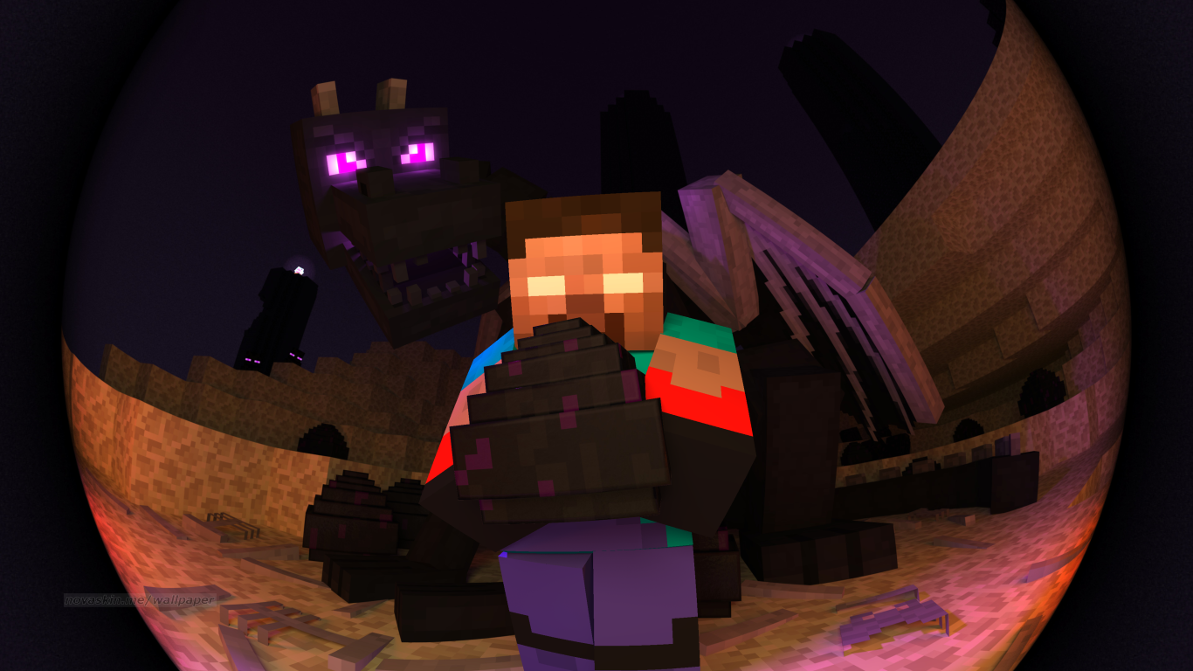
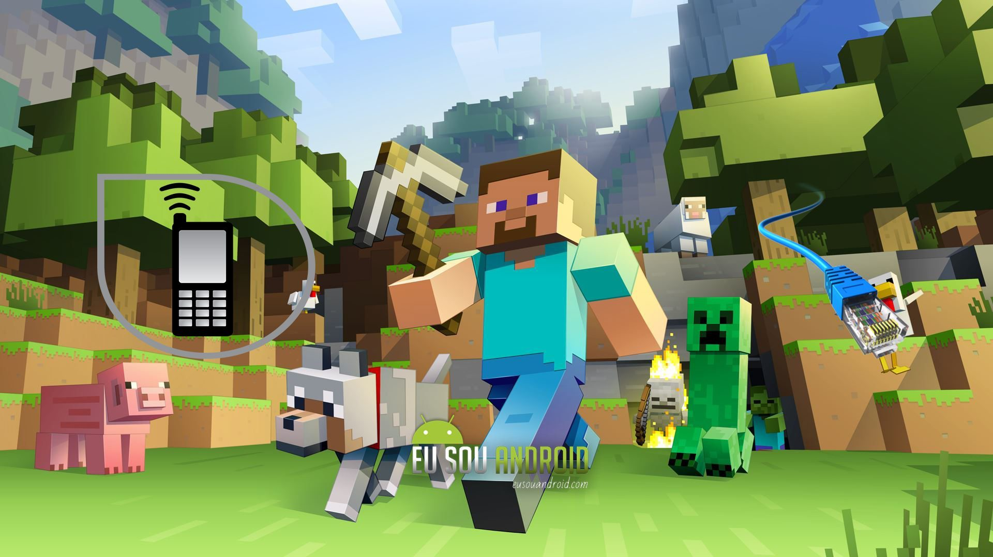
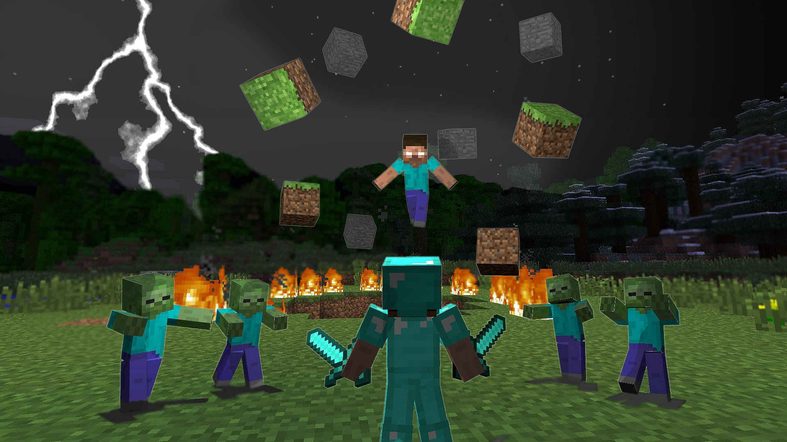
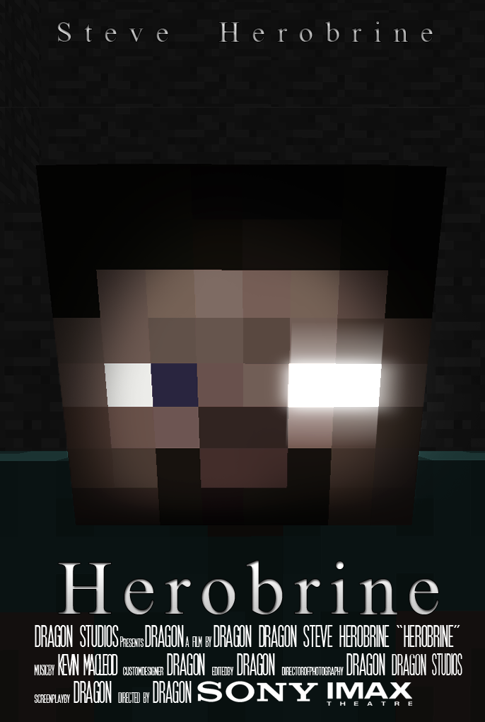

Slide 11
What I learned this week
Jerry- I like teamwork, art, compassion, coding, and making robot
Able-I learnmake pptc, compassion, linten to others’ ideas.
Jack – This lessons tell me a lot of art knowledge, building.

