Slide 1
Teamwork!
Build-It-Yourself.com

Slide 2
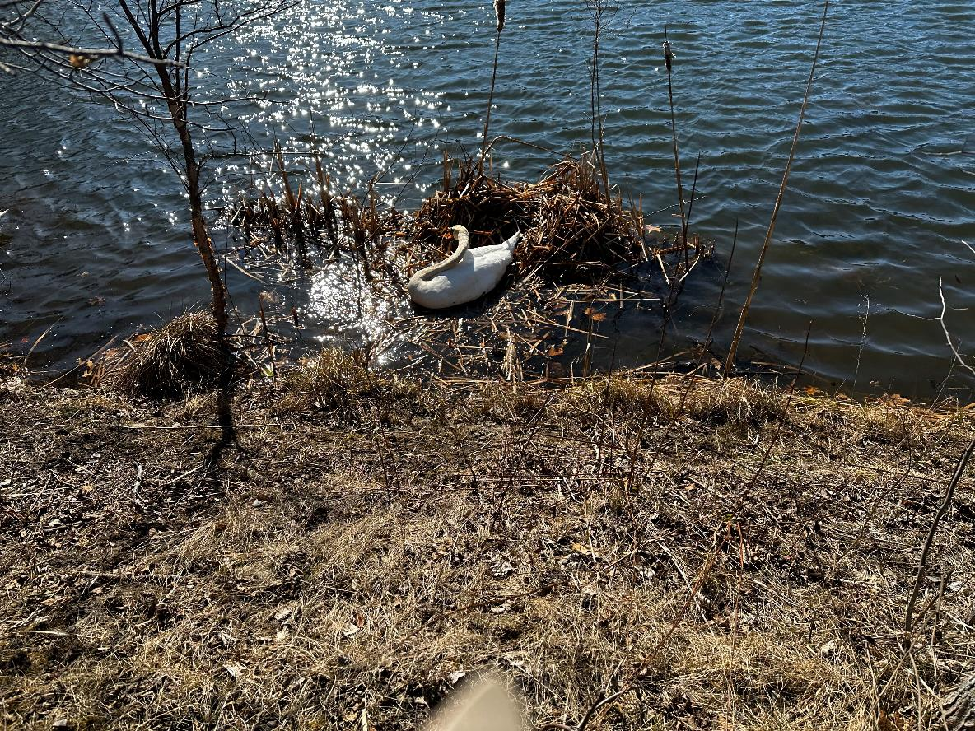
Houston … We have a problem.
Build-It-Yourself.com

Slide 3
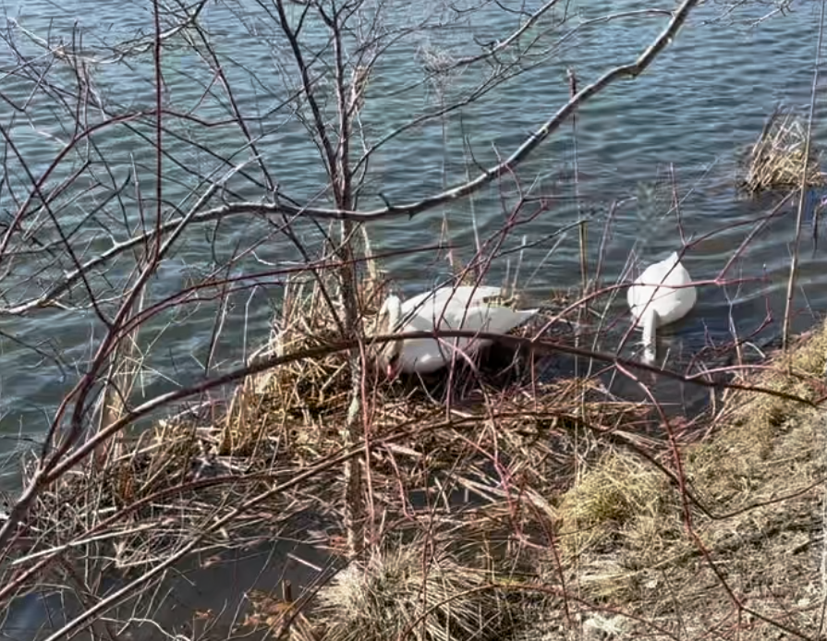
We need more stuff to build this nest.
Build-It-Yourself.com

Slide 4
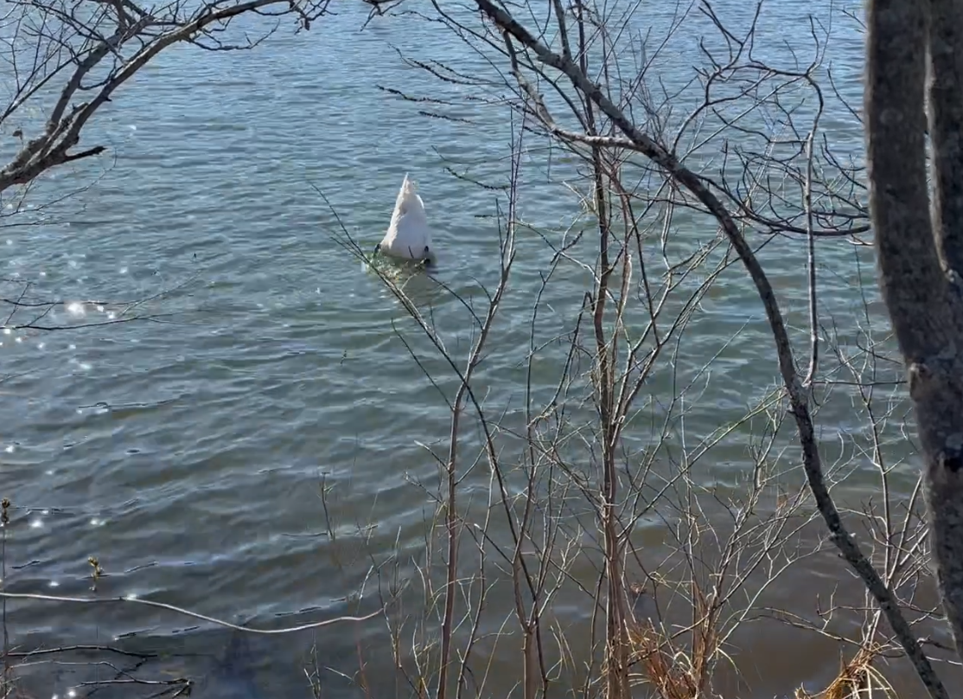
We need much more stuff!
Build-It-Yourself.com

Slide 5
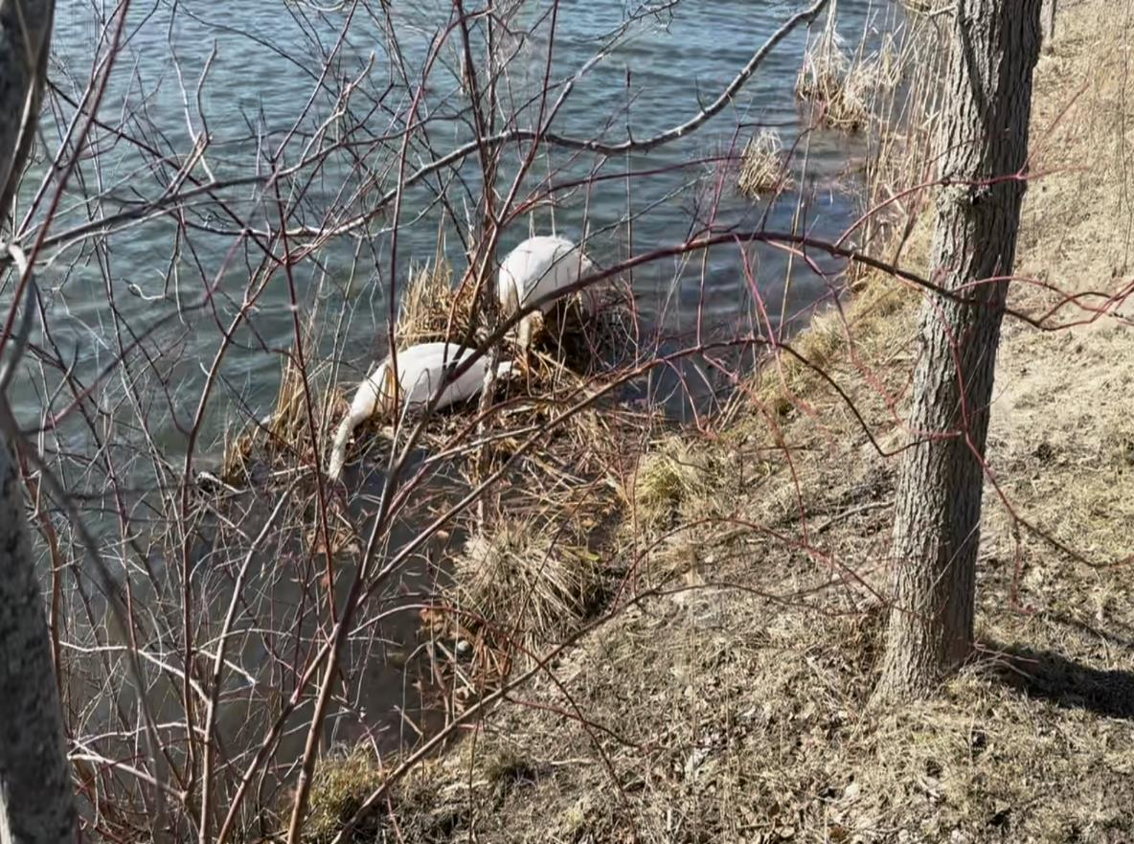
And we need help sorting all this stuff.
Build-It-Yourself.com

Slide 6
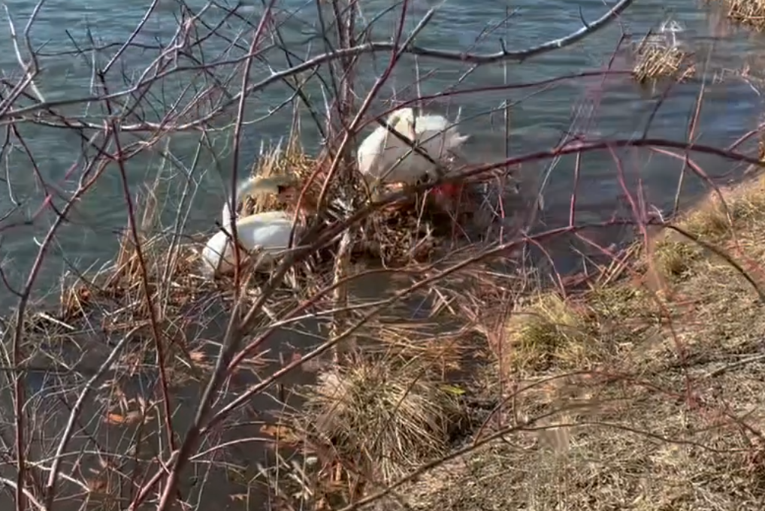
And we need help sorting all this stuff.
Build-It-Yourself.com

Slide 7
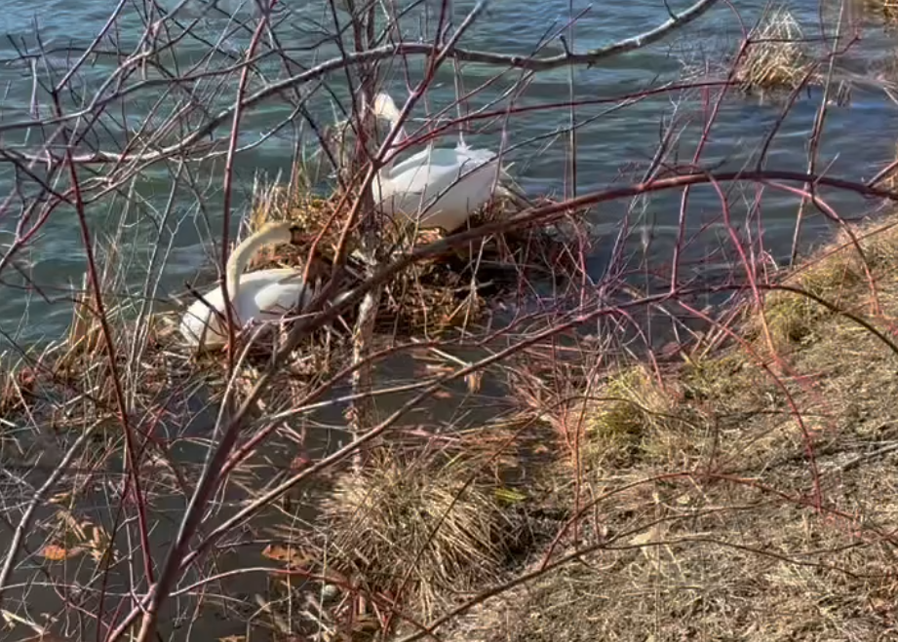
And we need help sorting all this stuff.
Build-It-Yourself.com

Slide 8
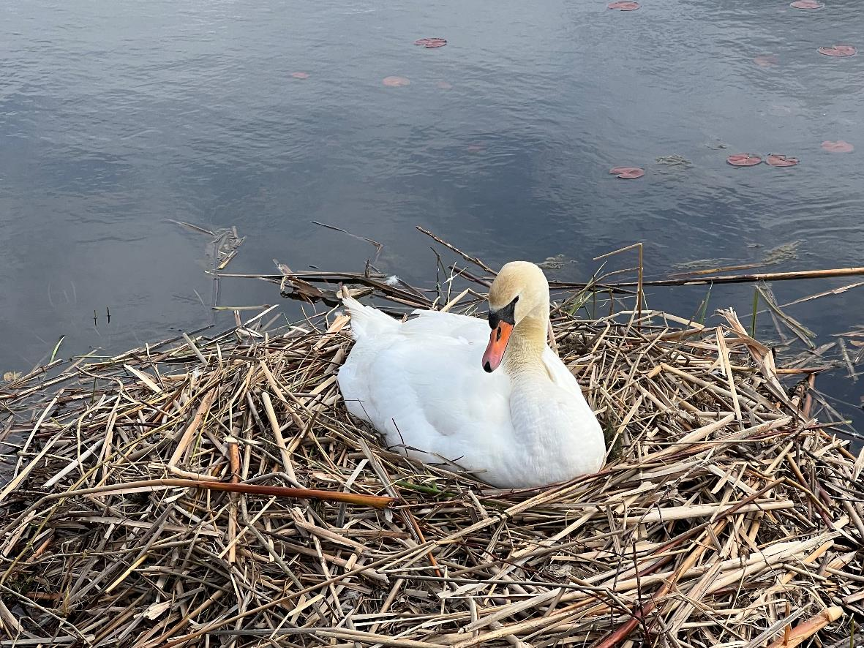
Teamwork Rewarded. Way cool PERFECT!
Build-It-Yourself.com

Slide 9
Teamwork!
What are examples of good teamwork?
Has anything really important been done by only one person?
https://www.youtube.com/watch?v=-4nk7ENEiZw
Build-It-Yourself.com

