Slide 1
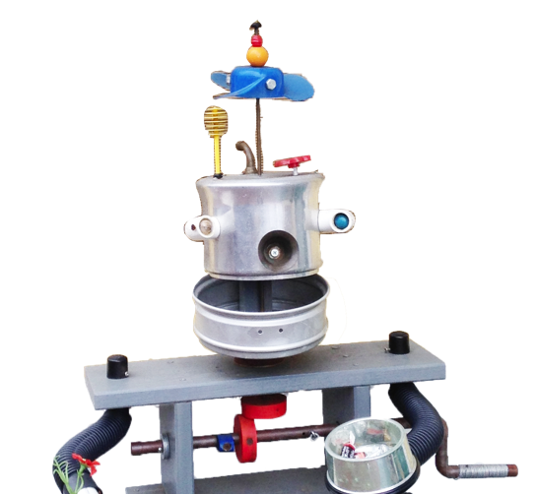

Slide 2
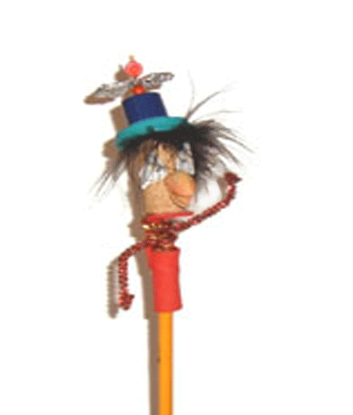
Let’s teach kids to share the universe!
Let’s teach kids to use technology to make the world better!

Slide 4
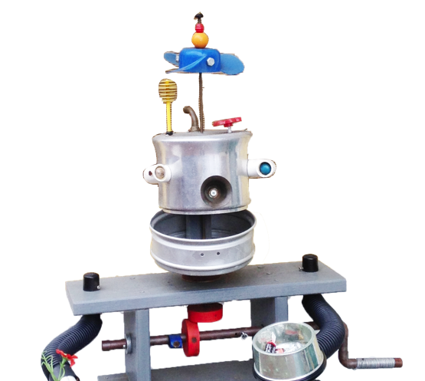
PROBLEM

Slide 5
FUN

Slide 6
SKILLS

Slide 7
SHARE

Slide 8
EXPENSIVE

Slide 9
MISSION

Slide 10
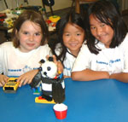
It is IMPORTANT for
Learn Together
Ideas
Build Collaboratively

Slide 11
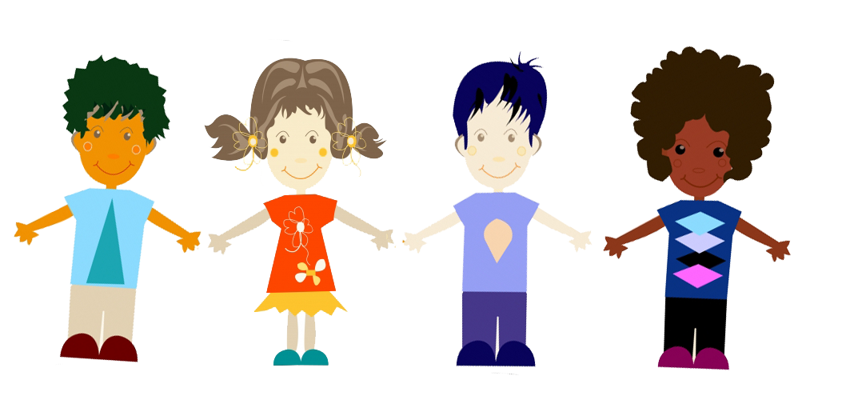
Economize
Have Fun
Share Ideas
Life Skills

Slide 12
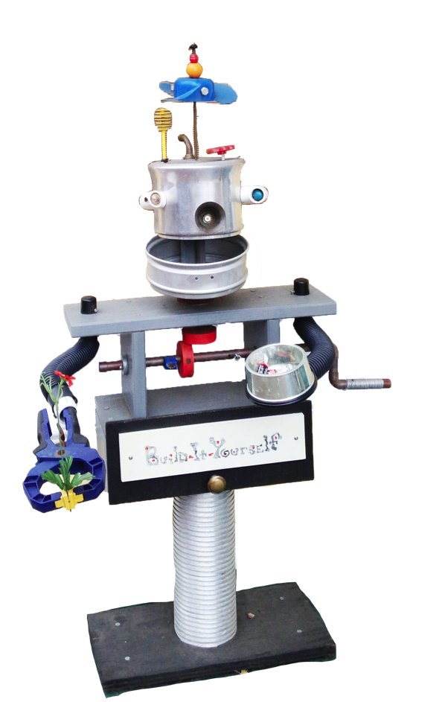
STRATEGY

Slide 13
CONTENT
TEACHERS
COLLABORATION PLATFORM

Slide 14
Game-like
Storyline Challenges
Building Tricks
Build-It-Blocks Modules

Slide 15
WIKI
SOCIAL MEDIA
UNIVERSIAL
VARIOUS
TEACHERS
UNIVERSIAL
KIDS
WEBCAST
INVENTION UNIVERSIAL

Slide 17
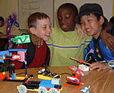
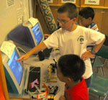
Universal

Slide 18
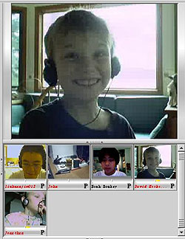
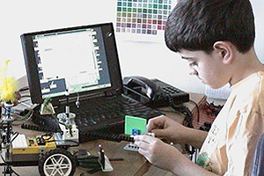
eLearning

Slide 19
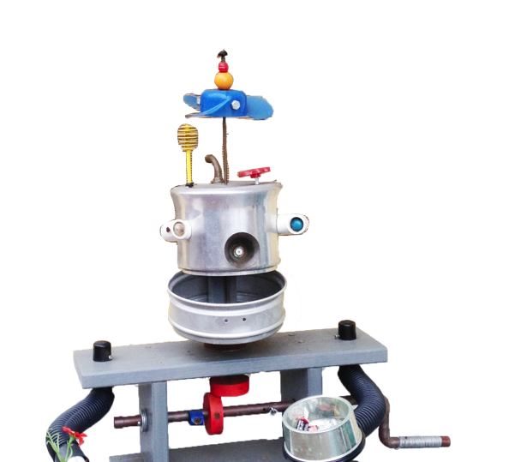
RESULTS

Slide 20
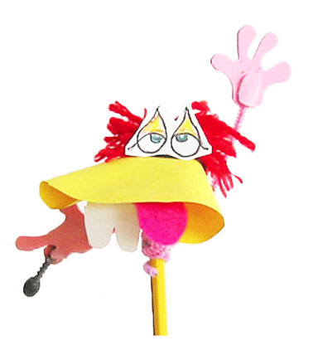
Fun

Slide 21
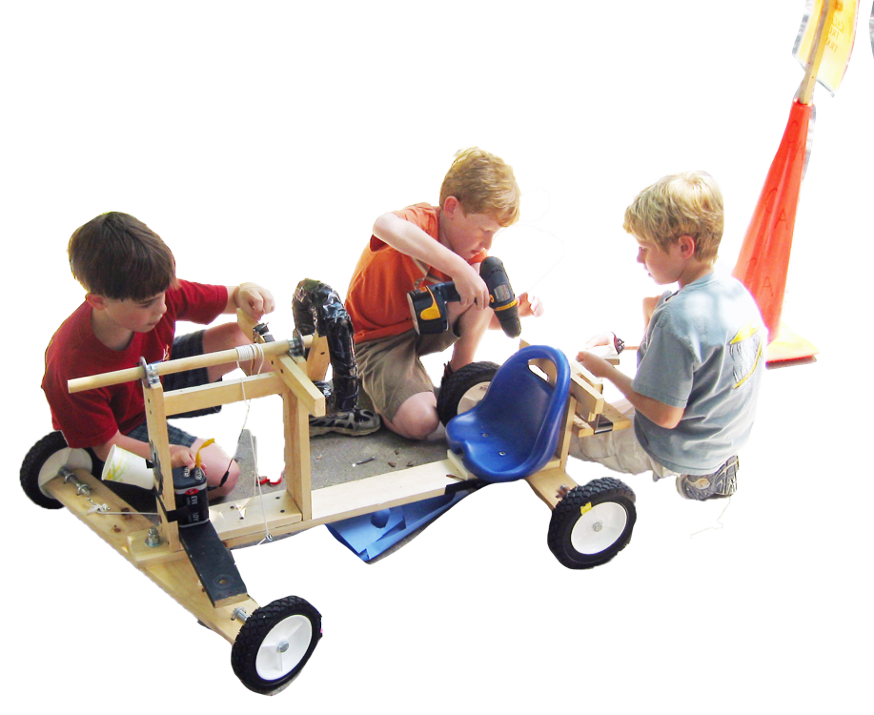
Valuable
Skills

Slide 22
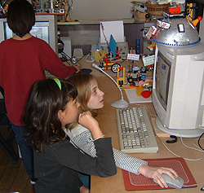
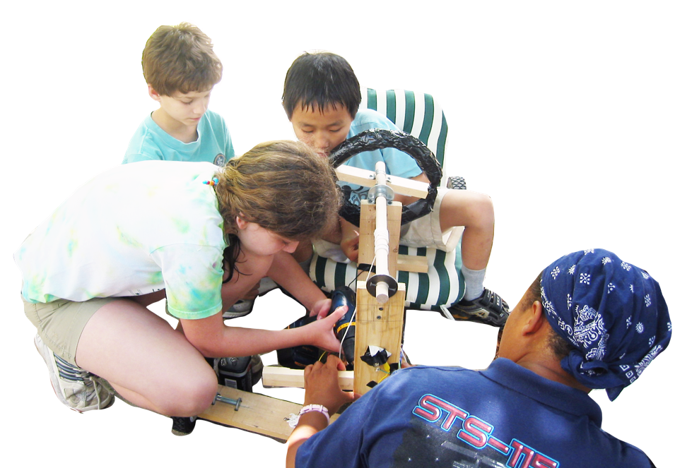
Engage

Slide 23
Join our team
Help us bring BIY to your community
Become a BIY member
Become a BIY intern
CALL TO ACTION

Slide 24
LET’S SHARE

