Slide 1
BIY Introduction to kids 8-12 who are:
Playful
Artistic
Builders
Notes:
Target audience interests / BIY differentiators

Slide 2
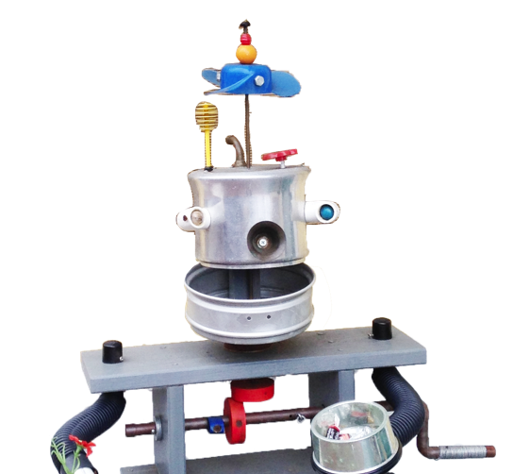
Creative STEAM
Notes:
Welcome to the Build-It-Yourself
Creative STEAM laboratory

Slide 3
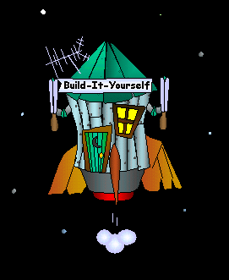
Creative STEAM
The Problem:
Build-It-Yourself to Planet Earth … Past generations have created some wicked nasty situations.
Ugly wars
Smelly pollution
Dreadful diseases
Notes:
The Problem:
The next generation of leaders and builders must use complex technology in creative ways to solve some very nasty problems.

Slide 4
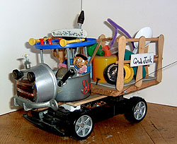
Creative STEAM
The Mission:
Build way cool contraptions that save the world from vile villains and scurrilous scoundrels.
Be a superhero!
Notes:
Our Mission:
Inspire and guide kids to use technology constructively and creatively.

Slide 5
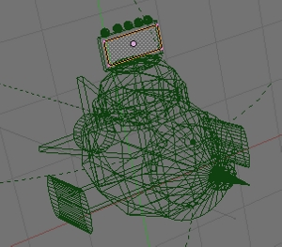
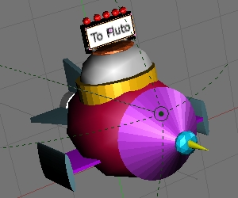
Creative STEAM
Projects:
Think and express your ideas in 3D.

Slide 6
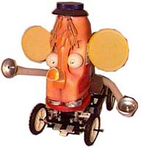
Creative STEAM
Projects:
Build wild things from premium quality junk.
Notes:
Thomas Edison said that to be a good inventor, you need a pile of junk.
We build robots from recycled materials.

Slide 7
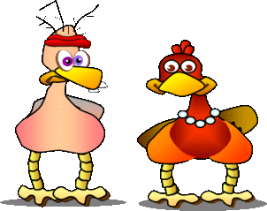
Creative STEAM
Projects:
Design emojis to share with your buddies.

Slide 8
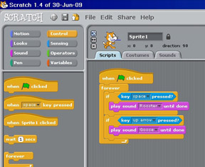
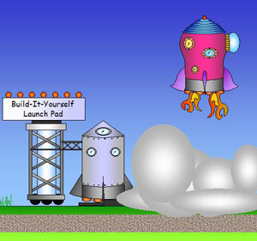
Creative STEAM
Projects:
Design games that stump your friends.
Notes:
MIT’s Scratch is our computer programming language.

Slide 9
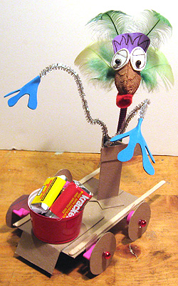
Creative STEAM
Projects:
How many pieces of candy can your robot collect?
Notes:
At BIY, your project must work and they must look way cool.

Slide 10
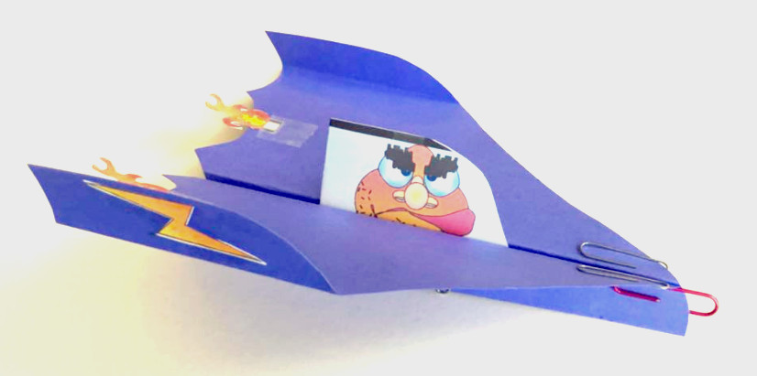
Creative STEAM
Projects:
Meet aliens from other worlds.
Notes:
Even food is recycled in Build-It-Yourself projects.
This is a turnip head from our ‘Ugly Veggies’ project.

Slide 11
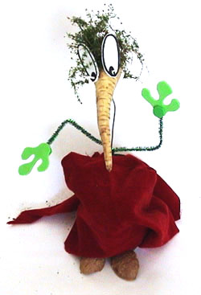
Creative STEAM
Problem:
Did your mom ever tell you not to play with your food?
Notes:
Even food is recycled in Build-It-Yourself projects.
This is a turnip head from our ‘Ugly Veggies’ project.

Slide 12
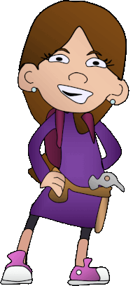
Creative STEAM
The Results:
Have a ton of fun doing good.
Notes:
Experience the joy of building

Slide 13
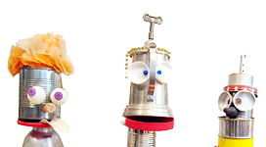
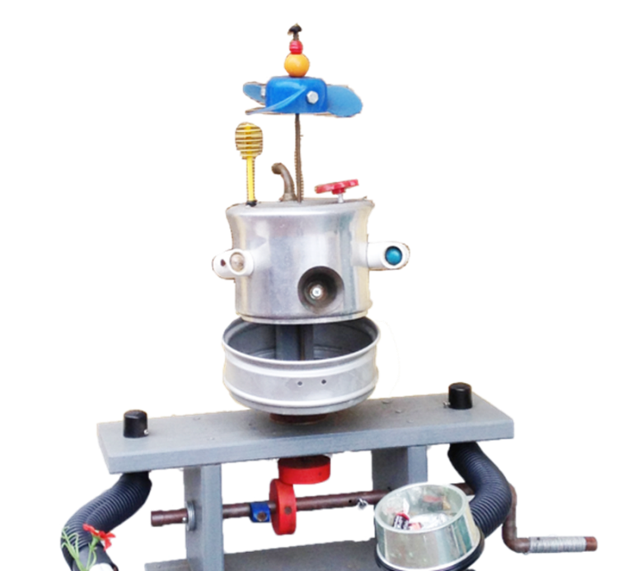
Join our crew.
Email: support@build-it-yourself.com
Telephone: 617-875-1960
Notes:
We invite you to join our team. Send us an email or WhatsApp message

Slide 14
BIY Introduction to parents who value:
Thinking like an artist
Building like an engineer
Global citizenship
Notes:
Target audience interests / BIY differentiators

Slide 15
Laboratory Hazel Lim, Lucian Covarrubias, John Galinato Inspire and guide kids to build.
Notes:
Welcome to the BIY Laboratory …
Where Art and Technology Rule.

Slide 16
The Mission
Think like an ARTIST
Build like an ENGINEER
Notes:
The BIY program coaches kids to think like artists and build like engineers.
Multi-discipline A-STEM.

Slide 17
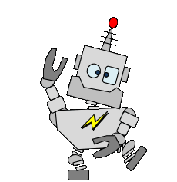
The Mission
In a unique global laboratory
Notes:
We aim to enable kids from all over the world to experience the joy of building together.

Slide 18
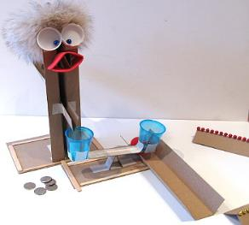
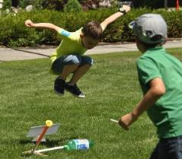
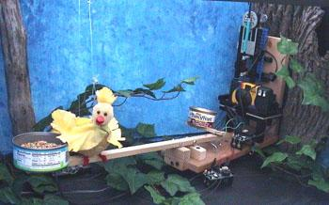
Projects
Notes:
How do we inspire and guide?
Our storylines lead to projects that build confidence, exercise practical skills, and drive creativity.

Slide 19
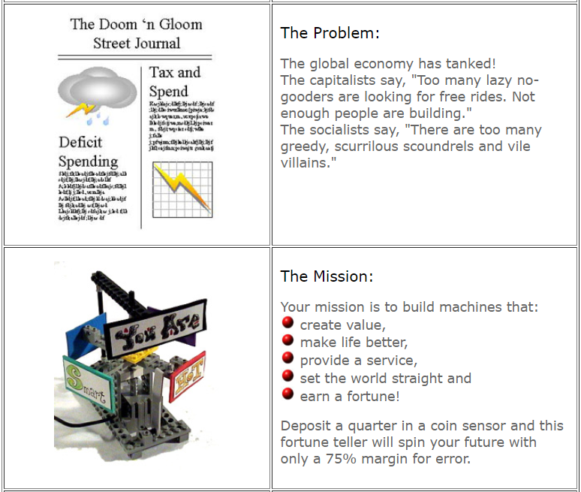
Projects
Notes:
How do we inspire and guide?
We have 30 8-week projects. Each project starts with a problem / mission storyline around some social issue.
The storylines have a serious social message, but a playful, computer-game like cover.
The Doom and Gloom Street Journal tells of greedy capitalists and lazy socialists wrecking our economy.
Your mission is to build a robot that sets the economy straight and earns a fortune.

Slide 20
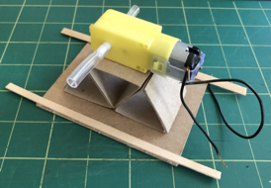
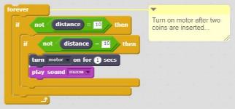
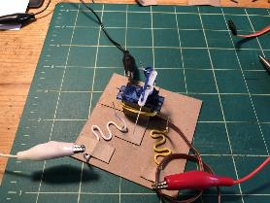
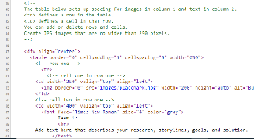
Build-It-Blocks
Robot
Building Blocks
Programming Building Blocks
Art
Building Blocks
Notes:
How do we inspire and guide?
Our library of Build-It-Blocks reinforces a key engineering concept:
Break a problem into simple parts.
Build-It-Blocks enables kids to build relatively complex, creative, unique solutions quickly.

Slide 21
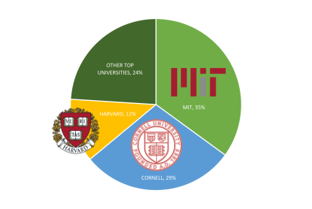
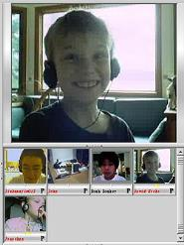
Network of TAs
Notes:
How do we inspire and guide?
Our network of TAs are recruited from well-known schools and trained to guide and inspire kids to follow the Build-It-Yourself artist – engineer way of thinking

Slide 22
Network of TAs
TA College
Annaliese MS CS, Cornell
Huan MS CS / EE, MIT Will MS CS, Cornell JD BS CS, Cornell
Tomisin BS CS, MIT
Michael BS CS, MIT
Aditi BS ME, Cornell
Wenyu BS CS, Purdue
Seth BS CS, MIT
Jaime BFA, Mass Art
Aleksya BS ME, MIT
Iok MFA, RISD
Company
Twitter
Mujin Google Amazon
Facebook
SpaceX
Microsoft
Apple
Bloomberg
Harmonix
Mattel
NASA
Notes:
How do we inspire and guide?
BIY has a long record of attracting talented developers.

Slide 23
Global Laboratory
Notes:
We invite you to join our unique online global laboratory.

Slide 24
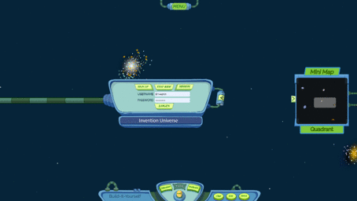
Invention Universe
Notes:
Invention Universe is like LinkedIn for kids.
Over several years, BIY members will develop a portfolio of projects that demonstrate their passion for art and engineering.
This portfolio could be useful in a college application.

Slide 25
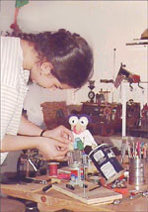
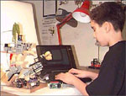
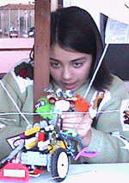
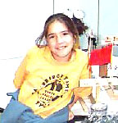
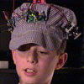
The Results
Notes:
We are looking for kids who are on an ambitious art or engineering track.

Slide 26
Benefits
Develop a passion for building.
Exercise problem-solving techniques.
Exercise communication skills.
Build a project portfolio.
Notes:
If we can make building playful and fun, then maybe we will spark a life-long joy of building and learning and working together.
We want to put your kids in a position to be the leaders of a global community that will solve the world’s toughest problems.

Slide 27
Projects
Physical Projects
Lab Setup
Veggie Sculptures
Money Robots
Flying Machines
Towers of Power
Virtual Projects
Scratch Games
Emoji Design
AI Tools
3D Graphics
Website Design
Minecraft
Build a Portfolio
Notes:
Watching kids build together, communicate freely, and be productive gives one confidence that the world will be in good hands when they take over.

Slide 28
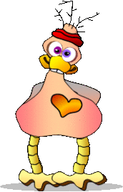
What you will need
WeChat Emoji Design
PowerPoint or Google Slides
I’m busy
That’s way cool
I love it!
Notes:
Parts, tools, and supplies

Slide 29
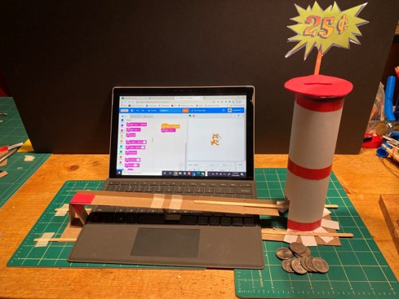
What you will need
Robots That Earn Money
PowerPoint, Google Slides,
or paper & pencils
Glue gun and craft materials
kit ($50 optional)
Many families can easily collect the parts and tools we use.
Notes:
Parts, tools, and supplies

Slide 30
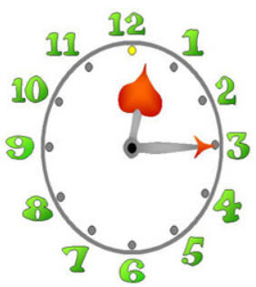
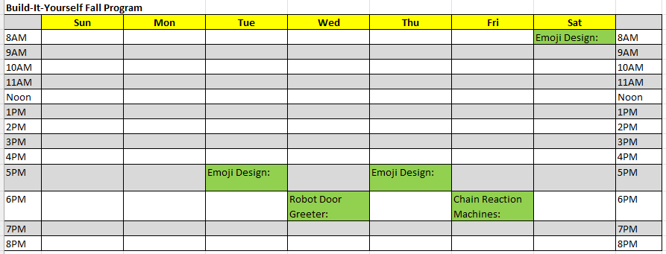
Schedule Mexico Time
For members ages 8-10
Starting September 23, 2024

Slide 31
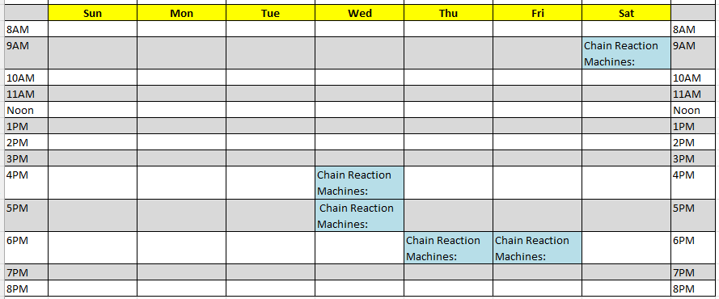
Schedule Mexico Time
For members ages 10-12
Starting September 23, 2024

Slide 32
Cost
Membership (Ages 8-12)
$ 120 Eight 1-hour webcast workshops
$ 400 Thirty-two 1-hour webcast workshops
Member Application
Intern Program (Ages 13-18)
$2500 Work on a BIY Development Team
Intern Application
Payment instructions

Slide 33
Join our crew
Email: support@build-it-yourself.com
Telephone: 617-875-1960

