Slide 1
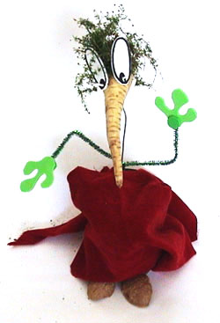
Project Leader Preparation
Notes:
Welcome to the BIY Laboratory …
Where Art and Technology Rule.

Slide 2
Preparation Session 1 https://youtu.be/plwXFiiG6wo
Company Goals
Build a product that can change the world.
Work with an inspiring team.
Make a ton of money
Have fun.
Notes:
We want to cultivate the entrepreneurial spirit!
We look for builders who
Want to build something big.
Will inspire teammates.
Are sensitive to the business world.
Like to have fun.
If we do 1 and 2, then 3 and 4 will follow.

Slide 3
Prep Session 1
Customer Product
Families who spend $2K/year/kid on extra curricula programs.
Kids 8-13 who are on a college track.
Art, Technology, and Engineering Project based learning
Think like an artist.
Build like an engineer.
Notes:
It all starts with understanding who our customer is.
Build personal relationships with our customers.

Slide 4
Prep Session 1
Elevator Pitch
Build-It-Yourself offers an art and engineering program driven by technology-in-education research at MIT.
Our mission is to inspire and guide the next generation of builders to use technology creatively in a unique global laboratory.
Think like and artist. Build like an engineer.
We aim to make it a ton of fun to build robots, contraptions, websites and games.
Notes:
We must all be able to sell the BIY program to friends, customers, partners, and investors

Slide 5
Prep Session 1
Differentiators
Art leads technology
Playful, MIT-like, project storylines
Network of artists and engineers
Build-It-Blocks
Invention Universe
Notes:
Our most obvious differentiator is that Art leads Technology.
All of our competitors say they have great teachers.
We aim to prove that our network of TAs is unusually good.
What is Build-It-Blocks? Reinforces modular construction
https://build-it-yourself.com/blocks/index-bib.php
What is Invention Universe? LinkedIn for kids
https://build-it-yourself.com/p-kids/index-kids.html

Slide 6
Prep Session 2 https://youtu.be/h-JwYB5N84Q
Presenting Ideas
Ugly
Inconsistent
Out of bounds
Average
Boring
In bounds
Way Cool !!!
Creative order
3rd dimension
https://build-it-yourself.com/s-lessons/lesson-present-ideas.ppt
Notes:
We emphasize the importance of presenting your ideas clearly, concisely and convincingly
And
We teach kids to think like an artist.
https://build-it-yourself.com/s-lessons/lesson-present-ideas.ppt

Slide 7
Prep Session 2
Problem Solving Tricks
#1 Focus - Identify the problem and set goals.
#2 Research - Don’t re-invent the wheel.
#3 Teamwork – Share ideas.
#4 Simplify - Break your solution into simple parts.
#5 Document - Keep a lab book.
https://build-it-yourself.com/s-lessons/lesson-problem-solving-tricks.ppt
Notes:
We teach kids to think like an engineer
https://build-it-yourself.com/s-lessons/lesson-problem-solving-tricks.ppt

Slide 8
Prep Session 2
Concord Academy Super Staff Sheet
Smiles: Be energetic. Communicate positive, 'can-do’ passion.
Relates: Learn member’s names and interests as quickly as possible and use names often.
Is ready: Be prepared (knows BIY content) and suggests alternative ideas. Provides personal commentary with instructional content.
Listens and responds: 'Tell me more about that' Praise good work and suggest how everyone's work could be even better. Cite examples relevant to individual member's interests.
Is on time: Get ready for workshops on time and respond to messages.
Notes:
This is a summary of attributes from the Concord Academy Super Staff Sheet.

Slide 9
Prep Session 3 https://youtu.be/h-JwYB5N84Q
Favorite Teachers???
Great story teller
Flexible
Patient
Qualities???
Notes:
What are the qualities of your favorite teachers or professors?

Slide 10
Prep Session 3
Presentation Qualities
Humor
Playful dialog
Personal stories
Interesting art, engineering facts
Energetic
Cool examples of good and bad
Deep knowledge of what you are teaching

Slide 11
Prep Session 3
BIY Content
Projects
PPT Intro
Lesson Plan
Parts, Tools, Supplies, Software
Build-It-Blocks
Invention Universe
Notes:
We have 30 projects. Half are virtual. Half are physical.
Build-It-Blocks enables kids to build unique, complex solutions to problems quickly.
Invention Universe enables kids to show their projects to the world.
LinkedIn or Istagram or Behance for kids.

Slide 12
Prep Session 3
Critique Presentations
Minecraft
Forts
Soap box racers
Towers of power
Blender
Measures of success:
Engaging
Fast paced
Meet lesson plan objectives
Notes:
What works well and what can we do better?

Slide 13
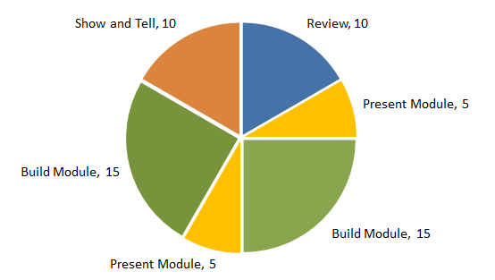
Prep Session 4 https://youtu.be/ghlwv014Ujo
Typical Lesson Plan Flow
1-hour Workshop Period
10 min – Review
5 min - Present lesson or challenge
15 min - Build
5 min – Present lesson or challenge
15 min - Build
10 min - Show and tell and critique

Slide 14
Prep Session 4
Typical Lesson Plan Flow
8-hour Workshop Series
Project intro, Start lab book, Research, Build a module
Review, Module intros, Build a module
Review, Module intros, Build a module, Present Problem solving tricks.
Review, Module intros, Build a module, Present Ugly, Average, Way Cool.
Review, Module intros, Build a module
Review, Integrate modules
Review, Integrate modules, Prepare to present projects
Present Projects

Slide 15
Prep Session 4
Measures of Success
No complaints
Safety
Meet expectations
Engagement
Repeat customers
Extra work outside workshop
Buy a tool

Slide 16
Prep Session 5
Next Steps
Build solutions to the projects you will be teaching.
Observe and gradually drive workshops. (We will send you a schedule of our workshops which you can observe.)
Submit playful bio and 100x100 picture.
Create an Invention Universe planet.
Fill out BIY HR Forms.

Slide 17
Prep Session 5
Next Steps
BIY will compensate you for up to 20 hours of training. If you need more hours to learn BIY tools, we hope you will consider the extra hours a valuable and fun investment of your time.
We welcome your suggestions:
How can we improve the training process?
(More fun, shorter, more effective)
How can we improve our content?

Slide 18
Tip of the Week #1
Teach to the BIG PICTURE.
BIY offers an art and engineering program to kids 8-12
We promise parents that at BIY, kids will …
Think like an artist.
Build like an engineer.
Relate activities to the importance of presenting ideas clearly, concisely, and convincingly.
Document "3 Ways to Present Ideas"
(Ugly, Average, Way Cool)
Relate activities to the engineering process and review the 5 problem-solving tricks often.
Document "5 Problem-Solving Tricks.“
(Goals, Research, Teamwork, Simplify, Document)

Slide 19
Tip of the Week #2
Have fun!
Make your passion for art, programming, music, and robots rub off on others.
Use playful, funny, extreme examples.
Smile for the camera.
Tell stories about your favorite memories or tricks, especially when kids are building or updating lab books.
Keep the pace fast. There should never be dead, silent time. Someone should always be talking and sharing screens.
Ask thoughtful questions often.
Try showing the UGLY vs. the BIY WAY COOL solution to make a point.

Slide 20
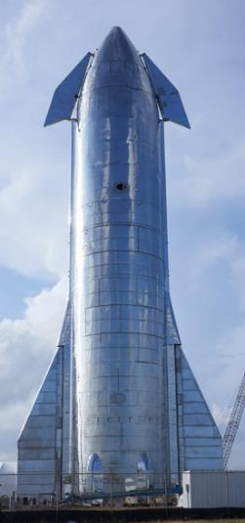
Tip of the Week #3
Think Computer Game and Comic Book
The new Elon Musk biography suggests that Elon got his passion, drive, and creativity by reading comic books, playing computer games, and building rockets, not from homework.
The BIY platform:
Project storylines are computer game-like (problem/mission)
Build-It-Blocks are like a puzzle game.
Invention Universe is inspired by the computer game, “Spore.”
When working with BIY members, remember that a kid’s loyalty is a function of how much the BIY program is like a computer game: full of fun, exaggeration, drama, and interactivity.
Our parents’ loyalty is a function of the creative and problem-solving skills they see their kids learning and talking about, as documented in their lab books.

Slide 21
Tip of the Week #4
Build Relationships
At Netflix: Families pay $10/month to sit on a couch and watch movies.
At BIY: Families pay $40/month to interact and build with artists and engineers who are on the exact track parents want their kids to follow.
Write periodic notes to kids and their parents.
Ask questions about their passions, heroes, pets, and least favorite things to do.
Tell stories about your own trail.
Send your lab book progress to families so they can see what you are doing.

Slide 22
Tip of the Week #5
Be prepared.
Know where to find modules in Build-It-Blocks.
Know or build a lesson before delivering.
Document an agenda for each workshop in your lab book.

Slide 23
Tip of the Week #6
Be professional.
Respond to emails promptly.
Be on time.
Report progress and offer feedback.

Slide 24
Feedback Notes
Presentation Strategy
I want to know why I have to learn something.
Tell the big picture first. Then drill down.
Explain why presenting ideas or Prob Solving Tricks or Lab Books is important.
Tell stories, especially personal stories.
Show good vs bad. Ugly vs Way Cool.
Presentation Pace
Make it move quick.
Prep is important. Build it first
Know your material
Less is more. Minimize blah blah blah. Cut to the chase.
Put side issues for off line or for later discussion.
Everyone should be doing something. Once you set the class on an assignment, then go back and address unique questions
Use Build-It-Blocks to get everyone building while we address specific questions.
Refer to extra assignments in the lesson plan for advanced students.
Focus and Engagement
Ask interesting questions. What are specific interests? Sports, music,
Add humor.
Get kids to tell stories.
Adjust to class ability.
Shut off MC when talking.
Or set up a task chart that kids have check off before building

Slide 25
Feedback Notes
Show and Tell Critique
Don’t be afraid to say what can be better. If you say something is cool, say why. If you think something could be better, be specific. Show ugly vs way cool example.
Present => Do
Minimize talking. To 5 min. Max doing. To 15 min.
After presenting a lesson, make a specific, FUN 15 minute challenge..
Use Module Templates
To keep everyone on the same page and working independently, use module templates. Don’t create new code until you demonstrate you know how the module template works.

Slide 26
Recommendations
Kick-off letter template:
Dear <New workshop leader>
Often, BIY is asked to write recommendations for BIY TAs and developers. To this end, let’s start the process of writing your recommendation.
Please list 3 hard skills and 3 soft skills you want to promote on your school and job applications.
Then let’s quantify how we can measure these 6 skills.
A few suggestions:
Takes initiative (Does more than the assignment dictates)
Is professional (On time, responds quickly to messages, listens well)
Is a team player (Shares, helps, respects)
Knows how to use PowerPoint to sell an idea.
???
Builders rule!

