Slide 1
Scratch game book

Slide 2
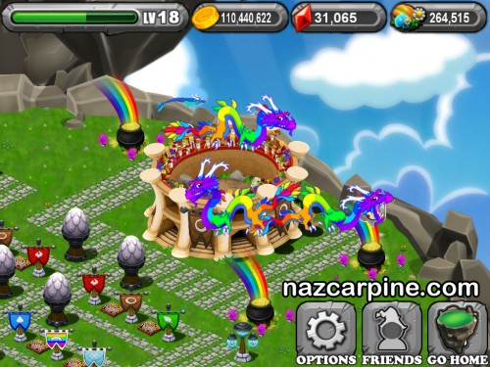
Good games #1: Dragonvale

Slide 3
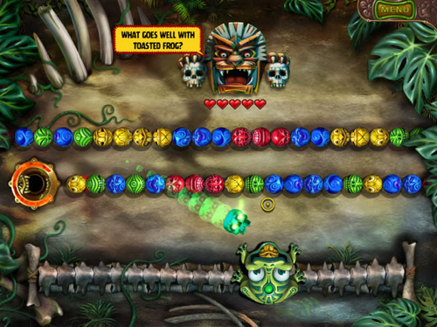
Good games #2: Zuma HD

Slide 4
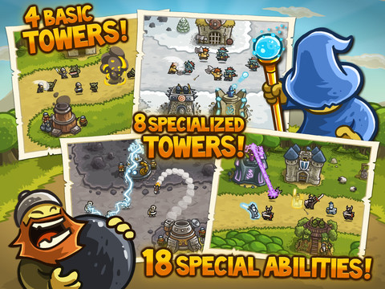
Good games #3: Kingdom Rush

Slide 5
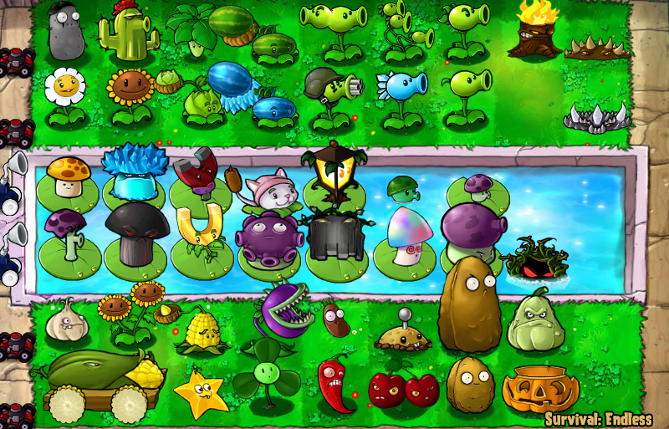
Good games #4: Plants vs Zombies
http://act.arlington.ma.us/

Slide 6
Ideas page #1
Space shuttle blasts off
Can see faces in it
three main characters – boy, girl, robot
Goes into outer space
Background of space with small Earth
Fly into a worm hole
Green portal with a red dot in the middle
Characters get zapped by lightning
Can see their skeletons!
Come out of worm hole with changed appearance

Slide 13
Black Hole

Slide 14
Maze Planet

Slide 15
Ocean Planet

Slide 16
Ringed Planet

Slide 18
Desert Planet

Slide 45
Multiple planets
Trivia game
Subsequent games
Maze games
Shooting games
Gravity games
Chance games

Slide 46
Ideas
Collect an artifact on each planet
At the end, show the artifacts collected
One sprite per artifact
Store collected artifacts in a list
How do we get from one planet to the next?
Is each planet in a quadrant (up, down, left, right)?
Instead do you do them in order?

Slide 47
Maze planet
Land on the planet
At the end of the maze is a base
Go into the base
Get a snake artifact
Each artifact is a different snake statue
One is a king cobra
One is a hydra snake

Slide 48
Go back to space ship
Every time you go back to the ship you see a table with your artifacts on it
If you have all of the artifacts you are done

Slide 49
Three artifacts to collect
Planet 1: Maze – king cobra artifact
Planet 2: Slot machine – python artifact
Planet 3: Gravity game – hydra artifact
Get to a gate
Gate shows each artifact that you have in a slot
If you have all of them, the gate opens
You have unleashed the snake level

Slide 50
The boss snake level
Snakes have swords
2 costumes: arm up, arm down
Hero has to beat the snakes
If you finish this, you go back through the worm hole
A serpent comes out and says “Your prize for finding the artifacts is to go back home”

Slide 51
What do we need?
Background picture of the gate
Picture of each artifact
First is king cobra
Background picture for the maze
Picture for the base
Picture for the landed rocket
Picture for the boy

Slide 52
Artifact #1

Slide 53
Artifact #2

Slide 54
Artifact #3

Slide 55
Artifact #4

Slide 60
Hydra

Slide 62
The base

Slide 64
v

Slide 65
v

Slide 68
The Artifact Adventures

Slide 69
The Artifact Adventures
By Nicholas (age 8)
and Andy (age 42)

Slide 70
Serpent

Slide 71
Robot

